Slide 1
Test Your Offering
Before you invest too much of your money into a business idea, how can you find out if a
consumer will actually buy?
www.SmallBusinessSolver.com © 2016

Slide 2
Don’t jump into deep without knowing if people will actually buy.
www.SmallBusinessSolver.com © 2016

Slide 3
The Goal
Reduce your risk by having a way to test if people will buy.
www.SmallBusinessSolver.com © 2016

Slide 4
Key Points
Ask friends
Market research with strangers
Virtual selling portal
Test market or beta testers
Example
What not to do
Your next steps
Wrap up
www.SmallBusinessSolver.com © 2016

Slide 5
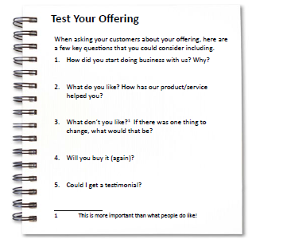
Worksheet
Grab your worksheet and follow along.
www.SmallBusinessSolver.com © 2016

Slide 6
Ask Friends
www.SmallBusinessSolver.com © 2016

Slide 7
Market Research with Strangers
www.SmallBusinessSolver.com © 2016

Slide 8
Virtual Selling Portal
www.SmallBusinessSolver.com © 2016

Slide 9
Test Market or Beta Testers
www.SmallBusinessSolver.com © 2016

Slide 10
Discussion: “Will people actually pay you money for your product or service?”
Has someone already bought your product or service?
If not, have you asked someone if they would buy your product or service?
If not, have you asked someone how much they thought your product or service was worth?
Have you sold to or asked these to people who are strangers (not friends or family)?
www.SmallBusinessSolver.com © 2016

Slide 11
How Does It Work? Restaurant
How did you start doing business with us? Live in the area
What do you like? Desserts and specialty coffee
What don’t you like? Wine selection and overcooked meat
Will you buy it (again)? It is very close to us. Yes.
Could I get a testimonials? Not now.
www.SmallBusinessSolver.com © 2016

Slide 12
Discussion: “Are you an optimist?”
Is this a good thing? What are its downside?
Why do entrepreneurs have to be optimistic?
What is the value in a devil’s advocate?
www.SmallBusinessSolver.com © 2016

Slide 13
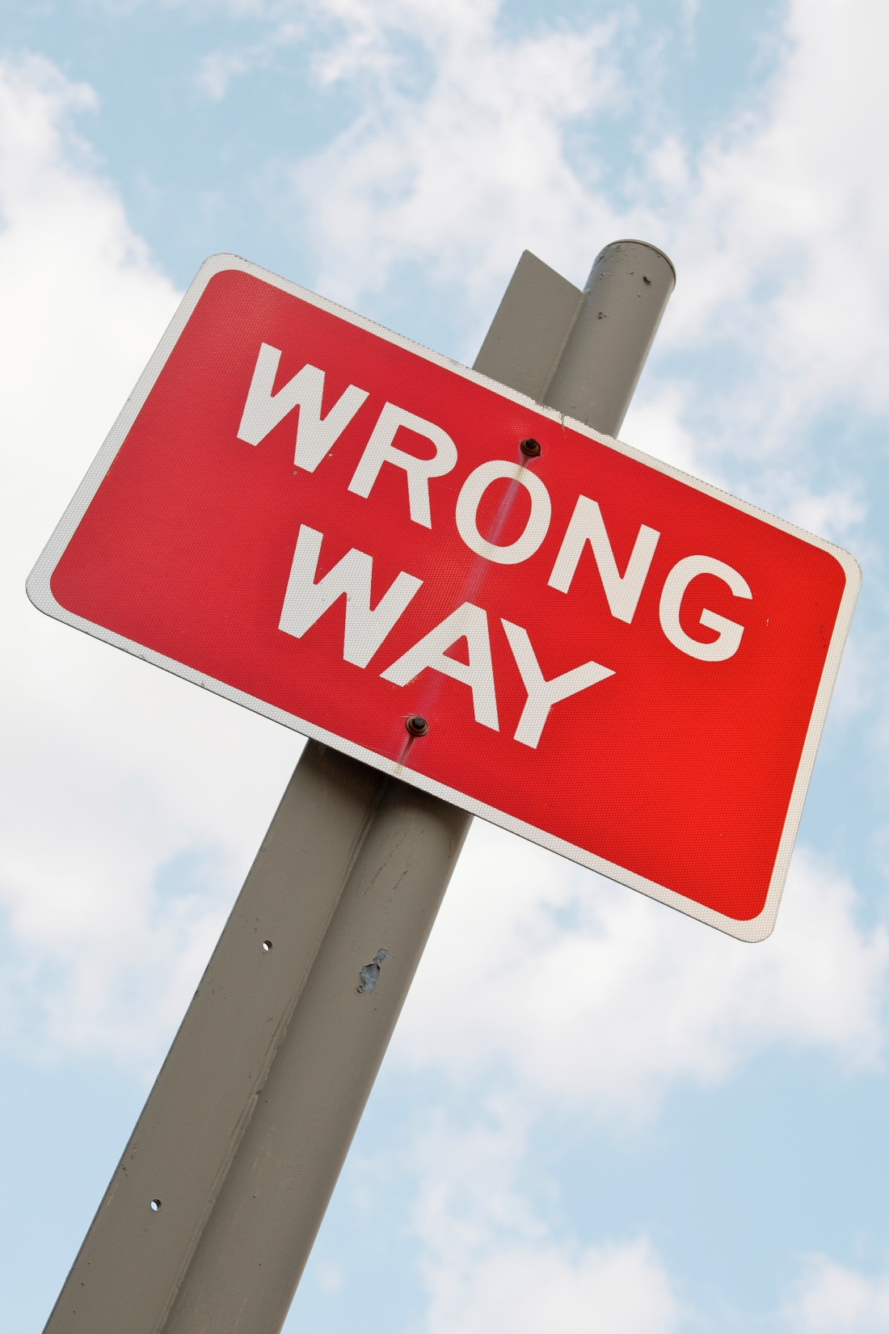
Top Mistakes To Avoid
Only listening to your friends
Only listening to people who have good feedback for you
Not testing if they are willing to put money behind it
www.SmallBusinessSolver.com © 2016

Slide 14
Now What?
Ask others.
Listen.
Figure out what your assumptions are.
Test your assumptions.
www.SmallBusinessSolver.com © 2016

Slide 15
Discussion: “What do you do once you get feedback?”
Are there ways to get feedback earlier in your process of developing your product or service?
How do you make sure that you are listening and being responsive? How do you keep this strength while you grow?
There are many different personality types that are important in a team. Why do you think this is?
Analysis paralysis is when someone continues to research and test whether they should move forward. What are the pros and cons of researching versus testing the market? What makes sense for you?
www.SmallBusinessSolver.com © 2016

Slide 16
Worksheet
How does this work for your business?
www.SmallBusinessSolver.com © 2016

Slide 17
Key Points
Ask friends
Market research with strangers
Virtual selling portal
Test market or beta testers
Example
What not to do
Your next steps
Wrap up
www.SmallBusinessSolver.com © 2016

Slide 18
The Goal
Reduce your risk by having a way to test if people will buy.
www.SmallBusinessSolver.com © 2016

Slide 19
There is no foolproof way other than jumping in with two feet – but checking the temperature of the water before jumping in prevents you from getting burned.
www.SmallBusinessSolver.com © 2016

