Slide 1
Who Should Be Your Customer?
Sometimes who you are selling to is not the right customer for you.
www.SmallBusinessSolver.com © 2016

Slide 2
If 20% of customers take up 80% of your time, but are not generating 80% of your revenue, they may not be the best customers.
www.SmallBusinessSolver.com © 2016

Slide 3
The Goal
Double check your assumption of who your ideal customer is.
www.SmallBusinessSolver.com © 2016

Slide 4
Key Points
Analyze what is happening today
Find out who should be your customer today
Figure out ways to make less ideal customers better
Example
What not to do
Your next steps
Wrap up
www.SmallBusinessSolver.com © 2016

Slide 5
Worksheet
Grab your worksheet and follow along.
www.SmallBusinessSolver.com © 2016

Slide 6
Analyze what is happening today.
Who is your customer?
Why do they buy from you?
Are you losing as many customers as you are gaining? What is your customer retention rate?
Why do you lose customers?
Which customers make you the most money? Is this margin or revenue?
Which customers require the most of your time?
www.SmallBusinessSolver.com © 2016

Slide 7
Find out who should be your customer today.
www.SmallBusinessSolver.com © 2016

Slide 8
Figure out ways to make less ideal customers better
Start focusing on the ones that take less time but make the company more money
Come up with ways to reduce the time that these customers take
Come up with ways for these customers to generate more money
www.SmallBusinessSolver.com © 2016

Slide 9
How Does It Work? Hot tub business
www.SmallBusinessSolver.com © 2016

Slide 10
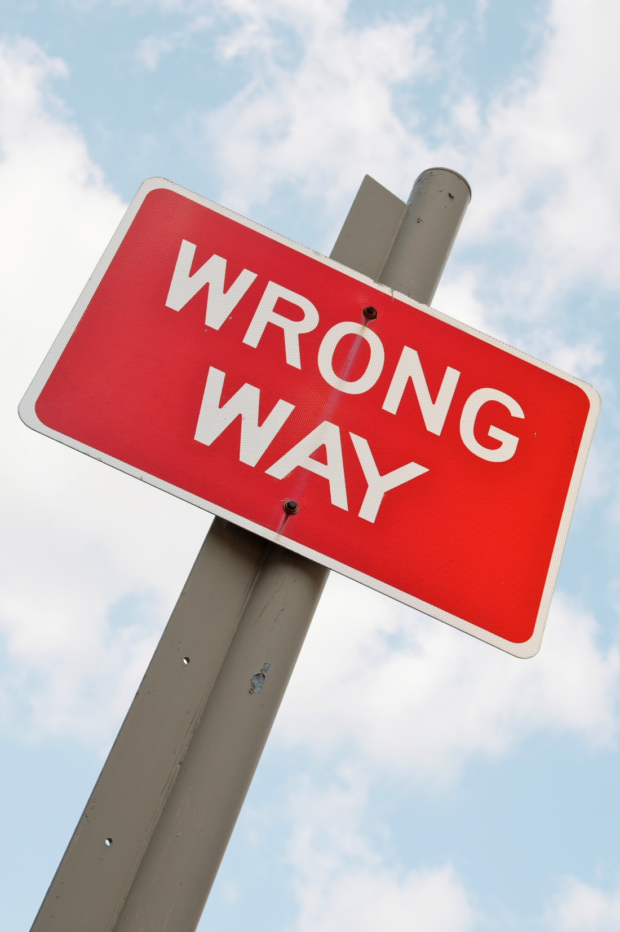
Top Mistakes To Avoid
Don’t assume
Don’t forget that this changes over time
Don’t forget the other factors that make an ideal customer
Don’t hold on to customers that don’t help your business
www.SmallBusinessSolver.com © 2016

Slide 11
Discussion: “Who is your ideal customer?”
Who makes the most amount of revenue for you? Is this all profit?
Who takes the most amount of time for you to deliver? What is the necessary amount of customer service?
Who takes the longest to close?
What is the probability of getting referrals or residual income?
Who do you like working with the best?
www.SmallBusinessSolver.com © 2016

Slide 12
Now What?
Narrow it down.
If there is a tie, go with what you WANT.
Try to fix your relationship with the less ideal customers
De-market the ones you can’t fix
Are there other areas where 80/20 will help you?
www.SmallBusinessSolver.com © 2016

Slide 13
Discussion: “How to say no?”
Can you charge an upfront retainer, consultation fee, or other fee that will weed out any prospects that are genuinely interested in moving forward?
Can you create a referral program or some way to have your ideal customers help you grow your business with other customers like them?
Can you create a checklist or way for customers to qualify themselves? This could be through education, credit check, or some other upfront test.
www.SmallBusinessSolver.com © 2016

Slide 14
Discussion: “Are there other ways to use the 80/20?”
Where else in your company can the 80/20 rule be applied?
How many revenue streams do you have? Could the 80/20 rule apply here?
Suppliers?
Employees?
Product types?
www.SmallBusinessSolver.com © 2016

Slide 15
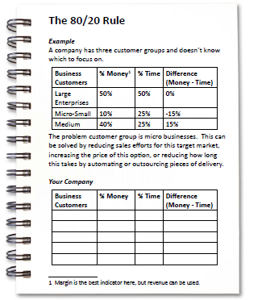
Worksheet
How does this work for your business?
www.SmallBusinessSolver.com © 2016

Slide 16
Key Points
Analyze what is happening today
Find out who should be your customer today
Figure out ways to make less ideal customers better
Example
What not to do
Your next steps
Wrap up
www.SmallBusinessSolver.com © 2016

Slide 17
The Goal
Double check your assumption of who your ideal customer is.
www.SmallBusinessSolver.com © 2016

Slide 18
Sometimes who you are selling to is not the right customer for you.
www.SmallBusinessSolver.com © 2016

