Slide 1

Customer Profiling
The world is your oyster, but you need to pick out your pearl.

Slide 2

Who you are doing business with today is a great indicator of who you should focus on selling to.

Slide 3

Discussion:
“How Many types Of Customers Do You Have?”
1. What are the different target markets that you go after?
2. How many are you targeting today?
3. How do you have to tweak your offering to satisfy each target market’s needs? Do you have tweak it?
4. How much time and money do you spend to go after each target? How do you do this?
5. How many targets do you think you reasonably could target at the same time?

Slide 4

The Goal
Figure out who your customer is today.

Slide 5

Key Points
Why profiling?
Commonalities
  Consumers
  Businesses
Example
What not to do
Your next steps
Wrap up

Slide 6
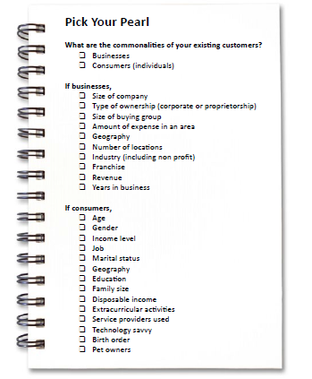
Worksheet
Grab your worksheet and follow along.

Slide 7

Why Profiling?
It is a lot easier to sell to customers who actually need your product or service.
It is easier when you have a satisfied customer with similar needs being met as this adds credibility and demonstrates you can fulfill the customer’s needs.
It is easier to make a profit when your clients are happy.

Slide 8

Consumer Commonalities
Age
Gender
Income level
Job
Marital status
Geography
Education
Family size
Disposable income
Extracurricular activities
Service providers used
Technology savvy
Birth order
Pet owners

Slide 9

Business Commonalities
Size of company
Type of ownership (corporate or proprietorship)
Size of buying group
Amount of expense in an area
Geography
Number of locations
Industry (including non profit)
Franchise
Revenue
Years in business

Slide 10
How Does It Work?
A sales tracking software company was developing industry specific software for over 10 industries.
They realized that they were spending more time and money on development of new products rather than selling what they had.

Slide 11
How Does It Work?
Size of company = < 50 employees
Amount of expense in an area = < $10,000
Geography = English speaking
Number of locations = <20 locations
Industry = Retail
Franchise

Slide 12
Discussion:
“How Do You Currently Classify Your Customers?”
1. How many times they come in? Or how much profit you make over a year?
2. How many times you speak with them? Or how enjoyable your time with them is?
3. How many customers they have referred to you? Or the lifetime potential?
4. What does your current way of describing your customers mean to your future business’ potential?
5. Are there other ways of describing or understanding your existing customers that you should be thinking about?

Slide 13
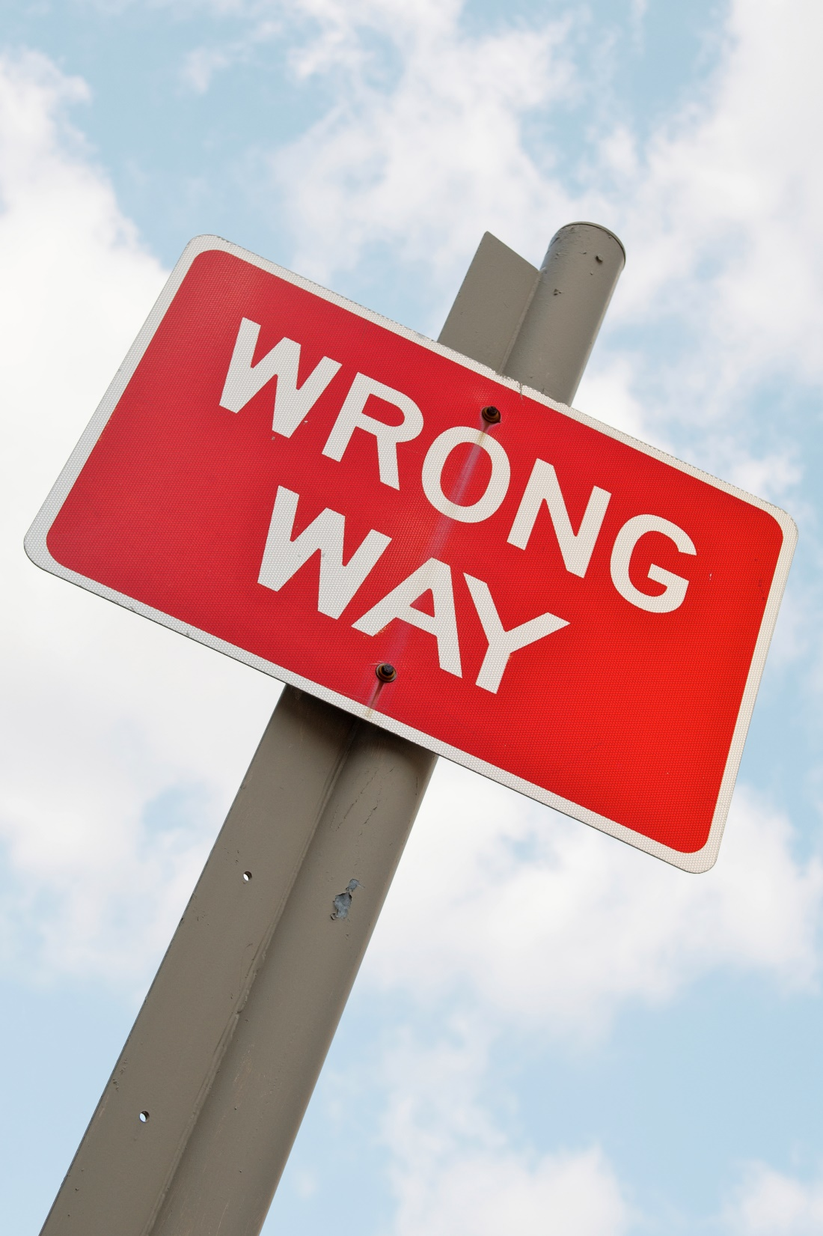
Top Mistakes To Avoid
Assuming who your customer is and not actually analyzing
Focusing your efforts on areas of your business that don’t support your main customer profile
Assuming that your customers have nothing in common

Slide 14

Now What?
You can’t make everyone happy all of the time.
Make sales easier by figuring out who likes your product or service the best, and spend your time going after more customer like them.
Going after everyone means that your budget and time are thinly spread.

Slide 15
Discussion:
“is There other Information About Your Customers You Are Missing?”
1. Have you found this exercise difficult?
2. Was there information that could have made this exercise easier?
3. If there is missing information, is there a way that you could begin to collect this?

Slide 16
Worksheet
How does this work for your business?

Slide 17
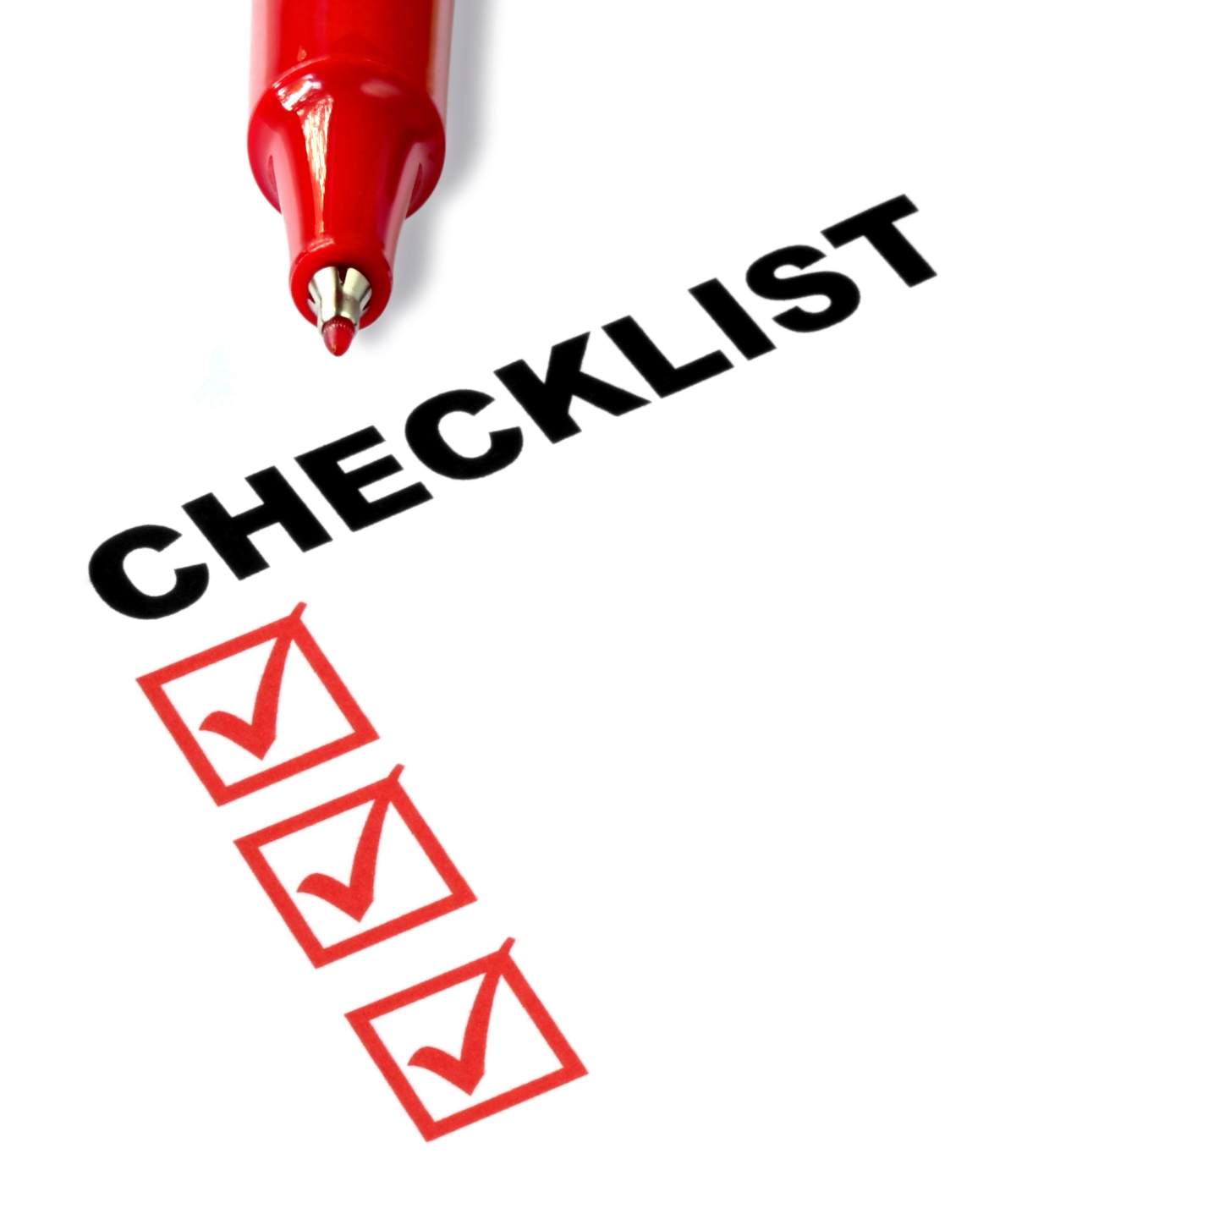
Key Points
Why profiling?
Commonalities
  Consumers
  Businesses
Example
What not to do
Your next steps

Slide 18

The Goal
Figure out who your customer is today.

Slide 19

The world is your oyster, but you need to pick out your pearl.

