Slide 1
Personal Brand
Who are you? Understanding who you are is important to ensure that your personal brand is aligned with your company’s.
www.SmallBusinessSolver.com © 2014

Slide 2
If these are misaligned, it can cause confusion. Plus it will end up being extremely uncomfortable for you.
www.SmallBusinessSolver.com © 2016

Slide 3
The Goal
Make sure you have an aligned brand image.
www.SmallBusinessSolver.com © 2016

Slide 4
Key Points
Personal brand
Personal fit
Gap analysis
Example
What not to do
Your next steps
Wrap up
www.SmallBusinessSolver.com © 2016

Slide 5
Worksheet
Grab your worksheet and follow along.
www.SmallBusinessSolver.com © 2014

Slide 6
Personal Brand
www.SmallBusinessSolver.com © 2014

Slide 7
Discussion: “Do you have a personal brand?”
What is your personal brand? Name a few adjectives that describe yourself.
Does your personal brand fit well with your business brand?
www.SmallBusinessSolver.com © 2014

Slide 8
Personal Fit
www.SmallBusinessSolver.com © 2014

Slide 9
Gap Analysis
www.SmallBusinessSolver.com © 2014

Slide 10
Discussion: “Is your personal brand strong?”
Is your personal brand strong? Would you like to make it stronger?
How do you plan on doing this?
Is what you think to be your personal brand the same as what others perceive?
Are you communicating this brand effectively? How might miscommunication be occurring?
www.SmallBusinessSolver.com © 2014

Slide 11
How Does It Work? Car Sales
Your personal brand:
Friendly
Honest
Technical details
Introvert & listener
What similarities with my business?
Trusted car sales
Guaranteed quality of cars
What difference do you have?
- Flashy used car sales marketing
www.SmallBusinessSolver.com © 2014

Slide 12
Top Mistakes To Avoid
Don’t take it for granted! Your personal reputation is your most valuable possession.
Don’t forget to consider on all parts of your personal brand. Your voicemail, clothing, and hair all count.
www.SmallBusinessSolver.com © 2014

Slide 13
Now What?
Personal branding makes you stand out from the crowd.
Your own image is just as important as your business’.
Know what type of brand you want to have to help make this achievable.
www.SmallBusinessSolver.com © 2014

Slide 14
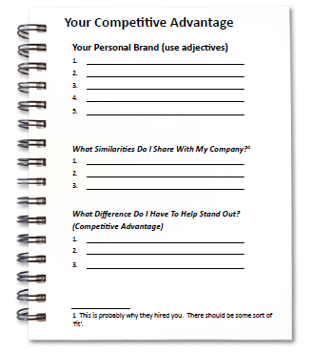
Worksheet
How does this work for your business?
www.SmallBusinessSolver.com © 2014

Slide 15
Discussion: “Do you need to change your personal brand?”
Have you ever thought of changing your personal brand?
How hard would this be to do?
How many behaviours would have to change?
Would it be believable?
How long would it take?
www.SmallBusinessSolver.com © 2014

Slide 16
Key Points
Personal brand
Personal fit
Gap analysis
Example
What not to do
Your next steps
Wrap up
www.SmallBusinessSolver.com © 2014

Slide 17
The Goal
Make sure you have an aligned brand image.
www.SmallBusinessSolver.com © 2014

Slide 18
Who are you? Understanding who you are is important to ensure that your personal brand is aligned with your business’.

