Slide 1
Company Brand
What is your company all about?

Slide 2
Verify that the brand image matches your actions.

Slide 3
Discussion: “What is your Business’ brand?”
Can you describe your business in a few words? List 10 words that you would say describe your business.
What do your customers think about your business? What words would they use?
If you have employees, how would they describe the business? The same way as you did?
How strong is your company’s brand? How could this be made stronger?
What are some benefits to the sales team of having a strong brand?

Slide 4
The Goal
Represent your business well wherever you go.

Slide 5
Key Points
Values
Brand image
Example
What not to do
Your next steps
Wrap up

Slide 6
Worksheet
Grab your worksheet and follow along.

Slide 8
Discussion: “Why do you think you are a good fit with this business brand?”
What is the core values of your business and yourself that overlap?
How is your personality infused into your brand?

Slide 9
Brand Image

Slide 10
How Does It Work? Dog Walker
Your Brand
Fun
Loving
Athletic
Safe
Worry free

Slide 11
Top Mistakes To Avoid
Thinking that branding does make a difference
Underestimating the importance of appearance
Hiring people that are a good fit, means that they represent your business’ brand

Slide 12
Now What?
The base of any corporate brand is the company’s values.
Having a consistent brand adds value.
Branding makes selling easier.
Your employees should represent your brand as well.

Slide 13
Discussion: “What are some day to day activities that you do to support this brand?”
Marketing and sales integration and how they both support the same brand message
How might you begin to behave differently or interact differently to portray the correct brand image?
How do you have to adapt your training for your employees to ensure that a consistent brand image is being created?
How might you hire people differently, manage people different, measure performance differently?
Describe how your business could perform additional services or create products to further enhance the brand

Slide 14
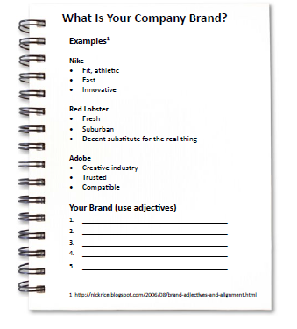
Worksheet
How does this work for your business?

Slide 15
Key Points
Values
Brand image
Example
What not to do
Your next steps
Wrap up

Slide 16
The Goal
Represent your business well wherever you go.

Slide 17
What is your company all about?

