Slide 1
Gender Selling
If women are from Venus and men are from Mars, why would we sell to them the same way?

Slide 2
We shouldn’t!

Slide 3
The Goal
Open up our eyes to how selling to other genders may need us to adjust.

Slide 4
Key Points
Men selling to men
Women selling to men
Women selling to women
Men selling to women
Example
What not to do
Your next steps
Wrap up

Slide 5
Worksheet
Grab your worksheet and follow along.

Slide 6
Note: Although the stereotype is male versus female, pay attention to left versus right-brained individuals. 30% of females are left-brained (logic driven) 30% of males are right-brained (creative and relationship driven)

Slide 7
Men Selling to Men
Follow all of the “Man’s Man Rules”
Drop your softer side and toughen up a bit
Bravado wins. Even if bravado doesn’t make everyone in the room love you, it makes them respect you.
Be more direct and speak to the numbers
Socializing should revolve around sports, including golf

Slide 8
Women Selling to Men
You need to balance being professional with being pretty
Being serious and direct shows you are professional
Making some male-style jokes can make you relatable. If you are drinking, drink beer
Don’t push flirting, as you can assume they will take it the wrong way

Slide 9
Discussion: “How do you act around males?”
Do you speak differently?
Do you have different body language?
In what other ways may you behave differently?

Slide 10
Women Selling to Women
Show your softer side. Be a little more direct if they are. But talk about kids and relationships if you get the opportunity.
Show interest in all aspects of their life.
Nod as they speak to show understanding.
Use relationships with men when creating metaphors.
Say things like, “I understand,” or “You know what I’m talking about”.

Slide 11
Men Selling to Women
Flattery will get you most places! The ladies love flattery, but they can sense when you are insincere.
Lean forward and show interest in them.
Really focus on listening to what they are saying to help them feel understood.
Corny jokes work well.
Dressing well goes a long way.

Slide 12
Discussion: “How do you act around females?”
Do you speak differently?
Do you have different body language?
In what other ways may you behave differently?

Slide 13
How Does It Work? Lawyer
As a woman, I should be…
Selling to men using the following tactics:
1. Be direct
2. Stay up to date on at least one sport
3. Wear professional clothes
Selling to women using the following tactics:
1. Make sure that I keep track of their family’s names
2. Ask how much time they have at the start
3. Start with personal questions if they have time

Slide 14
Top Mistakes To Avoid
Stereotypes are only useful to a certain point
Don’t forget the other factors that play into building rapport
Only 70% of each gender is right brained or left brained. That means 30% is the opposite!

Slide 15
Now What?
Knowing how you are acting today is the first step
Have a plan of how to approach genders differently
Test and improve your ability to build rapport
When in doubt, just find something in common

Slide 16
Discussion: “Does gender matter more in some geographical areas?”
Are there other factors that come into play when building a relationship with a specific customer?
What is their DISC profile?
What is their cultural background?
What is their personal experience, education, or other context?

Slide 17
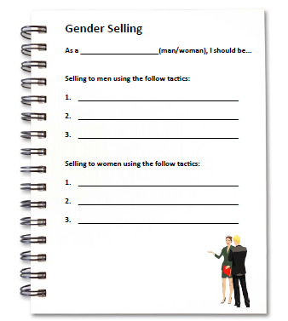
Worksheet
How does this work for your business?

Slide 18
Key Points
Men selling to men
Women selling to men
Women selling to women
Men selling to women
Example
What not to do
Your next steps
Wrap up

Slide 19
The Goal
Open up our eyes to how selling to other genders may need us to adjust.

Slide 20
If women are from Venus and men are from Mars, why would we sell to them the same way?

