Slide 1
Mirroring
It’s
scientifically proven to build an unspoken
connection between two parties.

Slide 2
If you are finding that your customer is mirroring you, they are feeling connected and engaged in the conversation.

Slide 3
The Goal
Learn to identify when mirroring is or is not happening.

Slide 4
Discussion: “Why Does Mirroring Work?”
When someone tells you a great story, what do they often do with their body language? How does this make you react? Are you both leaning in?
When someone is chatting to you standing up and has their arms crossed, where would your arms feel natural to be holding them?
When someone is sitting down at a coffee shop and leans back after a long day, how would you position yourself?

Slide 5
Key Points
Posture/Body
Gestures
Facial Expressions
Head Movement
Example
What not to do
Your next steps
Wrap up

Slide 6
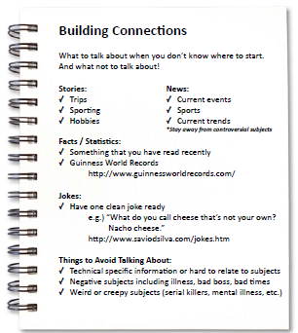
Worksheet
Grab your worksheet and follow along.

Slide 7
Body Posture

Slide 8
Gestures

Slide 9
Facial Expressions

Slide 10
Head Movement

Slide 11
Discussion: “Is there a time when this shouldn’t be used?”
If you are feeling uncomfortable with someone being in your personal space, how could you let them know?
If you are unhappy with something that someone is saying, how could you let them know?
If you not having a good day, how could you let them know?

Slide 12
How Does It Work? Car Sales
Have a list of go to things to talk about;
Funny story of the week
Bad joke
Reading the newspaper
Or even go to your CRM or online to find things to talk about in your customer’s interests.

Slide 13
Top Mistakes To Avoid
Don’t overdo it.
Don’t do anything that you aren’t comfortable with
Always mirroring. Not always necessary.

Slide 14
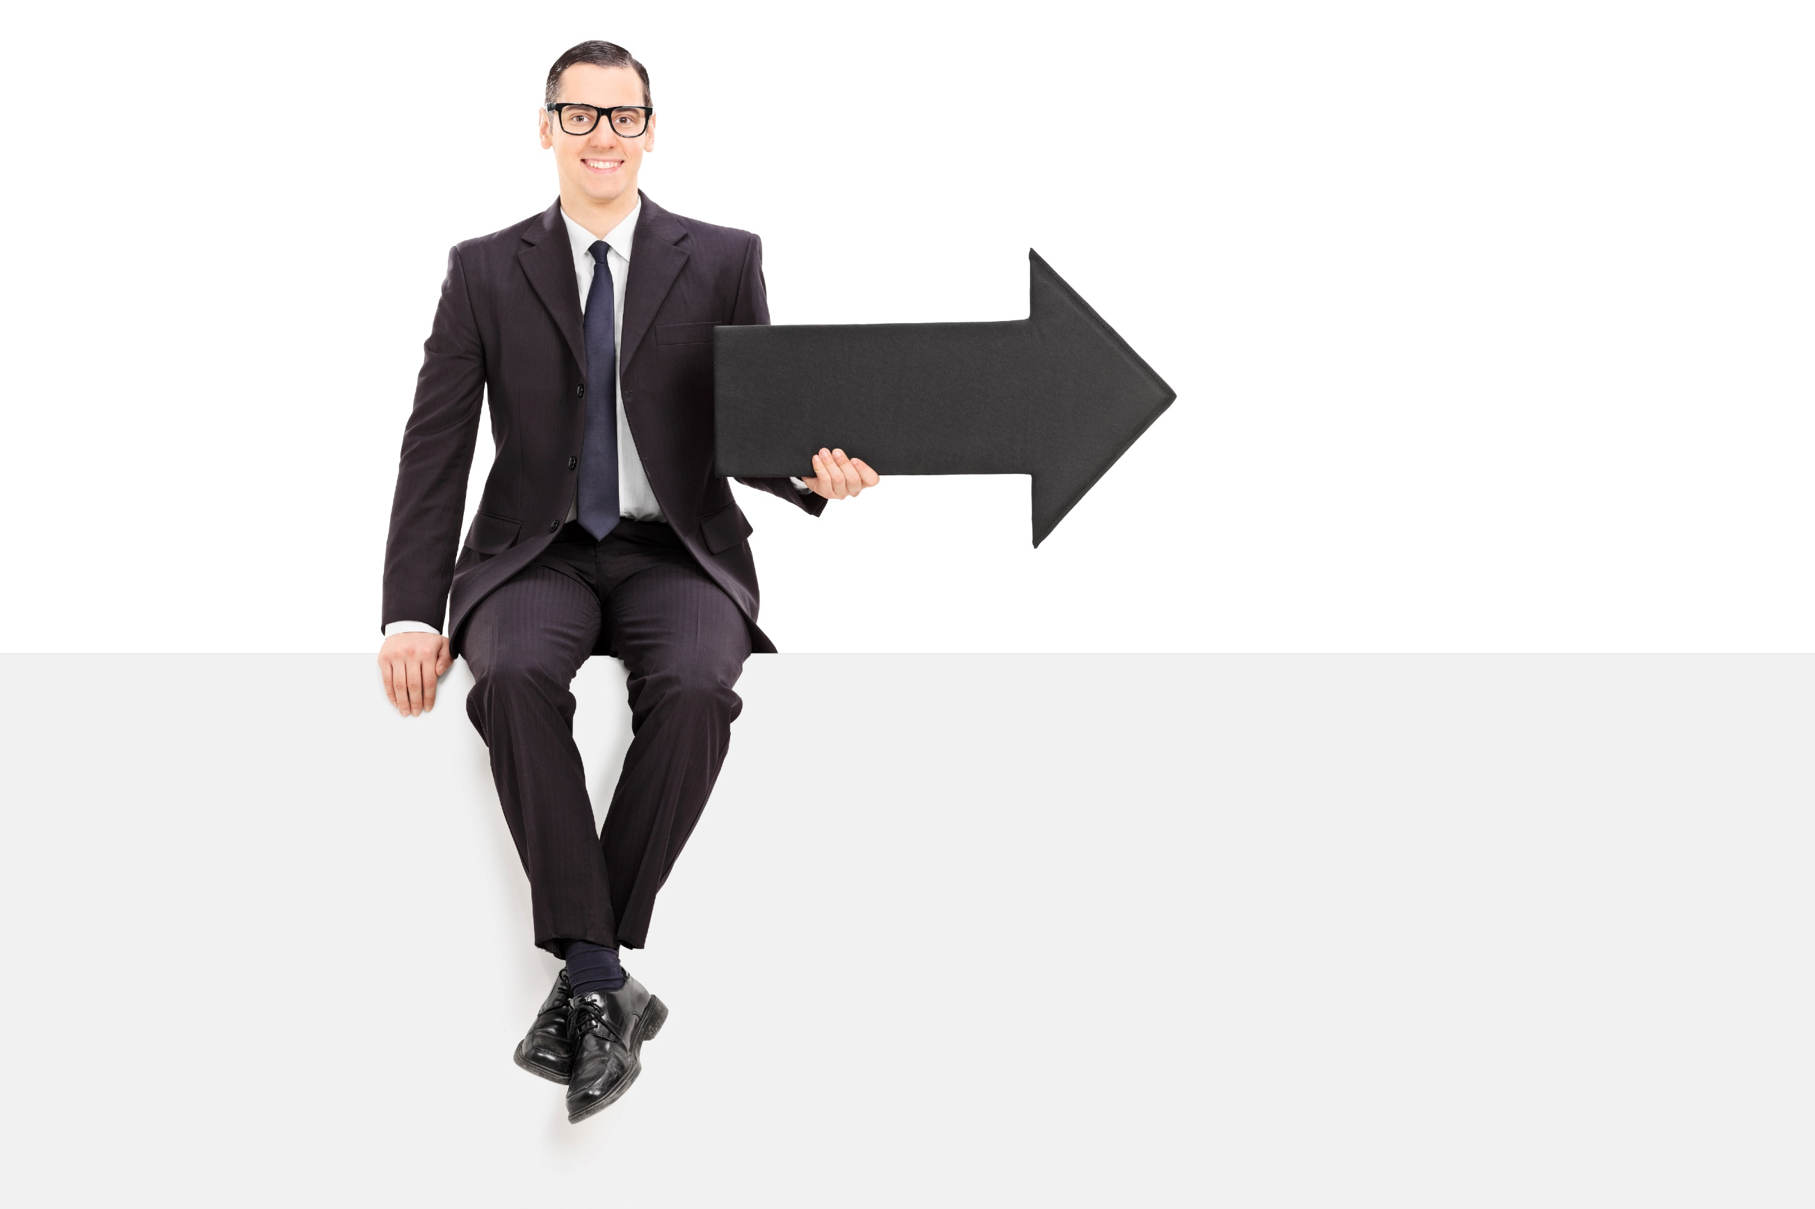
Now What?
Remember to pay attention to what the other person is saying!
If they mirror you, they are connecting with you.
Are there other advanced sales tactics you could try?

Slide 15
Worksheet
How does this work for your business?

Slide 16
Discussion: “Are there other advanced selling tactics?”
Are there other selling tactics that you’ve heard of and wondering how to do them or if they work?
Are there other sales tactics that you felt were used on your previously? And want to confirm your suspicions?
Who is the best sales person you’ve ever met? Did they do anything above and beyond that comes to mind?

Slide 17
Key Points
Posture/Body
Gestures
Facial Expressions
Head Movement
Example
What not to do
Your next steps
Wrap up

Slide 18
The Goal
Learn to identify when mirroring is or is not happening.

Slide 19
It’s
scientifically proven to build an unspoken
connection between two parties.

