Slide 1
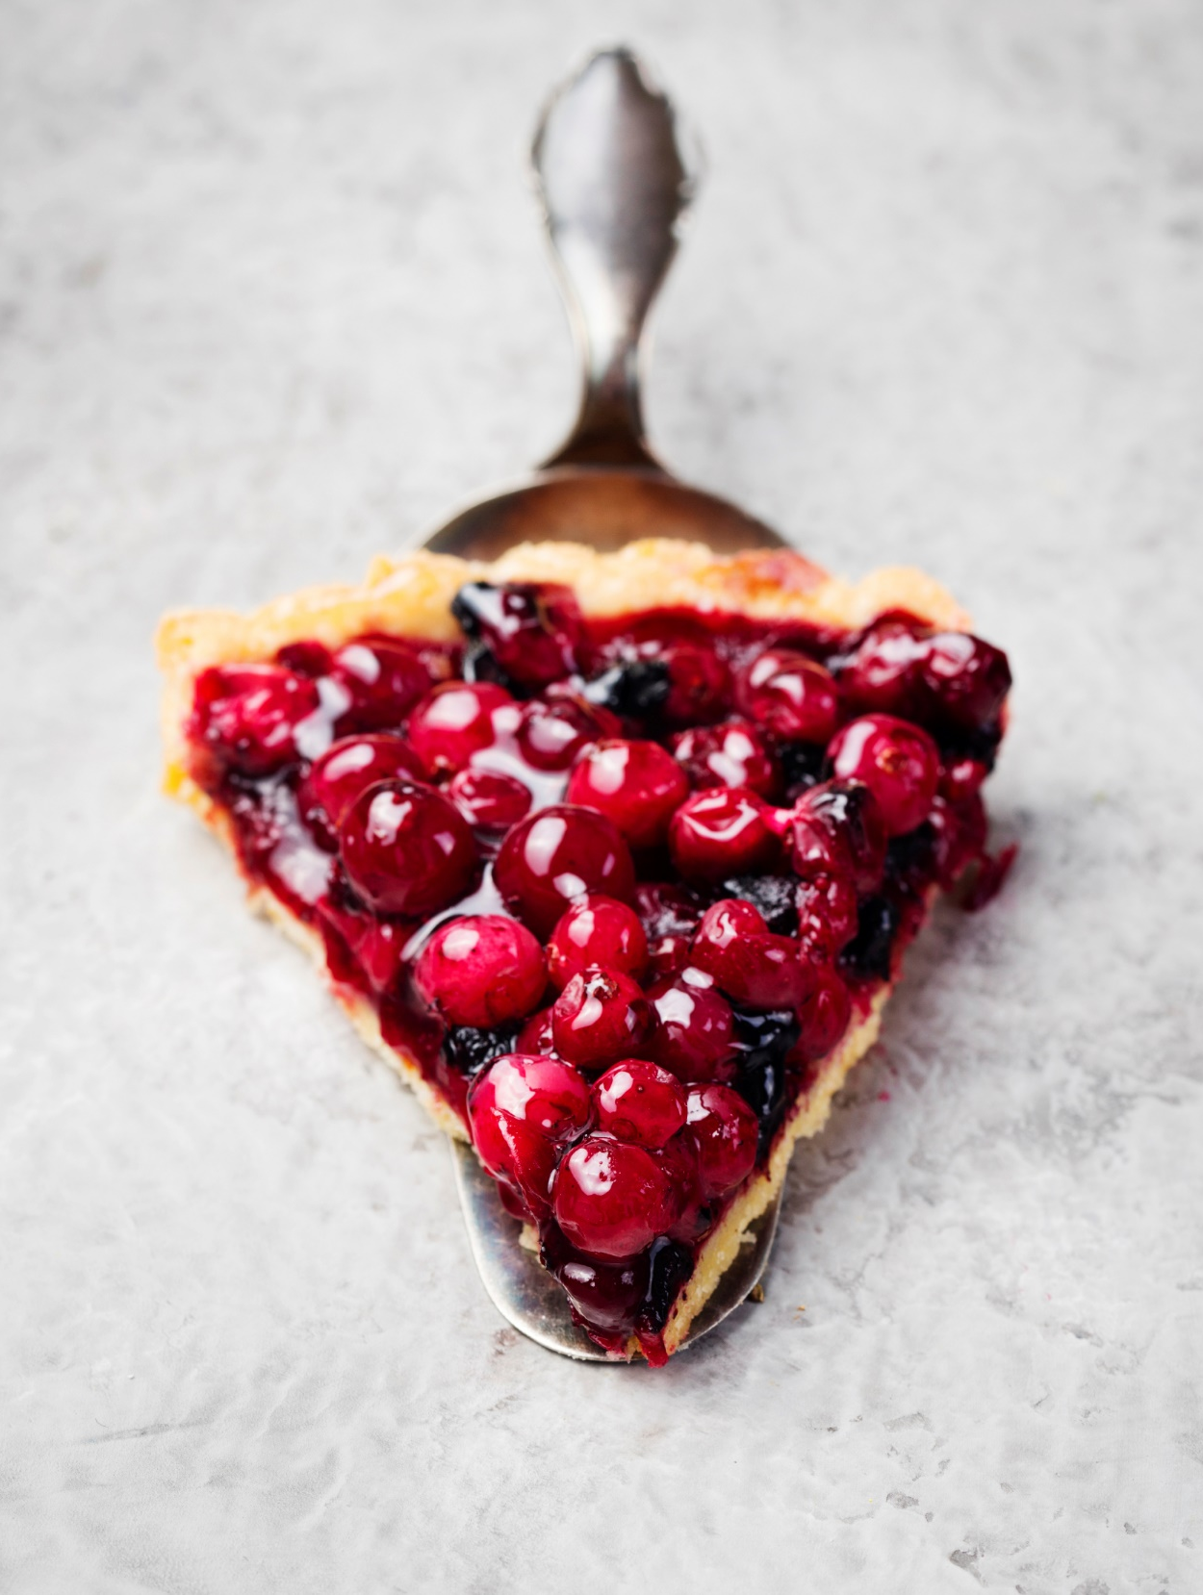
Upselling
How do you get a larger piece of the pie?

Slide 2
Increase the number of pies!

Slide 3
The Goal
A strategy to increase the type of pies you are selling.

Slide 4
Key Points
Trust
Needs Assessment
Internal Assessment
Conversion
Example
What not to do
Your next steps
Wrap up

Slide 5
Worksheet
Grab your worksheet and follow along.

Slide 6
Trust
Trust is the most important part of any sales relationship.
Don’t worry about anything else until you’ve established trust.

Slide 7
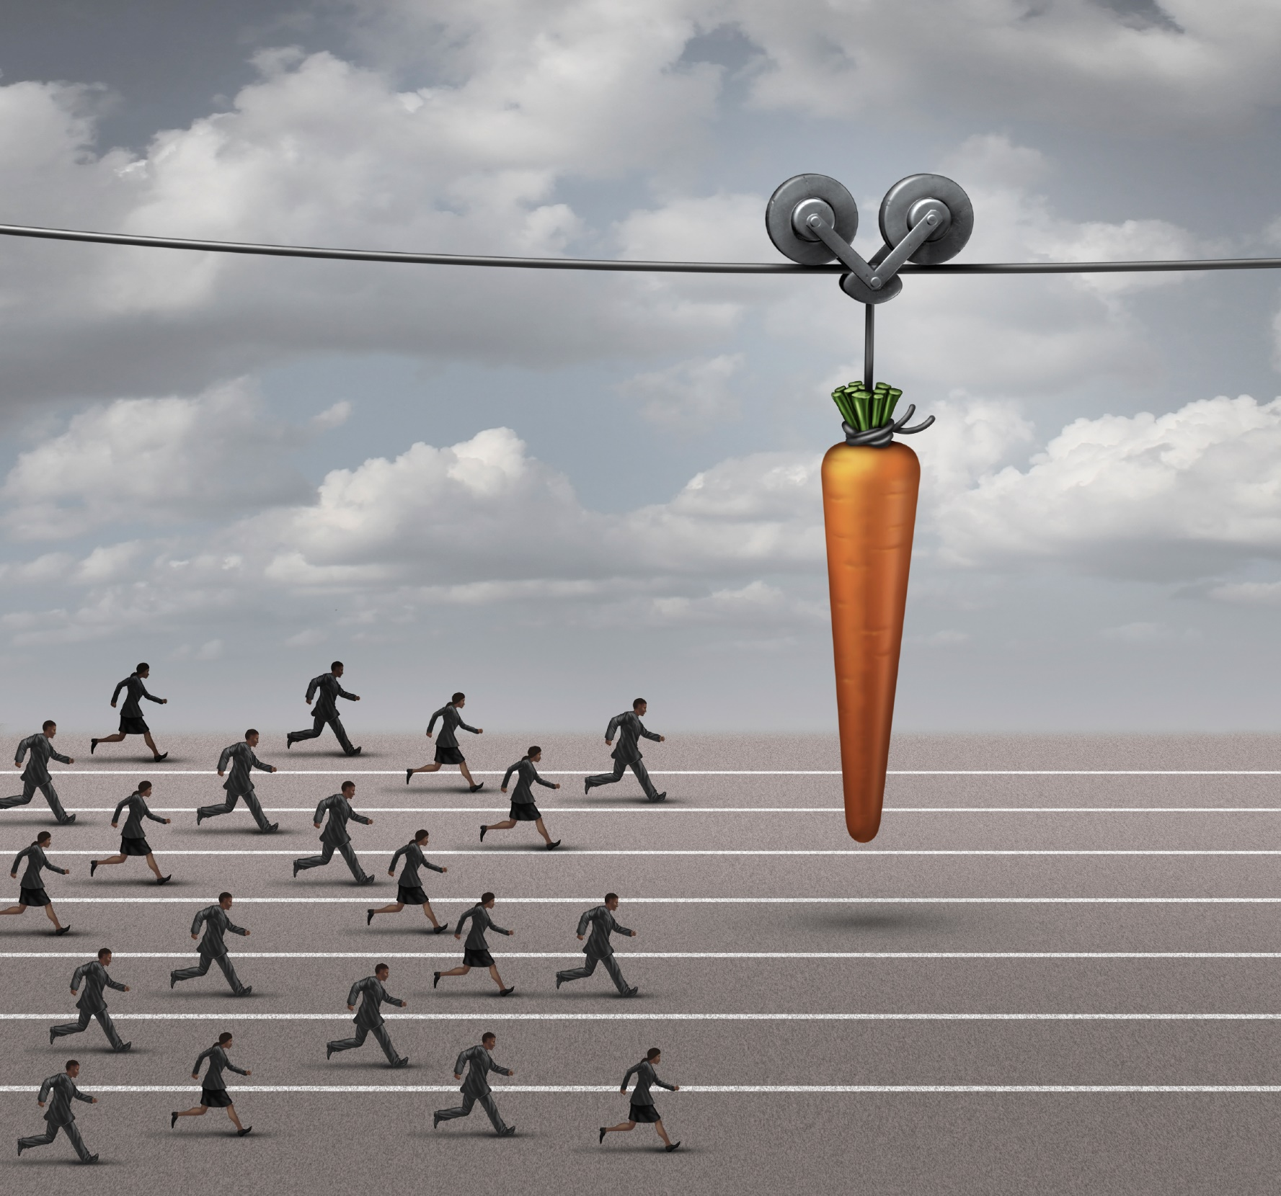
Needs Assessment
What else is the customer looking for?
How else can you help? What could make the experience even better for them?

Slide 8
Discussion: “Is there any opportunity to sell more to your existing customer base?”
Are there products or services that complement what you are already selling?
Are there products or services that could enhance your customers’ experience?
Are there products or services that your target market is purchasing elsewhere?
Are there adjacencies with what you are already doing?
Are there other ways to help your existing customer base?

Slide 9
Internal Assessment
Ask yourself if you can meet any of these additional needs with products/ services that you offer?

Slide 10
Conversion
Ask yourself if you can deliver on what you’re about to promise?
Does the customer agree that the upsell is something of value to them?

Slide 11
Discussion: “What pricing strategy makes sense for your offering?”
Product and service options?
Add-ons?
Bundle pricing?
Promotional prices?
Value adding?

Slide 12
How Does It Work?
“Looking at your past history, it might
help you to consider _________, because
it will earn/save/reduce/increase your
_________.”
“So what you are really looking for is ________. We could do that if you combined what you are currently doing with _______.”
“If you are looking at getting ________ as well, we offer that at a 15% discount to our customers.”

Slide 13
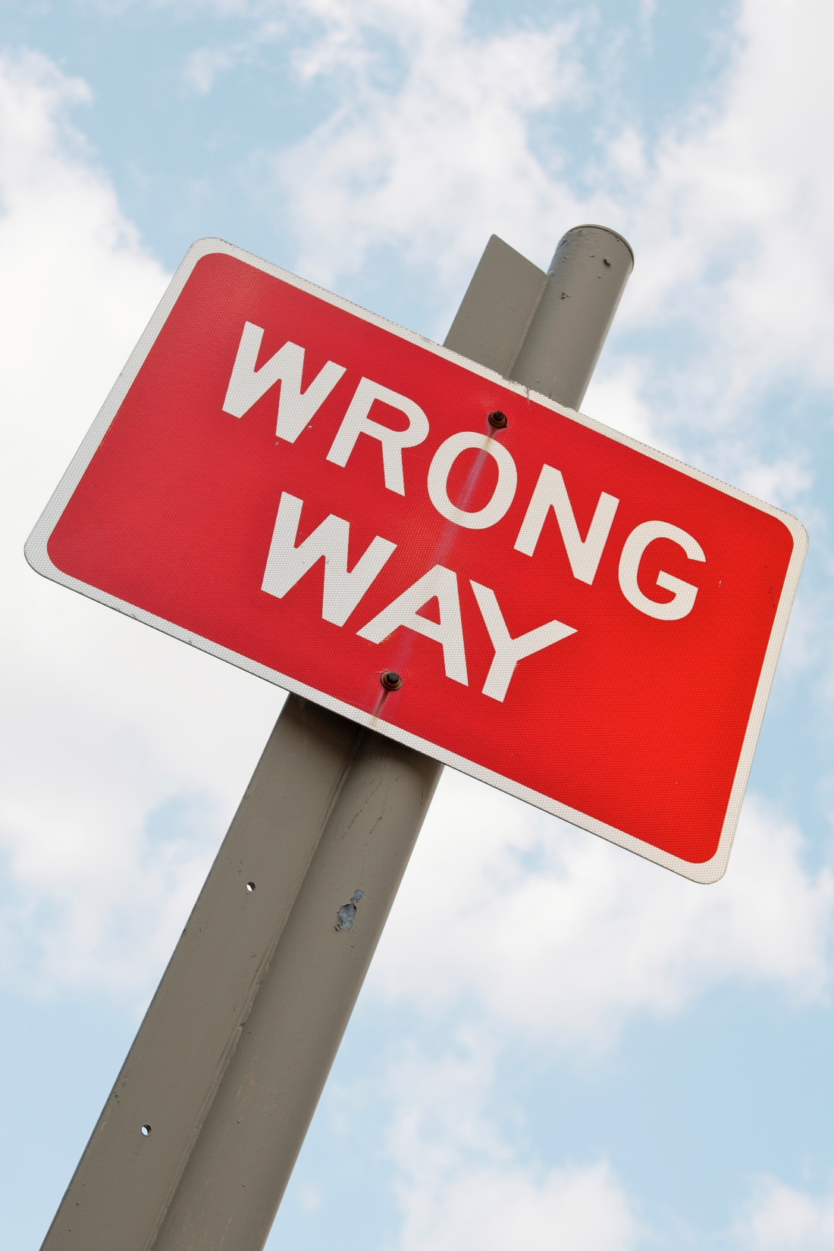
Top Mistakes To Avoid
Upselling products or services that your customers don’t need.
Upselling products or services that don’t ‘fit’ with your business.
Forgetting to analyze the margins.
Leaving money on the table by not upselling.

Slide 14
Now What?
Build trust.
Understand what would truly help your customer.
While upselling, focus on maintaining the trust in your relationship.

Slide 15
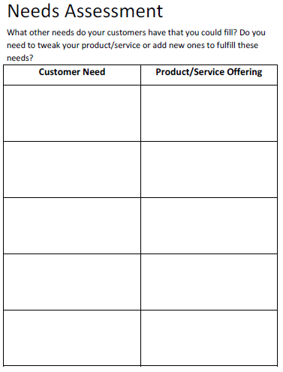
Worksheet
How does this work for your business?

Slide 16
Discussion: “How To Reward Employees Who Upsell?”
Are you tracking upsell revenue? Do you have a way to track this?
Do you have extrinsic rewards for incremental business?
Are all employees and departments able to benefit from these rewards?
Have you considered intrinsic rewards for incremental business?

Slide 17
Key Points
Trust
Needs Assessment
Internal Assessment
Conversion
Example
What not to do
Your next steps
Wrap up

Slide 18
The Goal
A strategy to increase the type of pies you are selling.

Slide 19
Have your cake and eat it too.
www.SmallBusinessSolver.com © 2016

