Slide 1
Selecting A CRM
Finding out about your customers is half the battle.

Slide 2
The other half is remembering!

Slide 3
The Goal
For the small business owner to create their CRM as soon as possible.

Slide 4
Key Points
Sales Funnel
Names!
Notes
Contact Information
Example
What not to do
Your next steps
Wrap up

Slide 5
Worksheet
Grab your worksheet and follow along.

Slide 6
Sales Funnel
Prospect
Interest
Close
Existing Customer

Slide 7
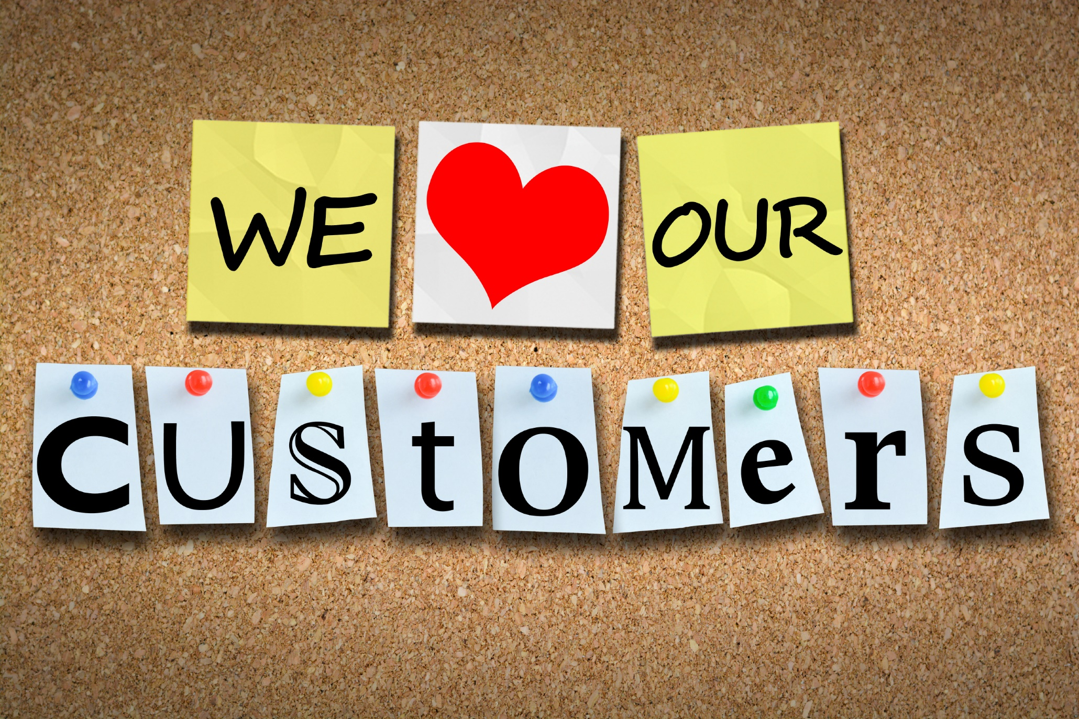
Names!

Slide 8
Notes

Slide 9
Contact Information

Slide 10
How Does It Work? Eaves troughs
Leaf Level | First Name | Last Name | Notes | Tel
Heavy | Charlie | Treehold | Booked every 3 months. Experienced clogged eaves. | 519-554-1832
Light | Nora | Supurb | Every Nov. Usually calls in. | 613-789-3356
Light | Joanne | Rouge | Every Oct. Usually calls in when leaves down. | 647-449-1039
Medium | Sharon | Ahman | Booked every 6 months. Had minor leak. | 905-783-7653
Heavy | Jon | Foret | Every 3 months. Had flooding. | 705-397-3865

Slide 11
Discussion: “how complex of a CRM is needed?”
How many people will be using your CRM?
Can your users see each other’s information? What type of security is required?
What type of information will be stored and shared?
Does this information have to flow elsewhere? Do you need it to interact with other systems?

Slide 12
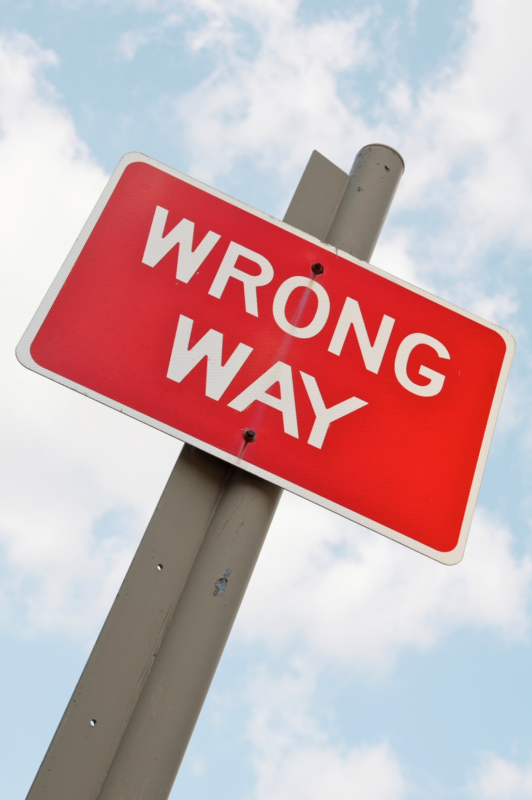
Top Mistakes To Avoid
Reviewing less than 3 CRMs.
Selecting a CRM and then not using it.
Having multiple CRMs in place.
Not having standard language to describe your sales funnel internally.
Under estimating the importance of privacy.

Slide 13
Discussion: “When Does It Become A Waste Of Time?”
How often are people expected to use it?
How often do people use it?
How much time does it take people to use it?
Do you make more money by using it?
Do you save money by using it?
Does it enhance your existing business processes or not?
What is the CRM’s value to your business?

Slide 14
Now What?
Decide on the CRM functionality that you need
Choose your CRM wisely
Decide upon the sales funnel statuses that you need
Train yourself and your employees
Have weekly or monthly reporting
Stretch your CRM

Slide 15
Discussion: “What Can You Do With A CRM?”
Do you email your customer with your CRM?
Do you renew your customers’ contracts with it?
Do you upsell your customer with it?
Do you keep information there such as contracts, invoices, and documentation?
Do you need invoices, quotes, or contract templates to be stored somewhere?
Does it actually help you build your customer relationships?

Slide 16
Worksheet
How does this work for your business?

Slide 17
Key Points
Sales Funnel
Names!
Notes
Contact Information
Example
What not to do
Your next steps
Wrap up

Slide 18
The Goal
For the small business owner to create their CRM as soon as possible.

Slide 19
Remembering more about your customer gives you a competitive advantage.
www.SmallBusinessSolver.com © 2016

