Slide 1
Referrals
You get referrals, not to help you, but to help the prospective customer!

Slide 2
Your goal is not to ask for referrals, but to explain why a referral would help a prospective customer.

Slide 3
Discussion: “Who Is Giving You Referrals?”
Who is giving you the most number of referrals?
Who is giving you the largest referrals?
Whose referrals are turning into business?
Are they on your board of advisors?
Are they your friends or family?
Are they other service providers?
Do they target the same market?

Slide 4
The Goal
Get more and better referrals.

Slide 5
Key Points
Why aren’t people referring you business?
What won’t referrers do?
How to help referrers refer more?
Example
What not to do
Your next steps
Wrap up

Slide 6
Worksheet
Grab your worksheet and follow along.

Slide 7
Why Aren’t People Referring You?
They don’t understand what you do.
They don’t understand the benefit to people they know.
They don’t know if you can actually deliver on what you say you can do.
They know someone who they think can do it better.
They don’t think that your personality is a good fit with the prospective customer.

Slide 8
What Won’t Referrers Do?
Think about whether the prospective customer can pay you.
Think about whether the person is your ideal client.
Think about whether you’ll like this person.
Give you the whole truth about the prospective customer up-front.
They might not know!

Slide 9
How To Help Referrers Refer?
Do they know your ideal client?
Do they know the various services?
Have you told them lots of stories and case studies?
Do you refer them business?
Do you thank them?

Slide 10
Discussion: “How are you thanking them?”
Are you sending them referrals?
Are you sending them thank you cards, gift cards, or another form of ‘thank you’?
Are you compensating them?
Are you keeping them updated on your business?

Slide 11
How Does It Work? Online marketing
Referral | By whom? | Why? | Good referral? | Feedback
Charlie | Samantha | Charlie needs more online business | No. Doesn’t have a budget. | Explain pricing to Samantha. Send card.
Suzanne | Jackie | Suzanne needs a website | No. Not what I do. | Explain ideal customer. Send card.
Tommy | Jackie | Tommy needs more content and copy. | Yes. | Thank you! Send gift card.
Hilary | Chris | Hilary owns a website business | Yes! | Send a gift basket.
Stu | Michael | Stu needs more sales in general | No. Looking for sales agent. | Explain service and business. Send card.

Slide 12
Top Mistakes To Avoid
Thinking that people are doing ‘you’ the favour when they refer you
Thinking that every referral is going to be a perfect fit
Forgetting to thank people regardless!

Slide 13
Now What?
Try to learn everything you can about a referred customer up-front.
Even if someone is not a potential customer, talk about your business in a way that helps them refer the right customers to you.
Keep track of who refers you the most and best customers.

Slide 14
Discussion: “How do you get other referrers like them?”
Is there a commonality between your best referrers?
Is there a common reason why you are getting the referrals?
Are there other sources like these?
Do these referrers know others like them?

Slide 15
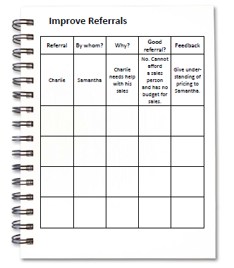
Worksheet
How does this work for your business?

Slide 16
Key Points
Why aren’t people referring you business?
What won’t referrers do?
How to help referrers refer more?
Example
What not to do
Your next steps

Slide 17
The Goal
Get more and better referrals.

Slide 18
You get referrals, not to help you, but to help the prospective customer!

