Slide 1
Former Customers
Following up with your past customers is a good opportunity for them to consider using you again.

Slide 2
Do you know why your customers left you?

Slide 3
The Goal
Get your customers back!

Slide 4
Discussion: “What Is your Retention Rate?”
How many of your customers stay with you every year?
How many of your customers renew a contract?
How many buy more than the year before?
How many upgrade to a higher value service offering?
How many leave?

Slide 5
Key Points
Transactional buy
Not satisfying all needs
Didn’t meet expectations
Example
What not to do
Your next steps
Wrap up

Slide 6
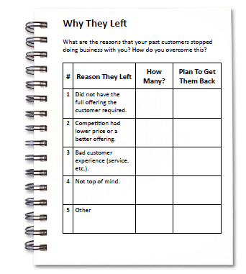
Worksheet
Grab your worksheet and follow along.

Slide 7
Transactional Buy
Not top of mind
New decision maker
Solution: Understand the political nuances and ensure you are an options

Slide 8
Not Satisfying All Needs
Were not a one stop shop
Needed a different product or service
Solution: Tell your past customer that you can now help them (if you can)

Slide 9
Didn’t Meet Expectations
Did they complain?
Are they threatening to leave?
Solution: React as soon as you receive negative feedback.

Slide 10
Didn’t Meet Expectations
Did they leave?
Solution: You have to win back their trust and make it up to them.
The worst case scenario, you just learn what your company could have done better.

Slide 11
Discussion: “Why are people leaving?”
Do people leave due to no longer needing the service?
Do people leave due to a change in their circumstances?
Do people leave due to a bad experience?
Do people leave due to an unsatisfactory experience?
Are there other reasons why they left you?

Slide 12
How Does It Work? Commercial handyman
# | Reason They Left | How Many? | Plan to Get Them Back
1 | New decision maker | 4 | Have regular follow ups Make sure know multiple people
2 | Just didn’t think of us | 9 | Need to have regular follow ups
3 | Didn’t offer electrical & plumbing support | 2 | Find a business to partner with and expand services

Slide 13
Top Mistakes To Avoid
Assuming that all of your customers stopped working with you because they didn’t like you
Thinking that once you lose a customer you can’t get them back
Not being proactive in retaining customers

Slide 14
Now What?
Remind your customers that you are around.
Keep your company top of mind.
Tell your customers new news.
Make it up to your customers if you’ve let them down.

Slide 15
Discussion: “What is your retention strategy?”
Do you monitor your retention rates?
Do you have an ongoing communication strategy?
Do you collect feedback?
Do you have a follow up policy?
Do you favour existing customers?
Do you have a retention strategy?

Slide 16
Worksheet
How does this work for your business?

Slide 17
Key Points
Transactional buy
Not satisfying all needs
Didn’t meet expectations
Example
What not to do
Your next steps

Slide 18
The Goal
Get your customers back!

Slide 19
Following up with your past customers is a good opportunity for them to consider using you again.
www.SmallBusinessSolver.com © 2016

