Slide 1
Retention
Acquiring a new customer is seven times more expensive than retaining an existing customer.

Slide 2
- Feedback - Strategic partnerships can be formed - Onboarding and the learning curve costs are reduced - Trust is developed - The worth of the company increases

Slide 3
Discussion: “What do your customers expect to be delivered?”
What is the industry norm?
What is the competition doing?
Are your sales people over promising?
Do you sales people understand how delivery works?
Do your sales people have to handle disgruntled customers?

Slide 4
The Goal
Keep your customers happy so that you keep your customers.

Slide 5
Key Points
Prioritize your existing customers
Be more than lip service
Exceed expectations
Example
What not to do
Your next steps
Wrap up

Slide 6
Worksheet
Grab your worksheet and follow along.

Slide 7
Prioritize Your Existing Customers

Slide 8
Be More Than Lip Service

Slide 9
Discussion: “How do you communicate with your customers throughout delivery?”
Do you provide updates or reports?
Do you plan weekly / monthly / quarterly meetings?
Does the customer understand the delivery process and timelines?
Do you have face time?
Do you contact them with an update before they contact you with questions?

Slide 10
Exceed Expectations

Slide 11
Discussion: “How do you know when you’ve met customer expectations?”
Do you know what success looks like prior to closing a sale?
Do you ask for customer feedback?
Do you have a launch party or review meeting?
Do you proactively follow up with customers?

Slide 12
How Does It Work? Painter
Extra bucket of paint for future touch ups
Discount for future work
Annual BBQ

Slide 13
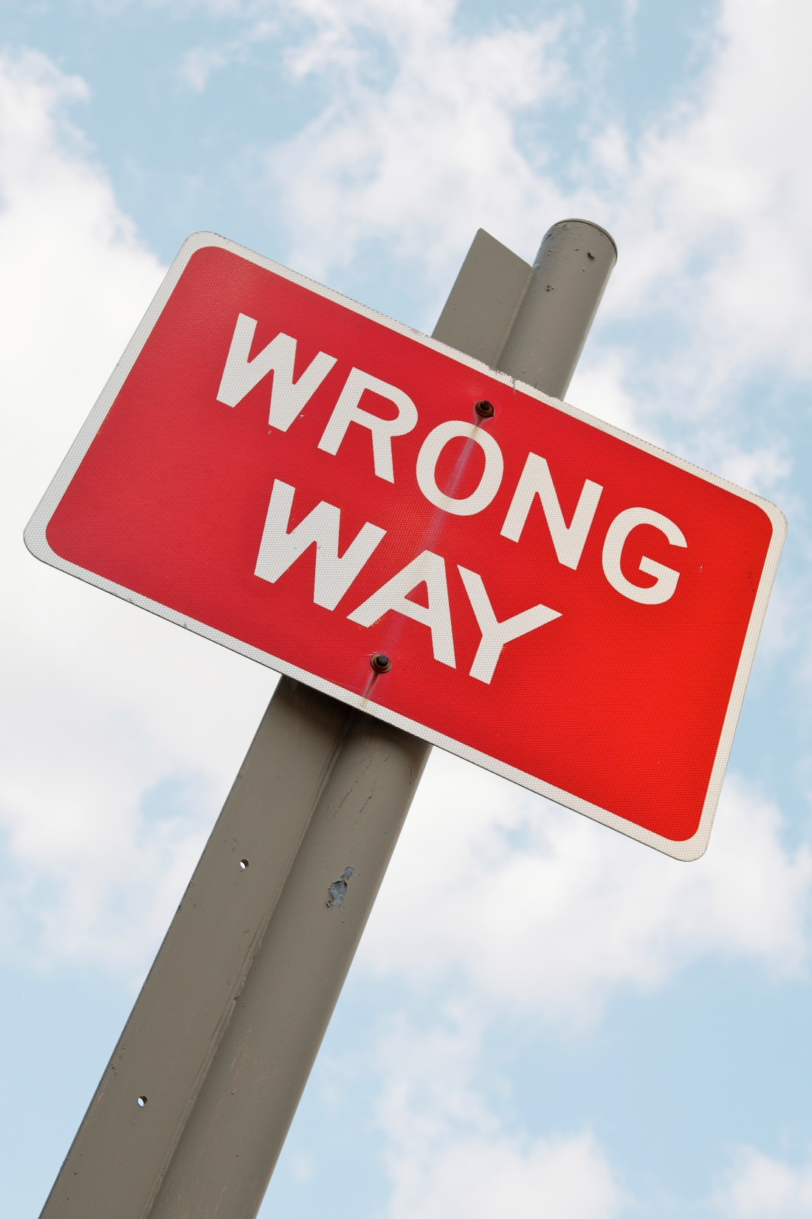
Top Mistakes To Avoid
Favouring new customers
Overlooking a strategy for retention
Not measuring retention
Not listening to customers

Slide 14
Now What?
Create a benefit for existing customers
Communicate more
Be genuinely thankful for their business
When in doubt, put yourself in your customers’ shoes

Slide 15
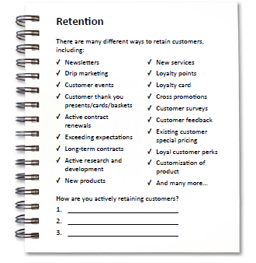
Worksheet
How does this work for your business?

Slide 16
Key Points
Prioritize your existing customers
Be more than lip service
Exceed expectations
Example
What not to do
Your next steps

Slide 17
The Goal
Keep your customers happy so that you keep your customers.

Slide 18
Acquiring a new customer is seven times more expensive than retaining an existing customer.

