Slide 1
Setting Expectations
The customer has made the decision to move forward, so you have to prove to them that
it’s the right decision.

Slide 2
They will be judging.

Slide 3
The Goal
Learn to set
up the right expectations from the beginning of a sale.

Slide 4
Key Points
Understand your own capabilities
Understand your constraints
Understand your ‘normal’ state
Don’t say yes automatically
Talk realistically
Example
What not to do
Your next steps
Wrap up

Slide 5
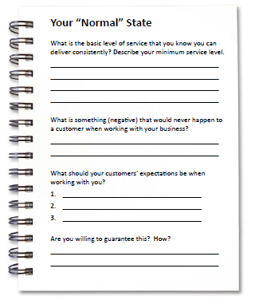
Worksheet
Grab your worksheet and follow along.

Slide 6
Understand Your Own Capabilities

Slide 7
Understand Your Constraints

Slide 8
Discussion: “What Expectations are you setting?”
How quickly do people expect you to return emails?
How quickly to people expect you to return phone calls?
How quickly do people expect you to complete a job?
How quickly do people expect you to follow up?
How quickly do suppliers expect you to pay their bills? What else do they expect from you?
What do your employees expect from you?

Slide 9
Understand Your “Normal State”

Slide 10
Don’t Say “Yes” Automatically

Slide 11
Discussion: “Is this sustainable as you grow?”
Are you training to these expectations?
Are you communicating these expectations?
Are these expectations part of your rand?
How important is it to you to maintain this level of service?

Slide 12
Talk Realistically

Slide 13
How Does It Work? Massage Therapist
What is the basic level of service?
Good massage, relaxing environment, catered to the client’s needs
What is something negative?
The massage could be too hard / soft, or not enough time spent on problem areas
What should your customers’ expectations be when working with you?
It will always be a full hour. I’ll always ask where the problem areas were. And no interruptions.
Can you guarantee this?
If there is any dissatisfaction, a discount card is given for their next massage.

Slide 14
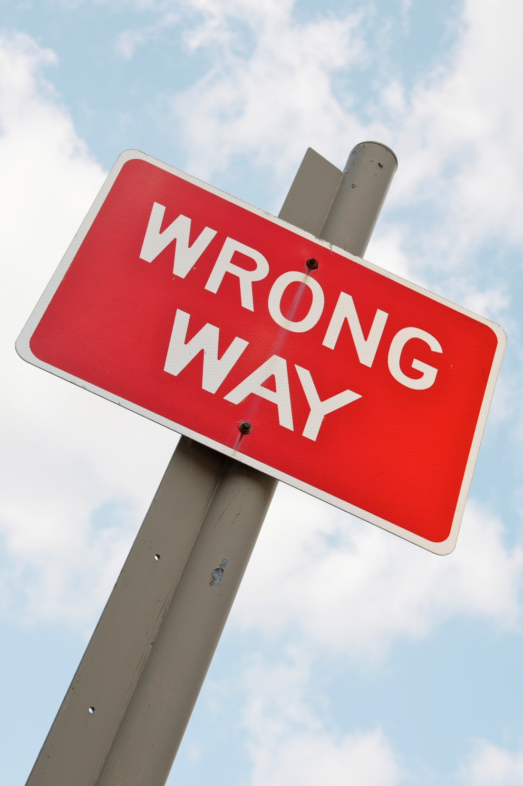
Top Mistakes To Avoid
Don’t say anything for the sale to close
Don’t start selling until you understand what you can deliver
Don’t promise the world even if you think you can deliver it

Slide 15
Now What?
Under-promise and over-deliver
Understand your own capabilities and constraints.
Don’t say yes if you don’t know you can deliver.
Start worrying about expectations from the start

Slide 16
Discussion: “What is reasonable in the long term?”
What are large enterprises in the industry doing?
What are medium-sized businesses doing?
Is your pricing structure supportive of your current delivery mechanism?
Is your pricing structure supportive of your current service level?

Slide 17
Worksheet
How does this work for your business?

Slide 18
Key Points
Understand your own capabilities
Understand your constraints
Understand your ‘normal’ state
Don’t say yes automatically
Talk realistically
Example
What not to do
Your next steps
Wrap up

Slide 19
The Goal
Learn to set up the right expectations from the beginning of a sale.

Slide 20
The customer has made the decision to move forward, so you have to prove to them that
it’s the right decision.

