Slide 1
Whales Vs. Minnows
The bigger they are, the harder they are to land.

Slide 2
Is bigger always better?

Slide 3
The Goal
Sell well to whales and minnows.

Slide 4
Key Points
Size of the sale
Priorities
Sales approach
Sales funnel length
Disadvantages
Example
What not to do
Your next steps
Wrap up

Slide 5
Worksheet
Grab your worksheet and follow along.

Slide 6
Size of the Sale
WHALES:
Can be huge. But they can take years.
MINNOWS: These are smaller sales and the total share is smaller, but you can quickly get more.

Slide 7
Priorities
WHALES:
Shareholders are paramount.
MINNOWS: These businesses want to build a relationship of trust.

Slide 8
Sales Approach
WHALES:
“Eat a whale one bite at a time.”
MINNOWS:
Go for the referral.

Slide 9
Sales Funnel Length
WHALES:
Larger buying group and you need to establish more credibility.
MINNOWS:
Small business is fast-paced.

Slide 10
Disadvantages
WHALES:
They know that they have the upper hand.
Corporate strategy shifts that can change everything.
People move around quite a bit.
MINNOWS:
Sometimes can require a lot of hand-holding or service.
The time to close them often is almost as long as to close a larger sale.

Slide 11
Discussion: “Who Is Your Largest Customer?”
- What part of your business comes from the larger customers?
- How long is your whale’s sales cycle?
- Are they impacted by the economy?
- Are they impacted by governmental policies?
- Is there risk in having all of your eggs in one basket?
- Is there additional cost in working with these larger customers?

Slide 12
Discussion: “How Many Small Customers are the Equivalent of a Whale ?”
- What part of your business comes from smaller customers?
- How long is the sales cycle for the minnow?
- Are they impacted by the economy?
- Are they impacted by governmental policies?
- Is there additional risk or cost in working with these smaller customers?

Slide 13
How Does It Work? Snow Removal
Who are your ‘whale’ customers?
- Property management firms
How do you treat them differently?
- Pricing fixed plus a variable piece, service level agreements, distance willing to travel, priority service Monday-Friday, write a formal proposal and contract
Who are your ‘minnow’ customers?
- Residential
How do you treat them differently?
- Local geography only, fixed pricing, on the spot pricing, handshake only

Slide 14
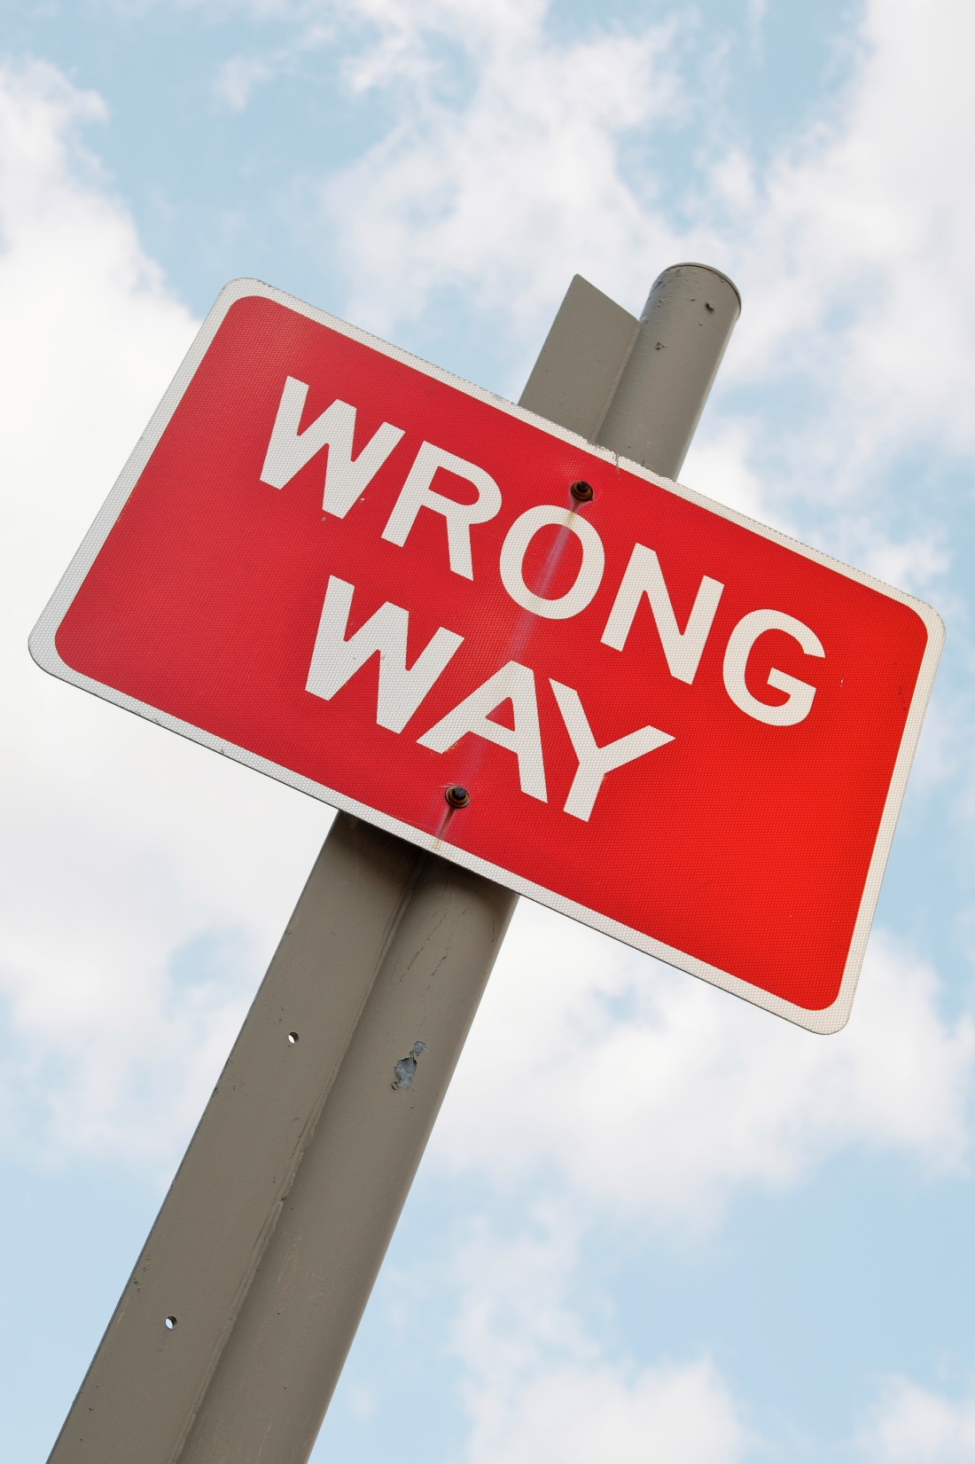
Top Mistakes To Avoid
Only having whales in your sales funnel
Not having patience for the whales
Only speaking to one person within a whale organization

Slide 15
Now What?
Analyze your sales funnel. Do you have enough whales and minnows?
How do you adapt your sales technique for whales? For minnows?
Is there a way to minimize the downside of working with whales or minnows?
Are some of your sales people better at selling to whales or minnows?
Is your business better designed or better at selling naturally to either whales or minnows?

Slide 16
Discussion: “How do you treat your whales differently than your minnows?”
- What do whales care about that your smaller customers aren’t concerned with?
- What is the toughest part of selling to the larger customer?
- What do minnows care about that your larger customers aren’t concerned with?
- What is the toughest part of selling to the smaller customer?
- How do you sell to them differently?

Slide 17
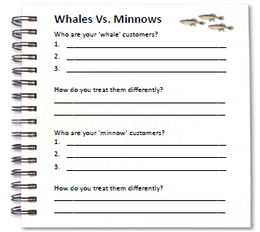
Worksheet
How does this work for your business?

Slide 18
Key Points
Size of the sale
Priorities
Sales approach
Sales funnel length
Disadvantages
Example
What not to do
Your next steps

Slide 19
The Goal
Sell well to whales and minnows.

Slide 20
The bigger they are, the harder they are to land.

