Slide 1
Competition
Keep your friends close, and your enemies even closer.

Slide 2
Suppliers & partners are your friends, and competitors your enemies.

Slide 3
Discussion: “Who is actually your competition?”
What is your scope? Who do you consider your competitors? Who isn’t your competition?
Do you consider other businesses outside your geographical area?
Do you consider businesses that are in the same industry, but don’t provide the same offering as you do?
Do you consider businesses that go after the same target market as you? Or could go after the same target market as you?

Slide 4
The Goal
Learn to deal with competitors when selling.

Slide 5
Key Points
Strengths
Your advantage
First mover advantage
Second mover advantage
How to talk about competition
Example
What not to do
Your next steps
Wrap up

Slide 6
Worksheet
Grab your worksheet and follow along.

Slide 7
Strengths

Slide 8
Your Advantage

Slide 9
How To Talk About The Competition?
Never say anything directly negative.

Slide 10
Discussion: “Do they have to be your competition?”
Is there a possibility to work with your perceived competitors?
Could you expand your product or service offering by doing so? Could you help them expand theirs?
Could you reach a new market place?
Could you expand your business’ resources?
Human resources?
Financial resources?
Technological resources?
Are there other benefits to considering this?

Slide 11
How Does It Work? Credit Union
Competitor | Strengths | Your Advantage
Local Bank | Relationships | Flexibility on who to financing
National Bank | Deep pockets | Flexibility on red tape
Private Investors | Provide own expertise & support | Wider network

Slide 12
Top Mistakes To Avoid
Talking negatively about your competition
Not knowing how you are different than the competition
Giving up as you are not the first mover

Slide 13
Now What?
Second can be the best.
Keep your eyes open.
You face both direct and indirect competition in addition to competition from substitutes.

Slide 14
Discussion: “Where are you today versus where you want to be in the future?”
Where do you stand versus your competition when it comes to;
Price?
Quality?
Customer service?
Innovation?
Brand image and recognition?
Is this where you want to be?
How could you change this?

Slide 15
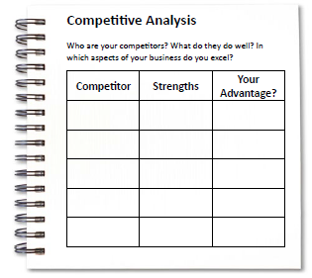
Worksheet
How does this work for your business?

Slide 16
Key Points
Strengths
Your advantage
First mover advantage
Second mover advantage
How to talk about competition
Example
What not to do
Your next steps
Wrap up

Slide 17
The Goal
Learn to deal with competitors when selling.

Slide 18
Keep your friends close, and your enemies even closer.

