Slide 1
Most Common Objections
Deal with them early rather than later on.

Slide 2
There is no point in belabouring something if the objection is a deal breaker and cannot be cleared up.

Slide 3
The Goal
Getting more “yes” from the start.

Slide 4
Key Points
Root causes
Create a plan
Be proactive
Example
What not to do
Your next steps
Wrap up

Slide 5
Worksheet
Grab your worksheet and follow along.

Slide 6
Discussion: “What Objections Are You Hearing?”
It isn’t in the budget this year…
We just haven’t gotten to this yet…
I haven’t been able to get this in front of my manager…
I’m not sure that this will work for us…
We are quite a unique organization and need something customized…

Slide 7
Root Causes
The need does not exist or is not as important as other needs
It is risky or it will not work
There is a better solution

Slide 8
Discussion: “What are they actually saying?”
This was potentially a higher price than they were expecting.
It is not a priority or it isn’t easy to implement.
My manager is the decision maker, not me.
The solution is unclear or the implementation was not explained.
You have not demonstrated understanding of client or that you are listening.

Slide 9
Create A Plan
Create a plan of attack for each root cause.
Example: They think it will not work, so you need to demonstrate how many people it has worked for.
Example: They think that it could be a lot of work to implement, so you can give examples of how little time it has taken past customers.

Slide 10
Be Proactive
Proactively avoid the most common objections.
Example: If you are always being told that customers think it will take a long time to implement, in your sales pitch explain how little time it will take.

Slide 11
Discussion: “Is there a way to overcome these objections before they even come up?”
Payment plans, lower cost options, follow up, and asking them what their budget is could avoid this objection.
Explain the result or risk of status quo. Process map or write down what the implementation schedule is.
Book a meeting with the manager, explain how it will benefit the manager, or control your message.
Over simplify the solution. Give similar case studies. Use diagrams and images to explain the implementation.
Use case studies and testimonials of a similar organization.

Slide 12
How Does It Work? Website Developer
Priority | Objection | Response
1 | Do I really need a website? | Did you know that buyers now do a majority of their research online?
2 | Will it be creative? | We focus on the creative side and have an in house designer.
3 | Will it be expensive? | There are a variety of options depending on what you are looking for.
4 | Will it get me more business? | Website is structured for conversion rates.

Slide 13
Top Mistakes To Avoid
Not listening to customers
Not avoiding the “no”
Not getting deal breakers discovered early on
Giving up

Slide 14
Now What?
Understand what the customer is really thinking.
Allow objections to happen, as knowing is better than not knowing.
Work on proactively avoiding the common objections.

Slide 15
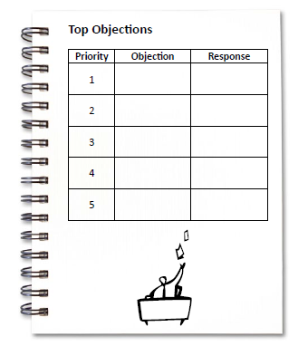
Worksheet
How does this work for your business?

Slide 16
Key Points
Root causes
Create a plan
Be proactive
Example
What not to do
Your next steps

Slide 17
The Goal
Getting more “yes” from the start.

Slide 18
Deal with them early rather than later on.
www.SmallBusinessSolver.com © 2016

