Slide 1
Controlling Your Message
When possible, always control your own message.

Slide 2
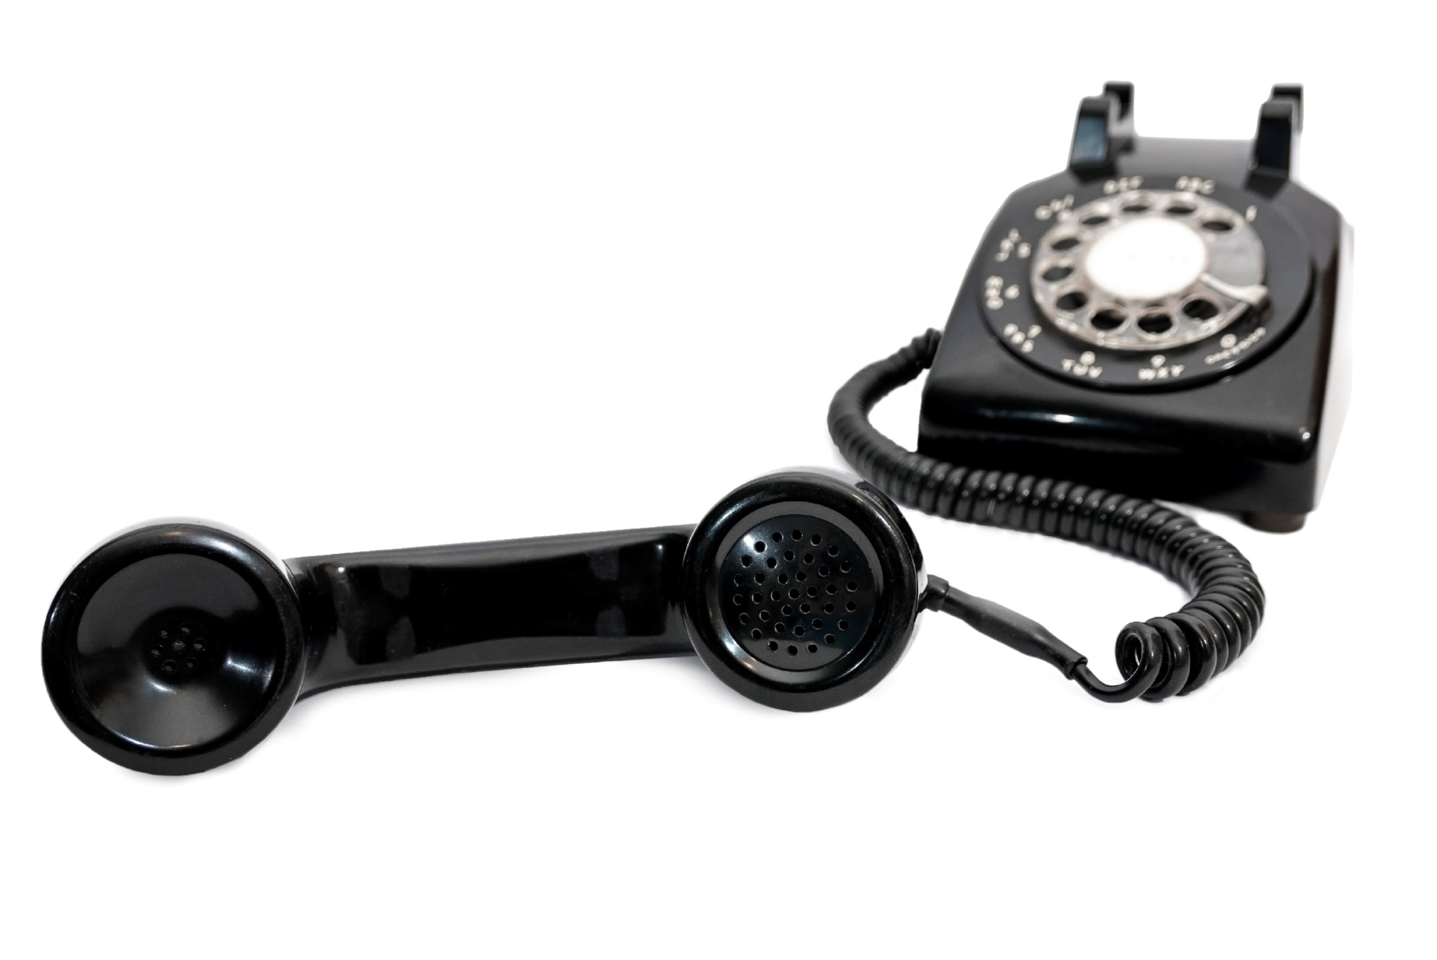
Ever played broken telephone?

Slide 3
Discussion: “If you don’t control your message, what could happen?”
Could the message continue to be communicated? Are there other decision makers? Are there influencers? How big is the buying group?
Could the message be changed?
Could there be a miscommunication in your message or medium used?
Could the relevant points be prioritized incorrectly by different members of the buying group, as they have different priorities than the decision maker?

Slide 4
The Goal
Making sure that the right message is being communicated.

Slide 5
Key Points
Why controlling your message?
Common ways to lose control
How to control your message
Example
What not to do
Your next steps
Wrap up

Slide 6
Worksheet
Grab your worksheet and follow along.

Slide 7
Why Controlling Your Message?
You are probably the best at saying your own message as you believe in your own product or service.
You want to be able to respond to questions in real-time while it is still top of mind for your customers.
You want to be able to get the customer’s feedback to improve your pitch or your product or service.
The message can be changed.

Slide 8
Common Way to Lose Control
Not speaking to the decision-maker from the beginning of the sales process.
You could be speaking to the influencer, end user, or gatekeeper.

Slide 9
Discussion: “How do you make sure that you are speaking to a decision maker?”
Do you ask them how a decision is usually made? Do you ask them the process?
Do you confirm that all the relevant parties will be at the meeting?
Do you ask directly who the decision maker is?

Slide 10
Ways To Control Your Message
Always make sure that the decision maker will be there
If you can’t speak with a decision-maker, control your message with
Handouts
Videos
PowerPoint slides
Recording the meeting

Slide 11
How Does It Work? Consultant
Brochure?
Will this be the easiest?
Website?
If they went to my site could they answer all of their questions?
Presentation?
Is there enough information on the slides?
Video?
Is this on my website?
Can we record the meeting?

Slide 12
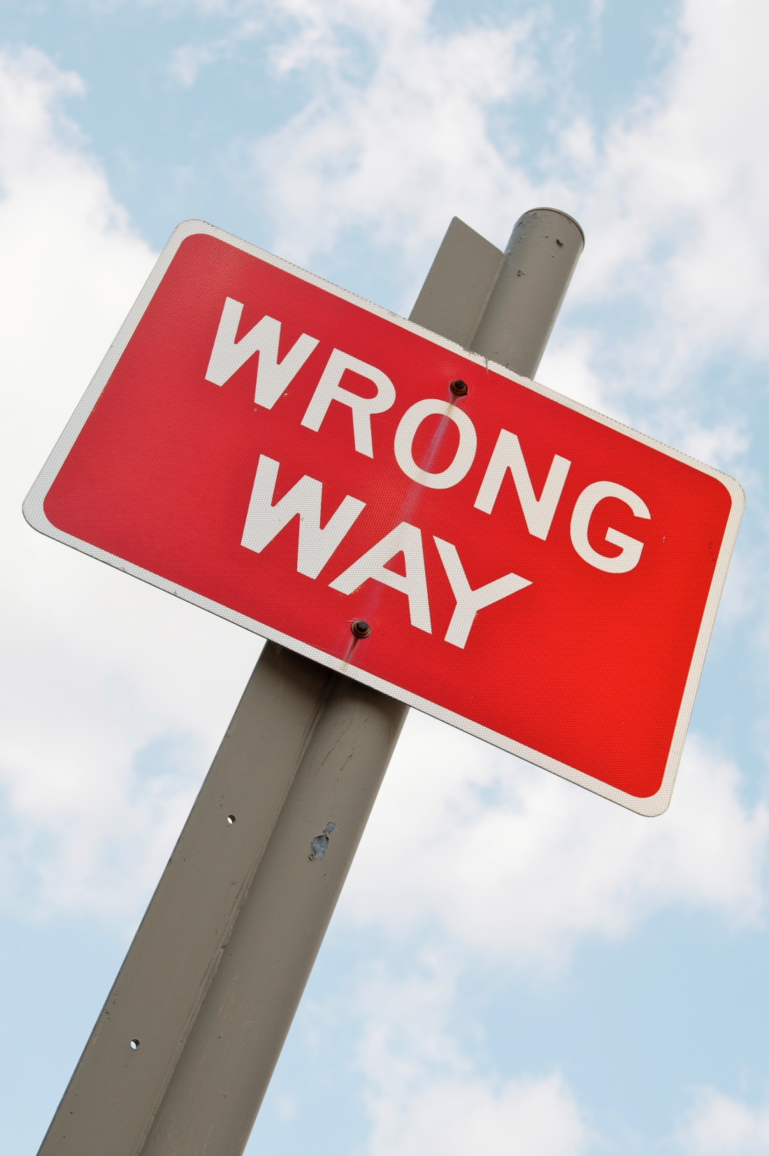
Top Mistakes To Avoid
Assuming that the first person that you speak to is the decision maker
Forgetting to figure out who is actually the decision maker
Not having a back up plan

Slide 13
Now What?
Marketing collateral—use it correctly or don’t use it at all.
Always make sure that you are speaking to the decision-maker.
If they aren’t there the first time, try to get a future meeting
If you can’t speak with the decision maker, be creative on how you control your message. Videos are great!

Slide 14
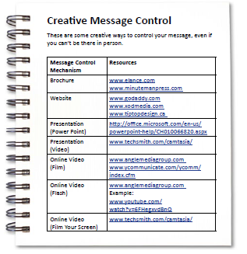
Worksheet
How does this work for your business?

Slide 15
Discussion: “What is your back up plan?”
If you can’t meet with the decision maker, how could you control the message?
If you have an online business, how do you ensure your message is communicated accurately?
With word of mouth, how do you avoid miscommunication?
What is a creative way to control your message?

Slide 16
Key Points
Why controlling your message?
Common ways to lose control
How to control your message
Example
What not to do
Your next steps

Slide 17
The Goal
Making sure that the right message is being communicated.

Slide 18
When possible, always control your own message.

