Slide 1

Gauging Interest
You need to be able to gauge interest so that you know when to close a sale.

Slide 2

Even if they aren’t saying it out loud, they are telling you if they are interested.
www.SmallBusinessSolver.com © 2016

Slide 3

Discussion:
“What are some reasons why a customer hasn’t been interested in the past?”
Was the offering out of their budget?
Were they looking for something more customized?
Do they believe that they have a problem?
Are they confused by your offering?
Did they already have in their mind what the solution was?
Did they have more pressing concerns or higher priorities for their time and money?
Do they believe that implementation is possible?
Could this be that they aren’t qualified prospects?

Slide 4

The Goal
Getting your customers more interested!
www.SmallBusinessSolver.com © 2016

Slide 5

Key Points
Interested body language
Uninterested body language
Sales presentations
Example
What not to do
Your next steps
Wrap up
www.SmallBusinessSolver.com © 2016

Slide 6
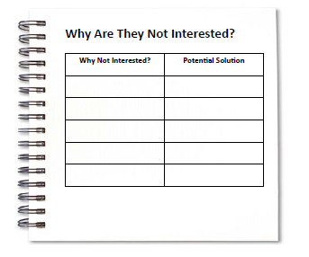
Worksheet
Grab your worksheet and follow along.
www.SmallBusinessSolver.com © 2016

Slide 7

Interested Body Language
Their head is tilted forward
They nod regularly
They make eye contact 70% of the time or more
Pupil size enlarges
If they briefly look to the right after you ask a question or state a meaningful message.
www.SmallBusinessSolver.com © 2016

Slide 8

Uninterested Body Language
Arms are crossed—this is a natural barrier they are putting up
They make eye contact less than 40% of the time
Their head is tilted to one side
They are interacting on their phone
If they are fidgeting (even when maintaining eye contact), they are thinking about something else
If they touch their face, they could be holding back information
If they are blink and look up to the left, they could be lying
If they are staring into a deep void, the attention is elsewhere.

Slide 9
Discussion:
“Are there ways that we could avoid having uninterested customers in the future?”
Could you have custom solutions?
Would a payment plan or performance based compensation or a low price option work?
Is the reason why you are different then your competition important to the prospect?
Do you have backup to show the implications of their challenge?
Is there a way to make the solution easier to understand?
Is there a way to make the solution easier to implement?

Slide 10

Sales Presentations
If they don’t interrupt you, it didn’t go as well as you think.
If they didn’t say no, they may be interested but they may not be the decision-maker.
If they ask implementation questions, they are interested.
If they ask a question about one of the products out of a group, they are interested.

Slide 11
How Does It Work? Head Hunter
Why Not Interested? | Potential Solution
Didn’t understand | Use diagrams, simply wording, no acronyms
Didn’t know if the company could deliver | Testimonials and storytelling of past success
Didn’t think it was addressing their main problem | Tie back to improving productivity

Slide 12
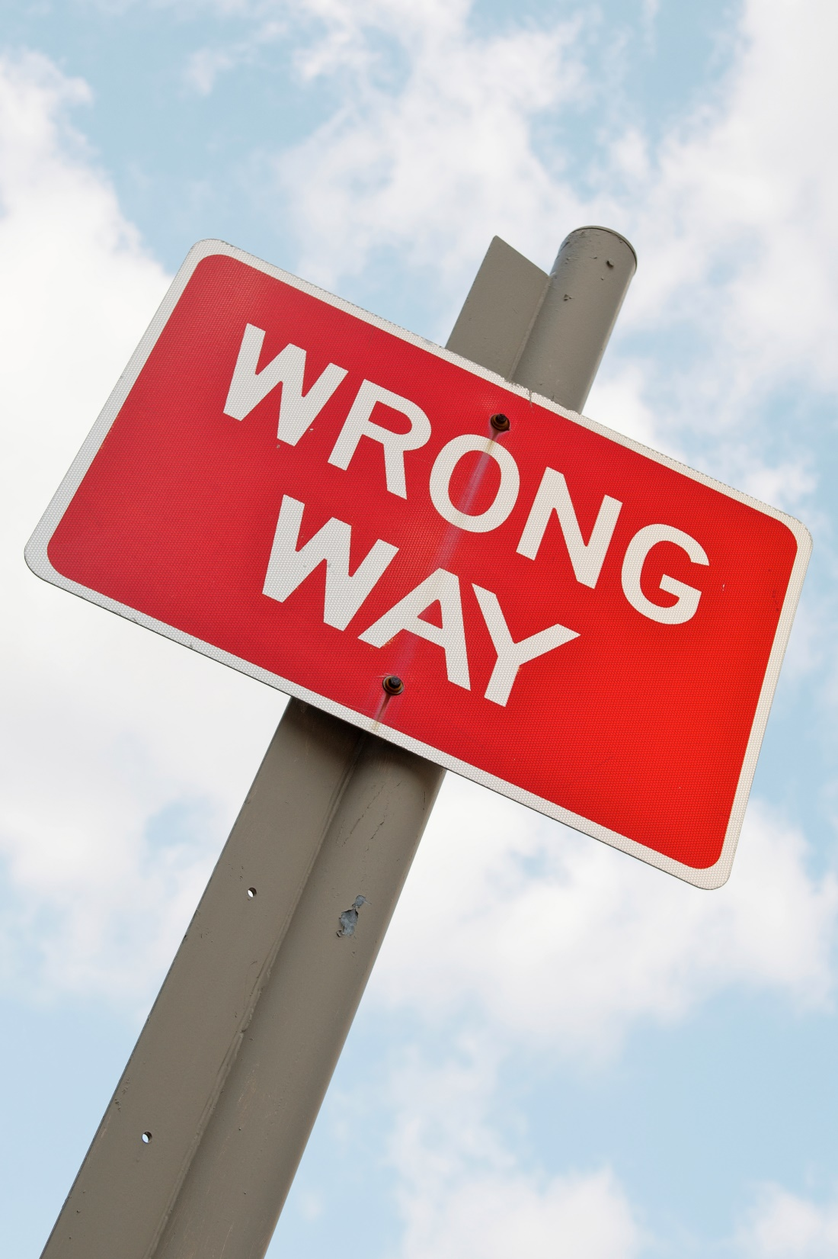
Top Mistakes To Avoid
Thinking implementation questions are a bad sign
Doing an entire presentation without engaging the customer
Not taking the feedback seriously
Not trying to improve
www.SmallBusinessSolver.com © 2016

Slide 13

Now What?
Be flexible.
Be attentive.
Have two people at a meeting where possible, with one person’s role being to gauge interest.
If they are not asking questions, ask them questions to get them engaged.
If interests picks up in one area, don’t be afraid to spend more time talking about that.
www.SmallBusinessSolver.com © 2016

Slide 14
Worksheet
How does this work for your business?
www.SmallBusinessSolver.com © 2016

Slide 15
Discussion:
“How Do You Keep Them Interested?”
How do you prove or justify any claims?
Are you a one trick pony?
Are there successes or new items that you can communicate?
Can you build a relationship of reciprocity?
Is there a point I time that you need to stop selling to a prospect?
www.SmallBusinessSolver.com © 2016

Slide 16

Key Points
Interested body language
Uninterested body language
Sales presentations
Example
What not to do
Your next steps
Wrap up
www.SmallBusinessSolver.com © 2016

Slide 17

The Goal
Getting your customers more interested!

Slide 18

You need to be able to gauge interest so that you know when to close a sale.
www.SmallBusinessSolver.com © 2016

