Slide 1

Sales
Are Not An Afterthought
Sales are important. If there are no sales, then a company is not making money in its own right.
www.SmallBusinessSolver.com © 2016

Slide 2
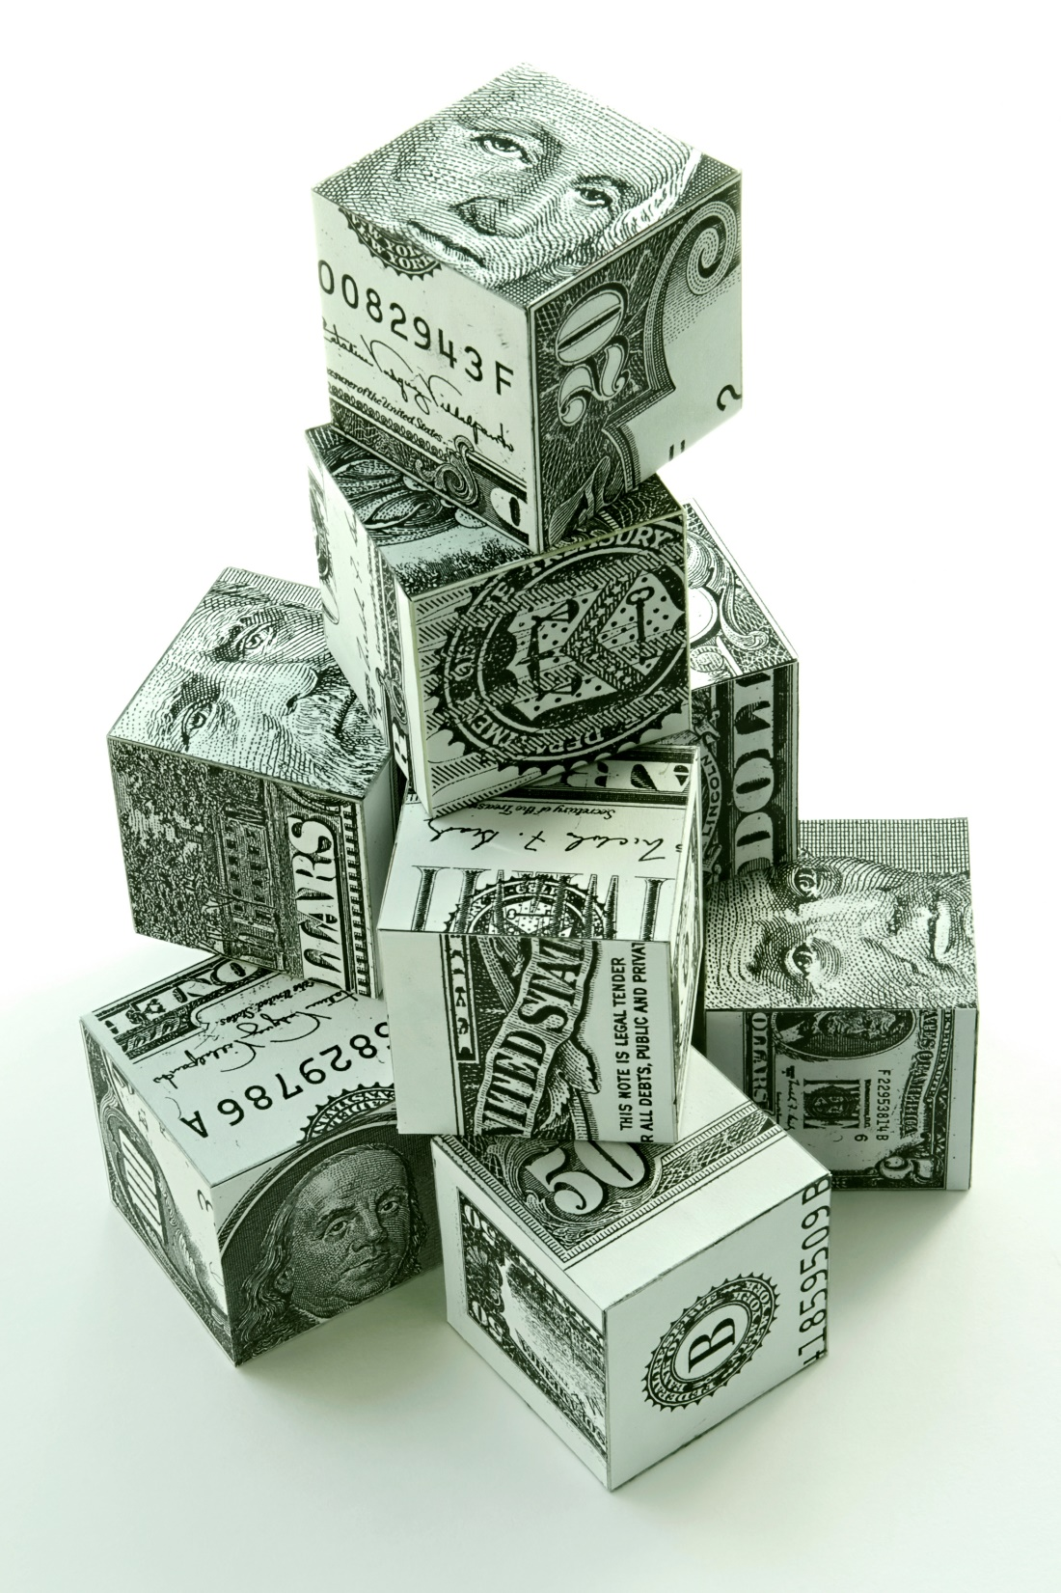
The only cash flow that should matter to a business in the long run is revenue from sales.
www.SmallBusinessSolver.com © 2016

Slide 3

The Goal
Start selling today!
www.SmallBusinessSolver.com © 2016

Slide 4

Key Points
Focus of business
Time management
Getting started
Example
What not to do
Your next steps
Wrap up
www.SmallBusinessSolver.com © 2016

Slide 5
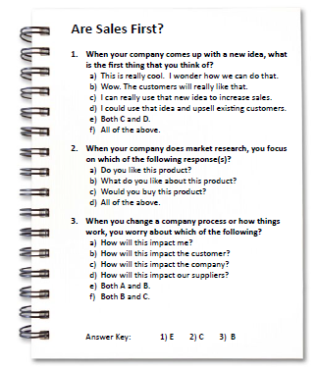
Worksheet
Grab your worksheet and follow along.
www.SmallBusinessSolver.com © 2016

Slide 6

Focus of Business
www.SmallBusinessSolver.com © 2016

Slide 7

Discussion:
“How important are sales in your business?”
How important are sales in other parts of your life?
  Do you sell yourself at work? Do you sell yourself at trying to get a job? Do you sell yourself to new people you meet?
What type of seller are you? The product orientation? The inventor? The entrepreneur? Other?
How do you make sure that you put your best foot forward in all aspects of life?
www.SmallBusinessSolver.com © 2016

Slide 8
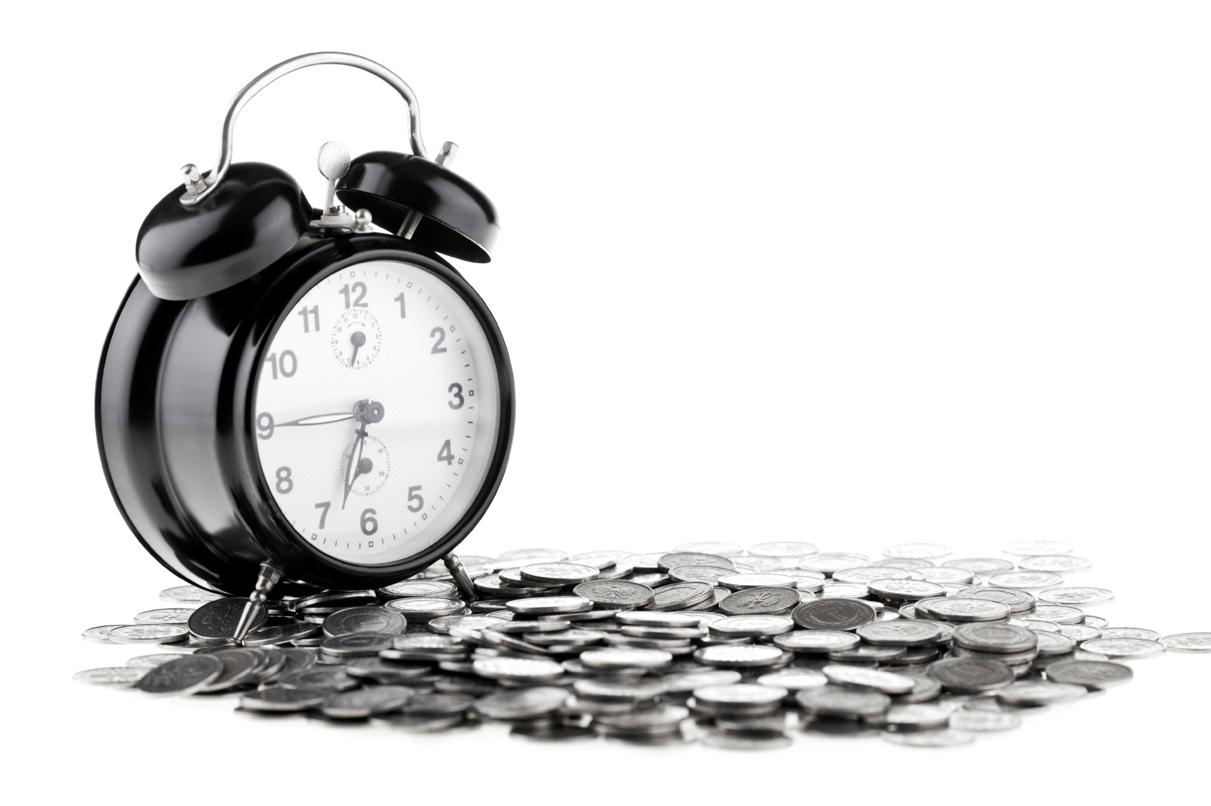
Time Management
www.SmallBusinessSolver.com © 2016

Slide 9
Discussion:
“What percentage of your time should be spend on selling? Why?”
How many people in a business are typically revenue generators? Should everyone be selling?
How can people in different roles still continue to sell?
What are your barriers to selling yourself? Are there ways to remove them?
Do your employees have barriers to selling? Are there ways to remove them?
www.SmallBusinessSolver.com © 2016

Slide 10

Getting Started
www.SmallBusinessSolver.com © 2016

Slide 11

Discussion:
“When is it important for you to start selling?”
Are you selling today? Why or why not?
What are your barriers to starting to sell? What would you have to do in order to start selling?
Could you start selling within 2 weeks? What would you have to start doing in order to do so?
Have you considered taking pre orders? Or piloting your business concept with friends who might be willing to buy
prior to your final solution is fully developed?
Could the biggest hurdle in starting to sell actually be in your own mind? Why are you resistant to selling?
www.SmallBusinessSolver.com © 2016

Slide 12
How Does It Work? Bed & Breakfast
When your business comes up with a new idea, what is the first thing that you thin of?
This is really cool. I wonder how we can do that.
Wow. The customers will really like that.
I can really use that new idea to increase sales.
I could use that idea and upsell existing customers.
www.SmallBusinessSolver.com © 2016

Slide 13
How Does It Work? Bed & Breakfast
When your business does market research, you focus on which of the following response(s)?
Do you like this product?
What do you like about this product?
Would you buy this product?
All of the above.
www.SmallBusinessSolver.com © 2016

Slide 14
How Does It Work? Bed & Breakfast
When you change a business process or how things work, you worry about which o the following?
How will this impact me?
How will this impact the customer?
How will this impact the business?
How will this impact our suppliers?
Both A and B
Both B and C
www.SmallBusinessSolver.com © 2016

Slide 15

Top Mistakes To Avoid
Spending the average marketing dollars and % selling time as a start up
Postponing when you start selling
Making sales an afterthought
www.SmallBusinessSolver.com © 2016

Slide 16

Now What?
The average small business spends 3% of their budget on sales, while a great one spends 10%.
The average marketing expenditure is 4 to 7%.
How much time and money do you have committed to selling?
www.SmallBusinessSolver.com © 2016

Slide 17
Worksheet
How does this work for your business?
www.SmallBusinessSolver.com © 2016

Slide 18

Key Points
Focus of everyone
Time management
Getting started
Example
What not to do
Your next steps
Wrap up
www.SmallBusinessSolver.com © 2016

Slide 19

The Goal
Start selling today!
www.SmallBusinessSolver.com © 2016

Slide 20

Sales are important. If there are no sales, then a company is not making money in its own right.

