Slide 1
Presentations
The biggest fear in the world is public speaking.
At a funeral, most people would prefer to be in the coffin than giving the eulogy.

Slide 2
Discussion: “What are your biggest concerns about presenting?”
Do you not know where to begin?
Are you nervous to stand in front of a crowd?
Are you comfortable, but just not as effective as you’d like?
Are you worried that your message won’t be well received?

Slide 3
Did you know that people who love public speaking and those who don’t, actually feel physically the exact same way? The difference? It’s in your head!

Slide 4
The Goal
Begin making more powerful presentations.

Slide 5
Key Points
Your audience
Speech skeleton
Sizzle
Visuals
Practice!
Prepare
Delivery
Example
What not to do
Your next steps
Wrap up

Slide 6
Worksheet
Grab your worksheet and follow along.

Slide 7
Your Audience

Slide 8
Discussion: “Why does your audience care about what you are talking about? Do they?”
Have you started with why your audience is there?
Are you making sure that you mention this at the beginning to hook them in?
Are there one or two things the audience will take away? Do you have new nuggets of information?

Slide 9
Speech Skeleton
A hook. Some interesting way to get the audience involved.
An overview. Talk about what you are going to talk about.
The body. Talk about it. Make sure that it isn’t more than five points. The most that people will actually remember is two or three points.
Conclusion. Summarize your talk.

Slide 10
Sizzle

Slide 11
Visuals
Rule of 6
Never use red text
Use pictures

Slide 12
Practice!

Slide 13
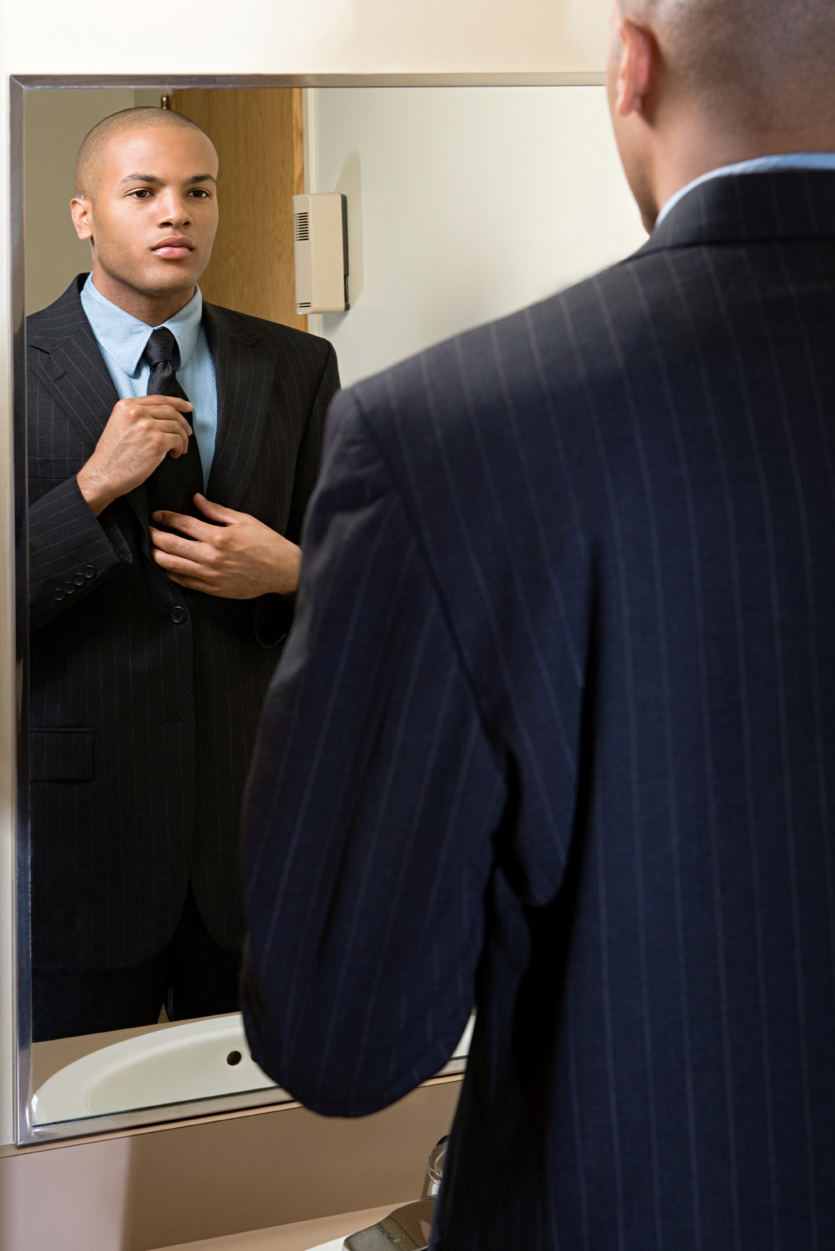
Prepare

Slide 14
Delivery
Eye contact
Good volume
Don’t fidget
Hand movements
Do not sway
Do not lean
Breathe

Slide 15
Discussion: “How do you keep them engaged?”
How do you add sizzle?
Do you add anecdotes? Stories? Jokes?
Do you add props? Interesting visuals? Handouts?
Do you engage the audience with questions, games, or other interactions?
Do you add sound effects? Change your volume?
Do you move around?
How do you change the pace, pitch or tone of the presentation?
How can you stretch yourself?

Slide 16
How Does It Work? Lawyer
Who is my audience? Small business owners
The Hook: Example of a small business owner that went out of business for a legal reason
Body Topics:
Incorporation
Contracts
Employment
Leases
Sizzle: Stories, hand out a standard contract, joke about lawyers
Thing to focus on: Hand movements

Slide 17
Top Mistakes To Avoid
Thinking that you just can’t present.
Thinking that you can’t improve on your presentation skills.
Walking into a sales presentation unprepared.

Slide 18
Now What?
Practice three times to be comfortable.
Practice seven times to be good.
Practice ten times to be great.
Keep presenting as you’ll keep getting better!

Slide 19
Worksheet
How does this work for your business?

Slide 20
Key Points
Your audience
Speech skeleton
Sizzle
Visuals
Practice!
Prepare
Delivery
Example
What not to do
Your next steps
Wrap up

Slide 21
The Goal
Begin making more powerful presentations.

Slide 22
The biggest fear in the world is public speaking.
At a funeral, most people would prefer to be in the coffin than giving the eulogy.

