Slide 1
First Impressions
You have less than 10 seconds to make an impact….

Slide 2
You only have one chance to make a first impression.

Slide 3
Discussion: “What was Your First Impression Of Me?”
Do you remember what mood or impression I gave you when I first met you?
If I showed up with a frown on my face and was abrupt, what might you assume about me?
Did you look at what I was wearing?
If my hair was messy, how might you perceive me differently?
What else contributed to your first impression of me?

Slide 4
Discussion: “What Is The First Impression You Want To Give?”
Do you want to be professional?
Do you want to be personable?
What other adjectives might you want people to think about you upfront?
What might make the rest of your relationship easier?

Slide 5
The Goal
Make a good first impression each and every time you meet someone.

Slide 6
Key Points
For any occasion
Over the phone
In person
Example
What not to do
Your next steps
Wrap up

Slide 7
Worksheet
Grab your worksheet and follow along.

Slide 8
Any Occasion
Be genuine in everything that you do.
Smile, even when on the phone.
Listen more than you talk.
Be interested in others.
Be empathetic.
Use language that mirrors the other person’s.
Talk about topics others are interested in.

Slide 9
Over the Phone
Stay upbeat with high energy by walking as you talk.
Act like a human; this means stay away from scripts.
Smile, nod, act like you are speaking to them in person.
When they ask questions, answer firmly and quickly to show confidence.
Look for things that you have in common.
Use phrases such as ‘I understand completely’ or ‘That makes sense’.
Feel free to laugh, but not too long or too loud.
Do not tell inappropriate jokes.
Do not say anything that you don’t know for sure.

Slide 10
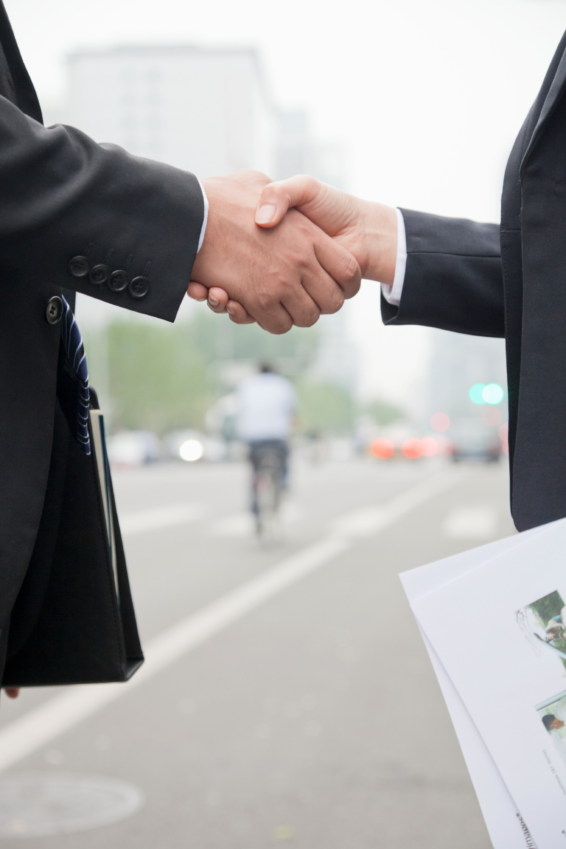
In Person
Ask questions about them and show interest in their responses.
Praise when possible.
Remember people’s names.
Make sure that your body language reinforces that you are interested
facing the individual
maintaining eye contact
not fidgeting
nodding as they speak

Slide 11
How Does It Work?
What is the worst first impression you’ve had? This person was a business coach who talked down to me.
Why? They thought the knew everything, never listened, and didn’t make eye contact.
What is the best first impression? This other business coach was great!
Why? He wore a funky suit, brought his own neat nametag, and ended up getting me a new customer by the end of the event.

Slide 12
Top Mistakes To Avoid
Lose your humility
Appear insincere
Act like a robot
Assuming that just showing is good enough
Making a bad first impression that forces you to work harder for the sale

Slide 13
Now What?
Smile
Think of others first
Be sincere
Practice
Learn from your mistakes

Slide 14
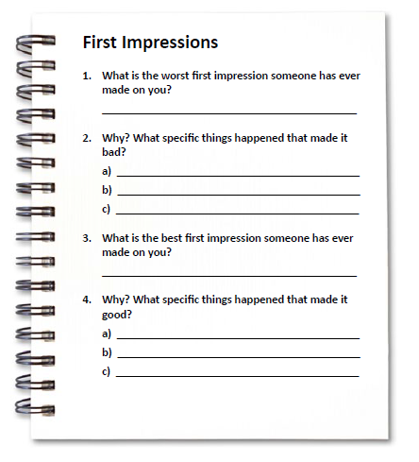
Worksheet
How does this work for your business?

Slide 15
Discussion: “How Could You Create The first Impression You Want to Create?”
Body language
Facial expressions
Listening
Dressing
Giving compliments, being generous
Tonality
Understanding
Remembering names

Slide 16
Key Points
For any occasion
Over the phone
In person
Example
What not to do
Your next steps
Wrap up

Slide 17
The Goal
Make a good first impression each and every time you meet someone.

Slide 18
You have less than 10 seconds to make an impact….so what will you do?

