Slide 1
Generate Interest
The best way to get your customer interested is to speak about what is important for them in a way they understand.

Slide 2
If they don’t care, why would they listen?

Slide 3
If they don’t understand, what you are saying won’t matter.

Slide 4
The Goal
Getting more people interested in your business.

Slide 5
Key Points
Identify what’s important
Using their language
Example
What not to do
Your next steps
Wrap up

Slide 6
Worksheet
Grab your worksheet and follow along.

Slide 7
Identify What’s Important
“What is the downside if this decision is not made?”
“How are my competitors handling this situation?”
“How is my personal performance measured?”

Slide 8
Discussion: “What’s Important to your customer?”
Do they have any deal breakers? If one of their criteria is not met, is it a ‘no’ deal?
Is there something that would make them want to learn more?
Is there something that is unusual or exceptionally different that could spark interest?

Slide 9
Discussion: “Can these be prioritized?”
Does this change over time?
If you only had 10 seconds, what one thing would you talk about?
Are the priorities for each customer the same?
What would be the benefit most frequently asked for?
What most frequently generated interest in the past?

Slide 10
Use Their Language
Simple words
Using the word ‘you’
Using benefits versus features.

Slide 11
Discussion: “Can this be catchier?”
Can this be more emotional? Can it focus on a pain or risk or huge opportunity for the customer?
Can emotional terminology be used?
Are there metaphors or analogies that would make it easier to remember?
Are there anecdotes or stories that illustrate the point?
Could it be shorter?
Could it be made simpler?
Could audio visuals or other senses be included?

Slide 12
How Does It Work? Cake Shop
What’s important to your customer?
Having an amazing event that has a great cake.
Change features into benefits:
Everyone who comes to the event finds it memorable.
Add in ‘you’: Your event is memorable.
Take out industry words: Your wedding is memorable.
Simplify it: Your wedding is talked about for years.

Slide 13
Top Mistakes To Avoid
Using buzzwords that are used internally or within the industry
Using ‘we’, ‘our’, ‘I’, etc.
Thinking only of what matters to you
Not getting to the main reason why they would care

Slide 14
Now What?
Talk about what your customers and/or their organizations care about.
Keep it simple.
Use the word ‘you’.
Believe in the message.

Slide 15
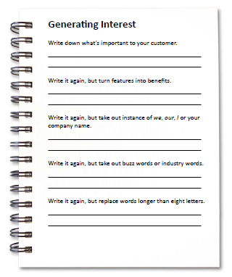
Worksheet
How does this work for your business?

Slide 16
Key Points
Identify what’s important
Using their language
Example
What not to do
Your next steps
Wrap up

Slide 17
The Goal
Getting more people interested in your business.

Slide 18
The best way to get your customer interested is to speak about what is important for them in a way they understand.

