Slide 1

Tradeshows
Tradeshows are a great form of learning and lead generation.

Slide 2

But they can be expensive, time consuming, and a lot of things can go wrong. How do you mitigate the downside?

Slide 3

The Goal
Ensure that your tradeshow investment pays off.

Slide 4

Key Points
Choose the right one
Go as an attendee
Prepare everything you can
Track your leads and follow-up
Make a budget and stick to it
Example
What not to do
Your next steps
Wrap up

Slide 5
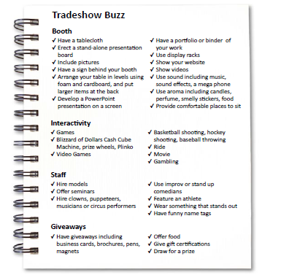
Worksheet
Grab your worksheet and follow along.

Slide 6

Choose the Right One

Slide 7

Discussion:
“What tradeshows are a good fit for your business?”
What is the price for a tradeshow booth?
Have you been to the tradeshow before?
What is the price for your display? Do you already have one?
What type of business do you expect to get from the tradeshow?
How much revenue do you expect to make from the tradeshow?

Slide 8

Go as an Attendee

Slide 9
Discussion:
“What tradeshows have you been to?”
What did you go to as an attendee?
What did you go to as a vendor?
What did you notice about the busy booths at these tradeshows?
What did you notice about the empty ones?

Slide 10

Prepare Everything You Can

Slide 11
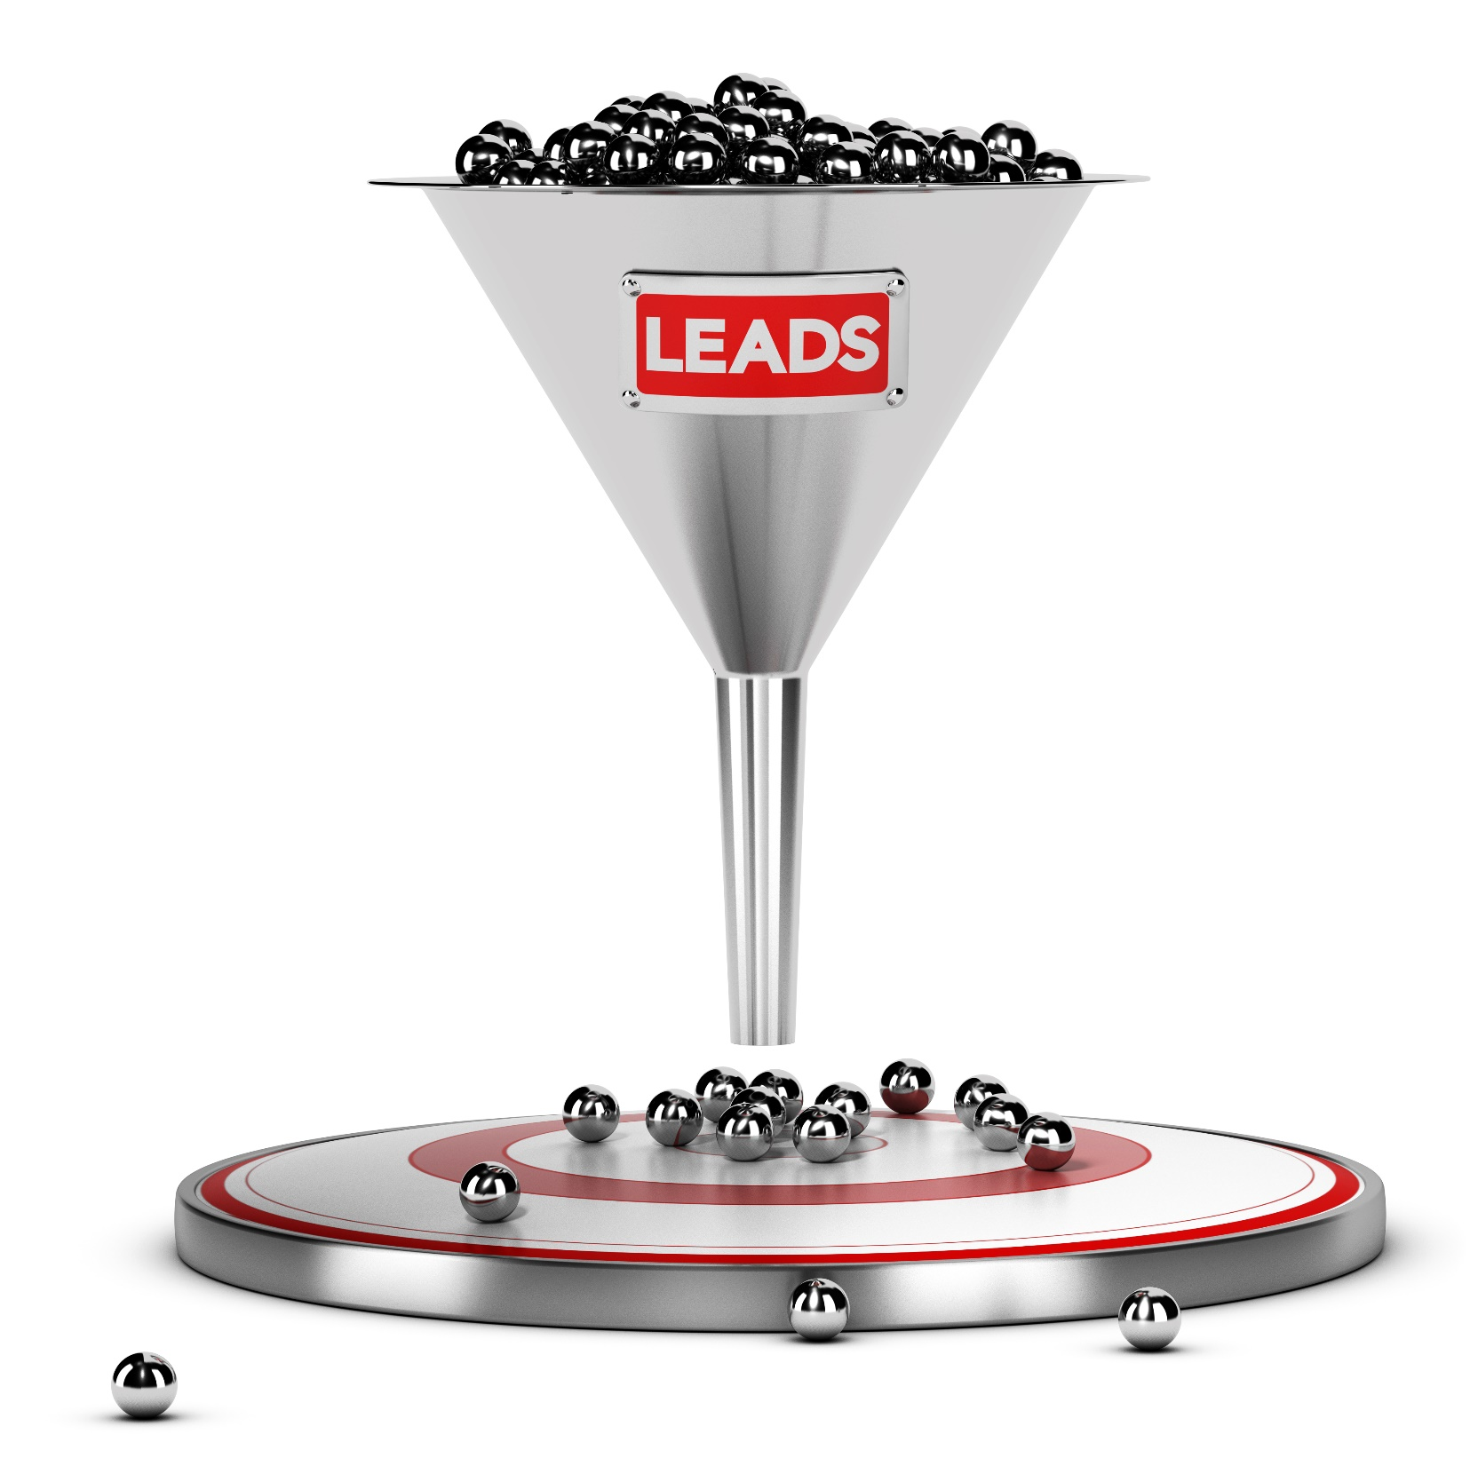
Track your leads and follow-up

Slide 12
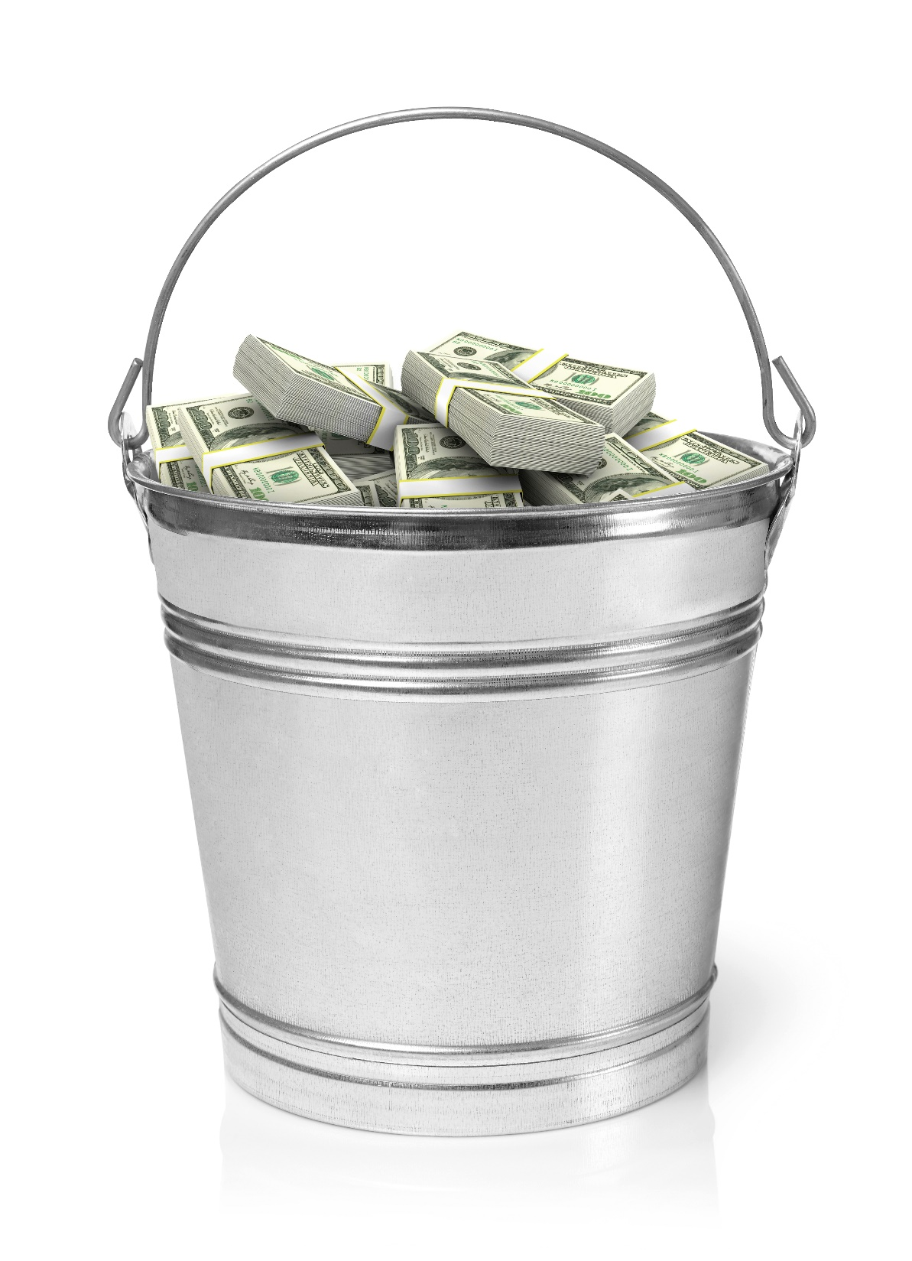
Make a budget and stick to it

Slide 13
How Does It Work? Hot tub business
Booth
Have a hot tub
Huge curtains of blue with a big sign
Interactivity
Have a picture zone where people can look like they are wearing bikinis
Staff
Hire models to swim in the pools
Giveaways
Give away plastic/waterproof playing cards with your logo on the back

Slide 14
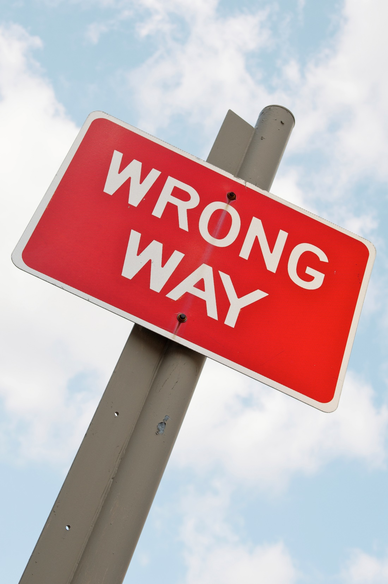
Top Mistakes To Avoid
Don’t show up without a plan
Don’t bother if you don’t have a way to stand out
Don’t go to a tradeshow you don’t understand or haven’t been to before
Don’t attend tradeshows your ideal customer won’t attend

Slide 15

Now What?
Make sure that you can get a return on your investment. Track the cost versus the potential sales.
Consider merely being an attendee.
Be extremely careful with your tradeshow staff selection and training as they can make or break your tradeshow experience

Slide 16
Discussion:
“How will you ensure your ROI?”
Will you collect emails?
How will you stand out from the crowd?
How will you entice people to your booth?
How will you ensure that potential customers are spoken with?
How will you ensure people remember your business?
How will you convert business at the show? Will you have a tradeshow special?

Slide 17
Worksheet
How does this work for your business?

Slide 18

Key Points
Choose the right one
Go as an attendee
Prepare everything you can
Track your leads and follow-up
Make a budget and stick to it
Example
What not to do
Your next steps
Wrap up

Slide 19

The Goal
Ensure that your tradeshow investment pays off.

Slide 20

Tradeshows are great when they work. Plan ahead and increase your chances.

