Slide 1

Social Media Impact
We all know the top sites out there, but how can we use them for business?

Slide 2

Can we use them for business?

Slide 3

Discussion: “What Can Social Media Do For My business?”
Does it help you manage your reputation?
Does it help you collect customer feedback?
Does it help you build a relationship with your customers or prospects?
Does it help you find industry information and new ideas?
Does it help you find suppliers and partners?

Slide 4

The Goal
Become more strategic when using social media.

Slide 5

Key Points
Facebook
Twitter
LinkedIn
YouTube
Example
What not to do
Your next steps
Wrap up

Slide 6
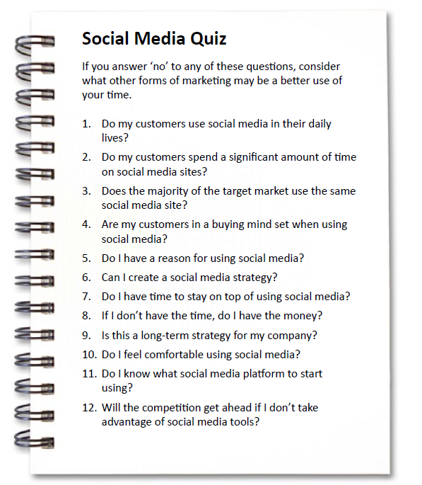
Worksheet
Grab your worksheet and follow along.

Slide 7

Facebook = grow & reward your customers

Slide 8

Twitter = monitor your brand

Slide 9

LinkedIn = be an expert and B2B sales

Slide 10

YouTube = 2nd largest search engine

Slide 11
Discussion: “How has Social Media Changed?”
Is your social media strategic?
Is your social media growing followers and fans?
Is your social media helping people find you?
Is your social media getting you incremental business?

Slide 12
How Does It Work? Dog Trainer
Do my customers use social media? Yes.
Do my customers spend a lot of time? Kids do.
Do they use the same type? Lots if different and new types. But all of them use Instagram.
Are they buying? No. Sharing pictures of their pets.
What is my reason to use it? Build a relationship. Get awareness and referrals rom their friends.
Do I have a strategy to do this? Share pictures of their pets on Instagram.
Do I have time? Yes.
If no time, do I have money? Not necessary
What’s the long term strategy? Pictures of dogs having fun, shows that I care about their pets.
Do I feel comfortable doing this? Yes.
What social media platform will I use? Instagram.
What is the risk in not using social media? No downside. This could be a competitive advantage.

Slide 13
Discussion: “What Is Your Social Media Strategy?”
What social media do you use?
How do you plan on managing this?
How do you measure your results?
What does success look like?
What are your future plans?

Slide 14

Top Mistakes To Avoid
Use it strategically or don’t use it at all.
Time is the biggest resource that is required.
Thinking that you need to be involved in every type of social media.
Don’t be afraid to change (content, approaches, time lines).

Slide 15

Now What?
Plan to keep with it for 6 months to test it.
Social media followers are only good for 6 months.
Use those that reach your target audience.
Create the strategy and measure the results.

Slide 16
Worksheet
How does this work for your business?

Slide 17

Key Points
Facebook
Twitter
LinkedIn
YouTube
Example
What not to do
Your next steps
Wrap up

Slide 18

The Goal
Become more strategic when using social media.

Slide 19

Just showing up won’t get you business. You need to be strategic.

