Slide 1

Integrated Marketing Strategy
Consistency helps your customer remember you.

Slide 2

Discussion:
“How Many Times Does My prospect Hear My Message Until They Buy?”
Are they on your email list for your email newsletter?
Are they on your call back list or email back list?
Have you spoken or written to them at least 3 times?
Are they following you through social media? How many types?
Do they walk past your store or advertising?

Slide 3

It takes 3 to 28 touch-points to get a sale!

Slide 4

The Goal
Increase the number of customer communication touchpoints you have.

Slide 5

Key Points
Select your target audience
Develop a message
Where is your target audience?
Develop your plan
Example
What not to do
Your next steps
Wrap up

Slide 6
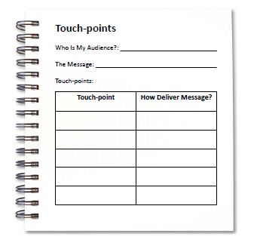
Worksheet
Grab your worksheet and follow along.

Slide 7

Select your target audience

Slide 8

Develop a message

Slide 9

Where is your target audience?

Slide 10

Develop your plan

Slide 11
How Does It Work? Dog Trainer
Who is my audience? Dog Owners
The message: Your dog is our business.
Touch-point | How To Deliver?
Adoption centres | Sponsorship of centre
Dog parks | Vest on own dog
Website | Dog blog

Slide 12
Discussion:
“How Many times Does My Existing Customer Hear me?”
Do they get reports?
Do they get newsletters or emails? Do they follow you using social media?
Is there an orientation or onboarding process for your customers?
Do they get invitations to events?
Do you send Thank You cards or Birthday cards?
Do they get invoices?

Slide 13
Discussion:
“Am I Missing out On Opportunities?”
Are there ways to communicate unexpectedly?
Are there ways to get repeat business?
Are there ways to get more business from the customers I have?
Are there ways to get referrals?
Are there ways to build loyalty?

Slide 14
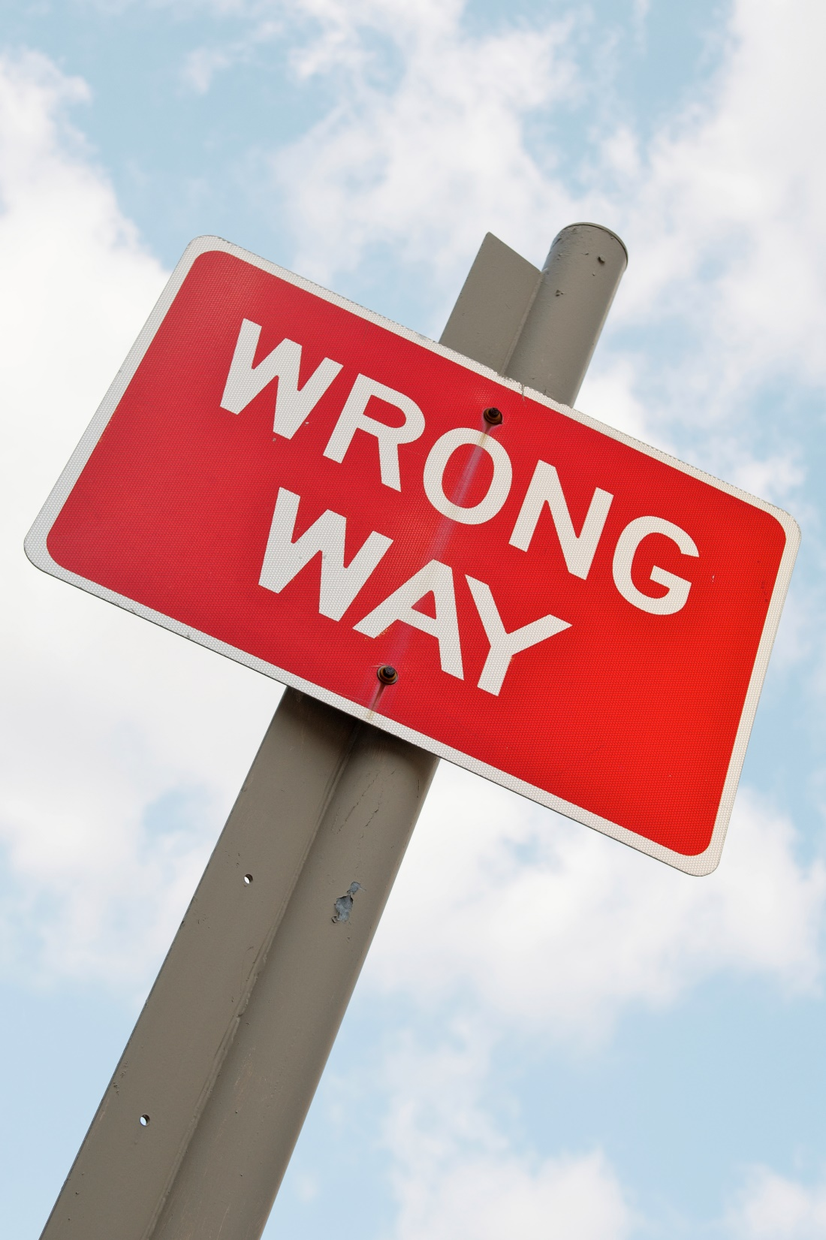
Top Mistakes To Avoid
Don’t forget your existing customers!
Thinking that one form of communication will reach your customer
Thinking that your customer only needs to hear from you once

Slide 15

Now What?
Using more than one communication tool strengthens your message.
Planning on using multiple tools, but not implementing is worse than only choosing a few communication tools.
Over communicate!!

Slide 16
Worksheet
How does this work for your business?

Slide 17
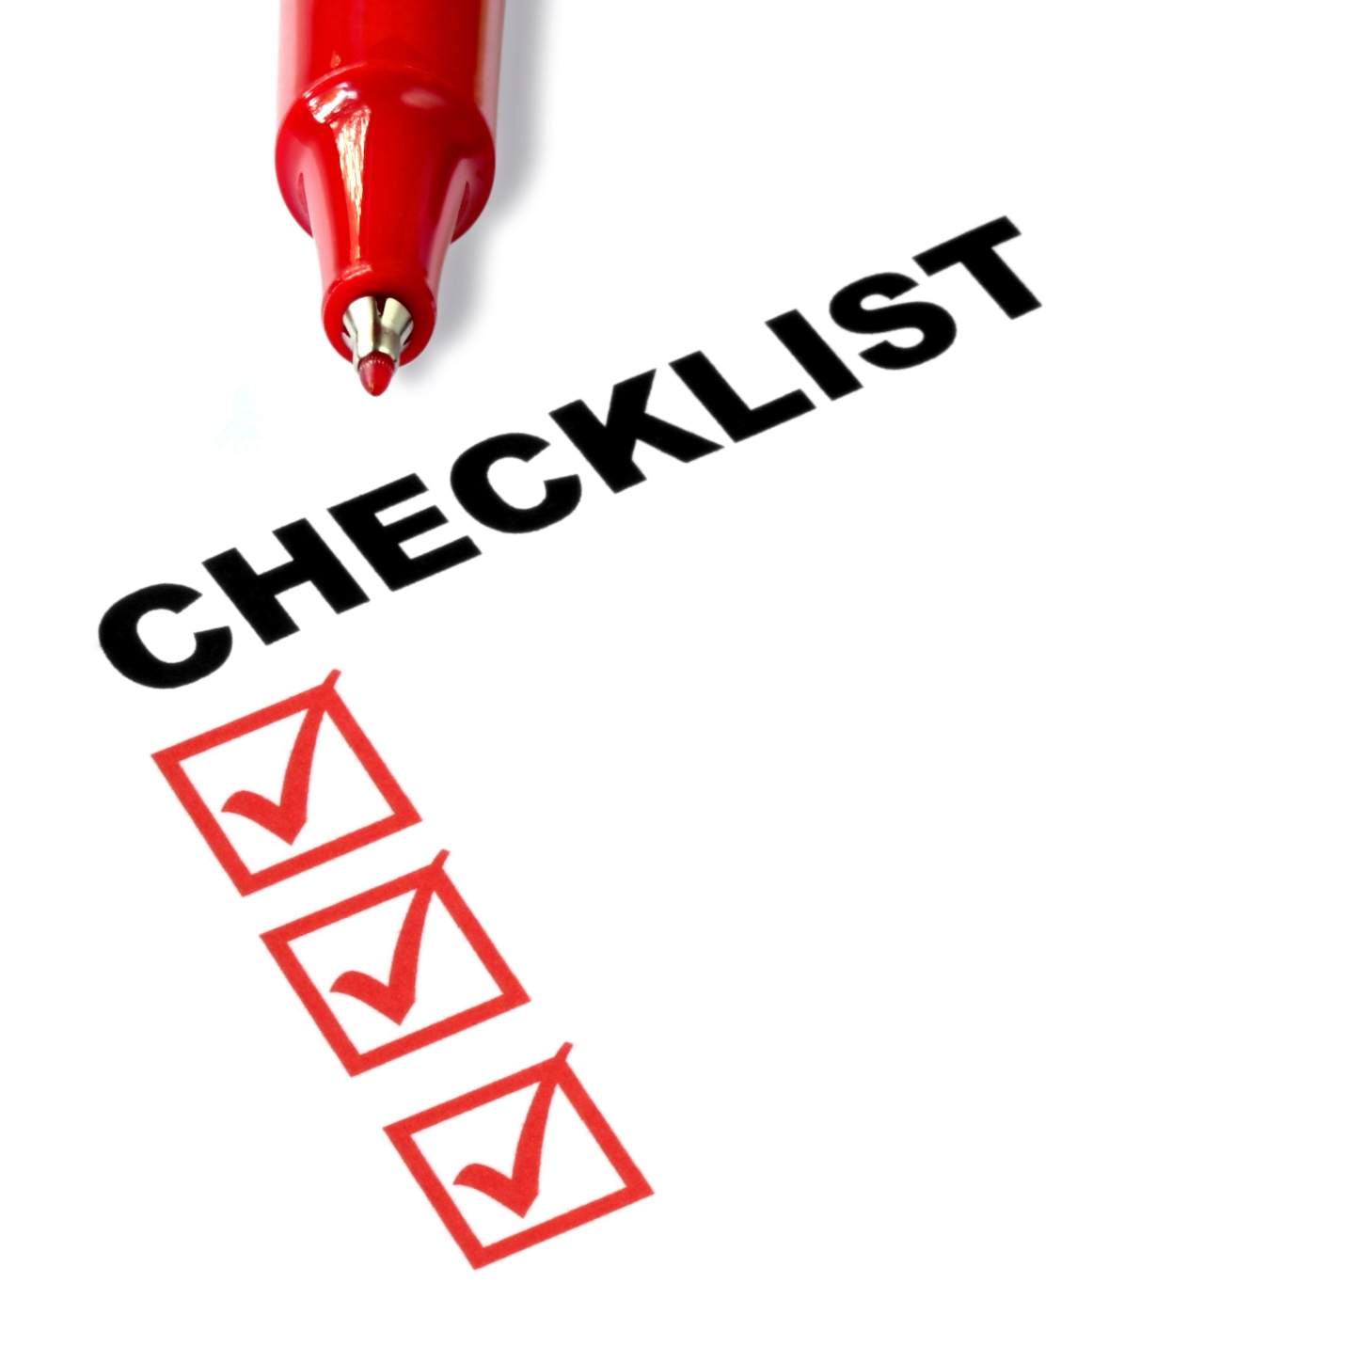
Key Points
Select your target audience
Develop a message
Where is your target audience?
Develop your plan
Example
What not to do
Your next steps
Wrap up

Slide 18

The Goal
Increase the number of customer communication touchpoints you have.

Slide 19

Consistency helps your customer remember you.
www.SmallBusinessSolver.com © 2016

