Slide 1
Drip Marketing
Email marketing can accomplish many different marketing goals.
www.SmallBusinessSolver.com © 2016

Slide 2
But only if it has the right stuff.
www.SmallBusinessSolver.com © 2016

Slide 3
Discussion: “What is an email worth?”
How many times do you contact someone before you close them?
How many emails can you send out in a year?
How many things can you add to an email?
www.SmallBusinessSolver.com © 2016

Slide 4
The Goal
Have a successful email strategy.
www.SmallBusinessSolver.com © 2016

Slide 5
Key Points
Why an email?
Plan your email
Distribution lists
Find the right email tool
Monitor analytics
Refine delivery
Example
What not to do
Your next steps
Wrap up
www.SmallBusinessSolver.com © 2016

Slide 6
Worksheet
Grab your worksheet and follow along.
www.SmallBusinessSolver.com © 2016

Slide 7
Why an email?

Slide 8
Plan your email

Slide 9
Distribution lists

Slide 10
Find the right email tool

Slide 11
Monitor analytics

Slide 12
Discussion: “How do you know that it is working?”
Are you tracking open rates? This is how many people actually open up the email that was sent to them.
Are you tracking subscribers and un-subscribers? Do you know what is driving this?
Are you tracking click-throughs? This is how many people are using the links that are included in your emails.
Are you tracking conversions? This is how many people are actually buying or performing another action that you are asking them to do in your emails. Other actions should be asking for a free ebook or registering for a webinar?
www.SmallBusinessSolver.com © 2016

Slide 13
Refine delivery

Slide 14
How Does It Work? Website Firm
Good morning Clara,
It was great to meet you at the networking event last Wednesday.
You mentioned that you were concerned that your website needed some work. I would like to offer you a free assessment of your website that we’d normally charge $500 for.
Please let me know your website address and if you’d like us to take a look.
Thank you,
Susan Jones
Jones Web Design is a custom website building business that puts your business on the map. Never wonder if your website is working again!
www.SmallBusinessSolver.com © 2016

Slide 15
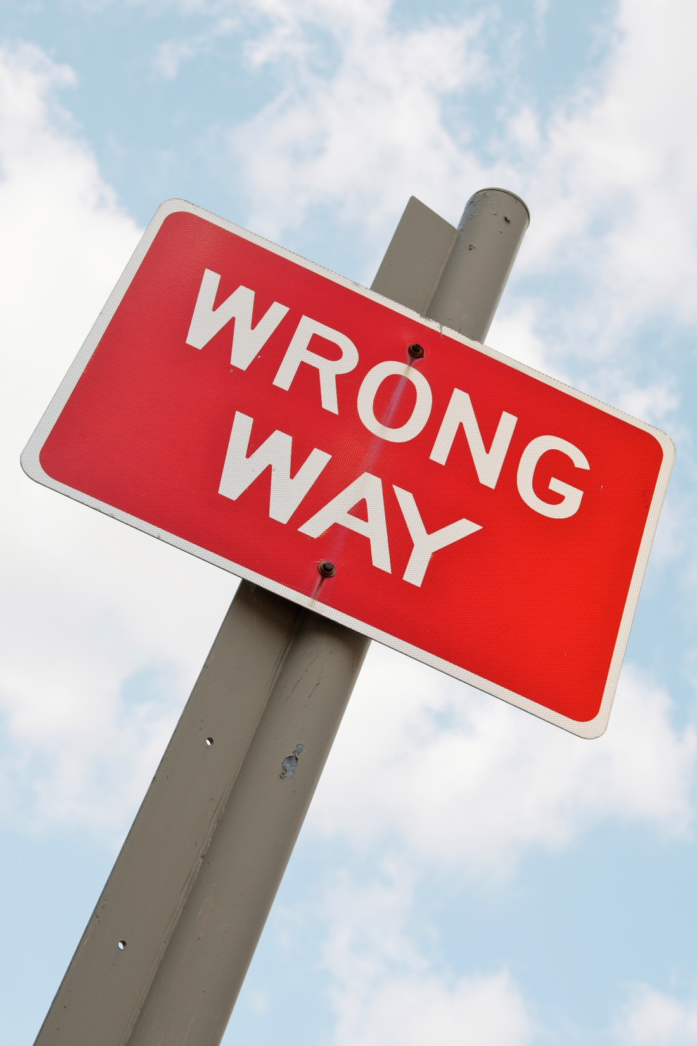
Top Mistakes To Avoid
Don’t send too many emails
Don’t send emails that don’t help the people you are sending them to
Don’t cross promote
70% of sales happen because of follow-up. Don’t forget to follow-up!
www.SmallBusinessSolver.com © 2016

Slide 16
Now What?
Make sure you have a reason to develop an email campaign
Getting legitimate emails and protecting privacy is important to people
Getting the reader to opt-in is important (allowing them to opt-out is just as important)
Quality of the readership is just as important as the quantity of readers
www.SmallBusinessSolver.com © 2016

Slide 17
Discussion: “How do you make emails even better?”
Do you have different lists? Ability to send more custom information?
Can you personalize the information?
Can you shorten the message?
Is there more emotional language that could be added?
Have you ever thought of sending something physical instead?
www.SmallBusinessSolver.com © 2016

Slide 18
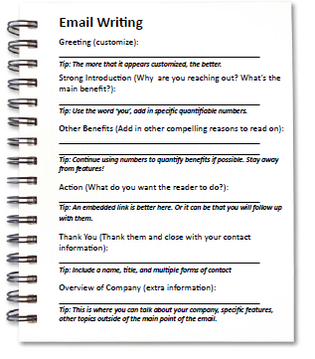
Worksheet
How does this work for your business?
www.SmallBusinessSolver.com © 2016

Slide 19
Key Points
Why an email?
Plan your email
Distribution lists
Find the right email tool
Monitor analytics
Refine delivery
Example
What not to do
Your next steps
Wrap up
www.SmallBusinessSolver.com © 2016

Slide 20
The Goal
Have a successful email strategy.
www.SmallBusinessSolver.com © 2016

Slide 21
Emails are the best follow up to convert a sale!
www.SmallBusinessSolver.com © 2016

