Slide 1
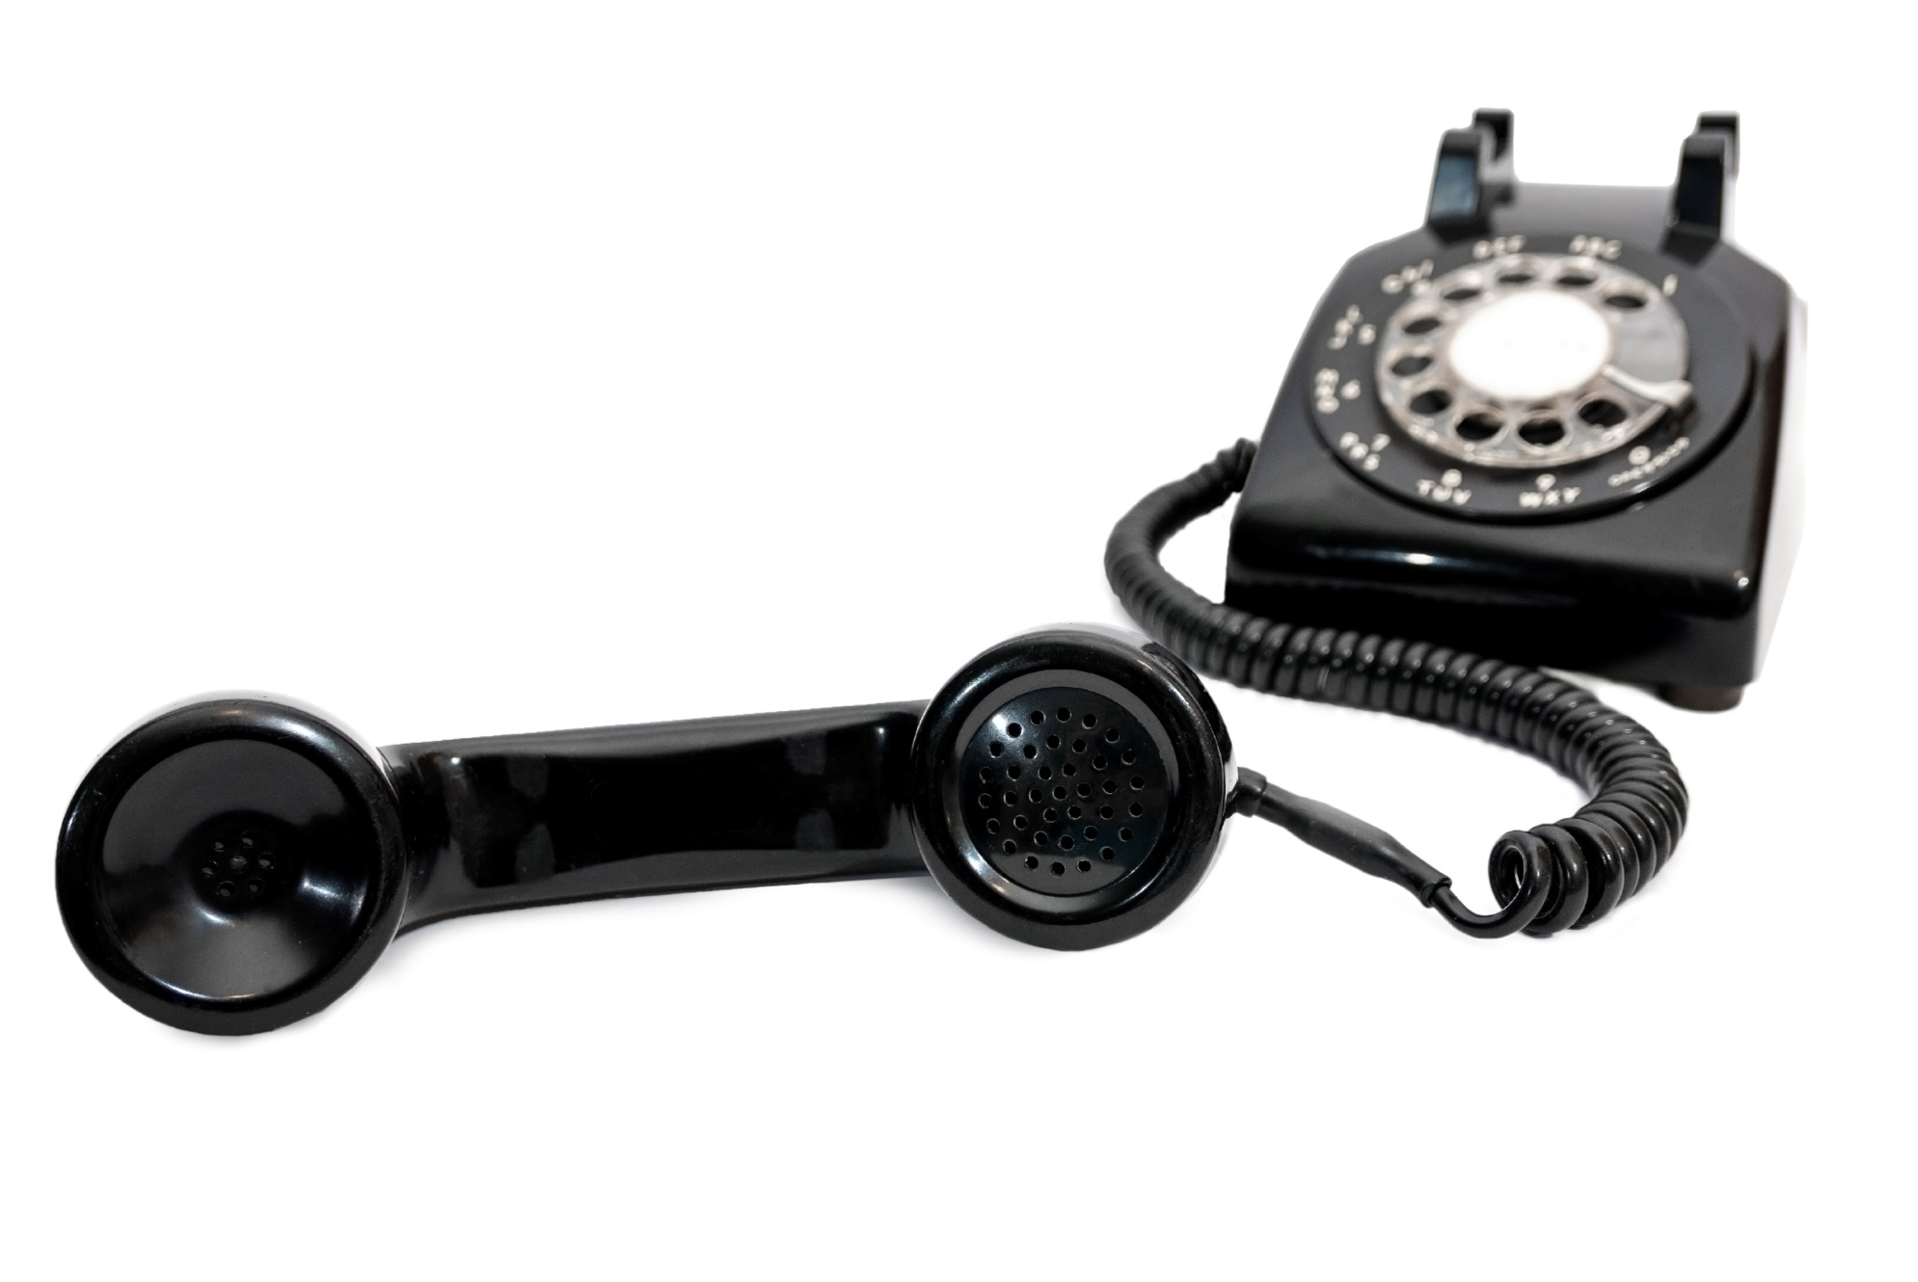
Inside Sales
Cold calling. These are two words that fill most people with dread.
www.SmallBusinessSolver.com © 2016

Slide 2
The best sales people think about what their customers are thinking first.
Would your customers be upset if you called them during dinner?
Would your customer listen if you read a script?
Would your customers prefer to talk to a human with a personality during unobtrusive hours?
www.SmallBusinessSolver.com © 2016

Slide 3
The Goal
Thinking more about your customers to make you a better caller.
www.SmallBusinessSolver.com © 2016

Slide 4
Key Points
Be optimistic
Relax
Answer quickly
Test the waters
Follow up
Example
What not to do
Your next steps
Wrap up
www.SmallBusinessSolver.com © 2016

Slide 5
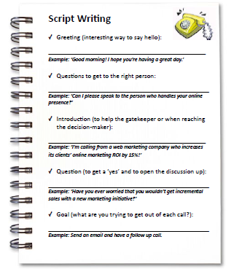
Worksheet
Grab your worksheet and follow along.
www.SmallBusinessSolver.com © 2016

Slide 6
Discussion: “Who are you calling?”
Are you speaking with executives or VPs?
Are you speaking with marketing, IT, purchasing, or another department?
Are they potential partners that you could be working with rather than customers?
Are they large organizations or very small?
www.SmallBusinessSolver.com © 2016

Slide 7
Be Optimistic

Slide 8
Relax

Slide 9
Discussion: “How do you handle the gatekeeper?”
Is the gatekeeper a helper? Are they there to actually get you to the right person internally?
Is the gatekeeper a stopper? Are they there to prevent you from wasting people’s time?
Is the gatekeeper indifferent? Are they simply picking up the phone and rely on you to direct them?
Do you have a tactic for each type of gatekeeper?
www.SmallBusinessSolver.com © 2016

Slide 10
Answer Quickly

Slide 11
Test the Waters

Slide 12
Discussion: “What is the point of the call?”
Are you trying to simply generate interest, get awareness, or gather contact information?
What is the goal of your call?
What will be the goal of the next call?
www.SmallBusinessSolver.com © 2016

Slide 13
Follow Up

Slide 14
How Does It Work? Association
Good morning! I hoe you’re having a great day!
Can I please speak to the person who handles association memberships?
I’m calling from the local chamber where we help local businesses help each other. We find that new members typically see 10% increase in revenue in their first year with us.
Have you ever considered ways to work more with other local businesses?
We’d love to come and visit you to explore some of your ideas.
www.SmallBusinessSolver.com © 2016

Slide 15
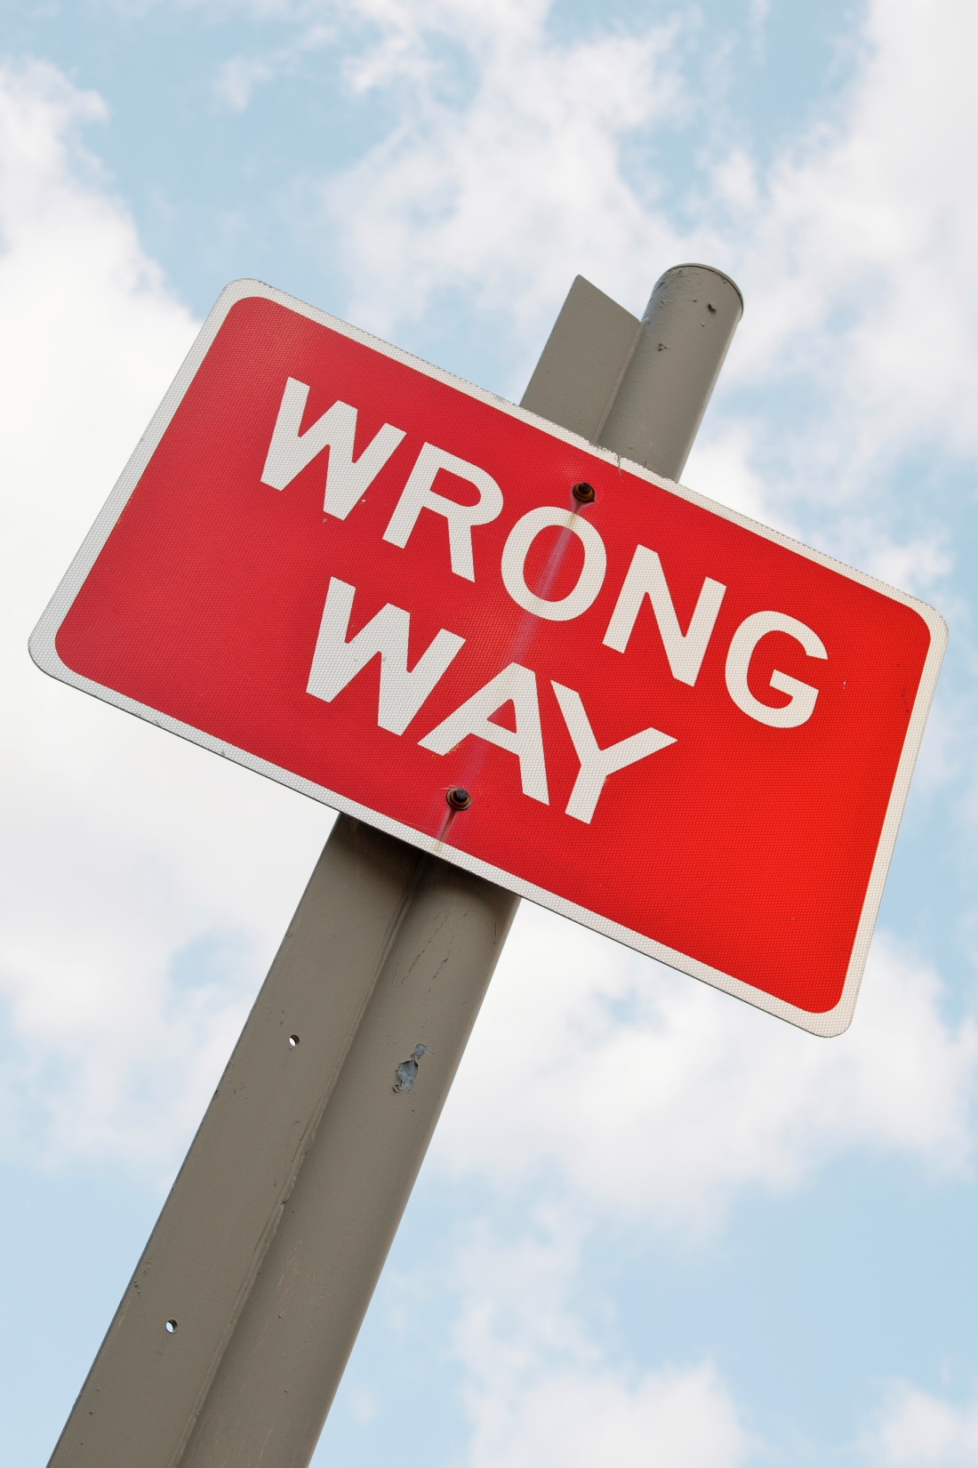
Top Mistakes To Avoid
A negative attitude. You need to think you are helping people.
Speaking in monotone. Practice!
Delaying picking up the phone. The first call is the toughest.
www.SmallBusinessSolver.com © 2016

Slide 16
Now What?
The best way to learn is to pick up the phone.
The worst thing that could happen is that you don’t get business, which is where you are at now.
The hardest part is being able to bounce back from rejection.
Come up with ways to keep motivated.
www.SmallBusinessSolver.com © 2016

Slide 17
Worksheet
How does this work for your business?
www.SmallBusinessSolver.com © 2016

Slide 18
Key Points
Be optimistic
Relax
Answer quickly
Test the waters
Follow up
Example
What not to do
Your next steps
Wrap up
www.SmallBusinessSolver.com © 2016

Slide 19
The Goal
Thinking more about your customers to make you a better caller.
www.SmallBusinessSolver.com © 2016

Slide 20
Don’t delay picking up the phone! The first call is the hardest.
www.SmallBusinessSolver.com © 2016

