Slide 1
Lead List Testing
After generating a list, the only true way to know if it works is to use it.
www.SmallBusinessSolver.com © 2016

Slide 2
Sometimes a list gets stale.
www.SmallBusinessSolver.com © 2016

Slide 3
The Goal
Find out if your lead list is good or bad.
www.SmallBusinessSolver.com © 2014

Slide 4
Discussion: “Are you willing to pick up the phone?”
Who is the best person to do this? You?
When are you going to start?
How are you going to sell in the long run?
How else can you get direct feedback?
www.SmallBusinessSolver.com © 2016

Slide 5
Key Points
Why lead lists go stale
What you need to test
Example
What not to do
Your next steps
Wrap up
www.SmallBusinessSolver.com © 2016

Slide 6
Worksheet
Grab your worksheet and follow along.
www.SmallBusinessSolver.com © 2016

Slide 7
Why Do Lead Lists Go Stale?
Outdated database information.
Your own old list.
Incorrect records.
Incorrectly sorted information.
www.SmallBusinessSolver.com © 2016

Slide 8
What do you need to test?
Are prospects qualified?
Are the contacts correct?
How should I be contacting them?
www.SmallBusinessSolver.com © 2016

Slide 9
Discussion: “What are you hearing?”
Are they interested? Why are they interested?
What are their objections?
What are their questions?
Are different types of customer more interested than others? Why are they?
www.SmallBusinessSolver.com © 2016

Slide 10
How Does It Work? Cleaners
List Name: City offices
Start Date: January
End Date: April
Question | Total # | %
How many contacts are on the list? | 354 | 100%
# of qualified prospects | 100 | 28%
# of correct contacts | 80 | 67%
# you have reached out to | 120 | 34%
# of interested prospects | 15 | 13%
Does this list have value? | Yes
www.SmallBusinessSolver.com © 2016

Slide 11
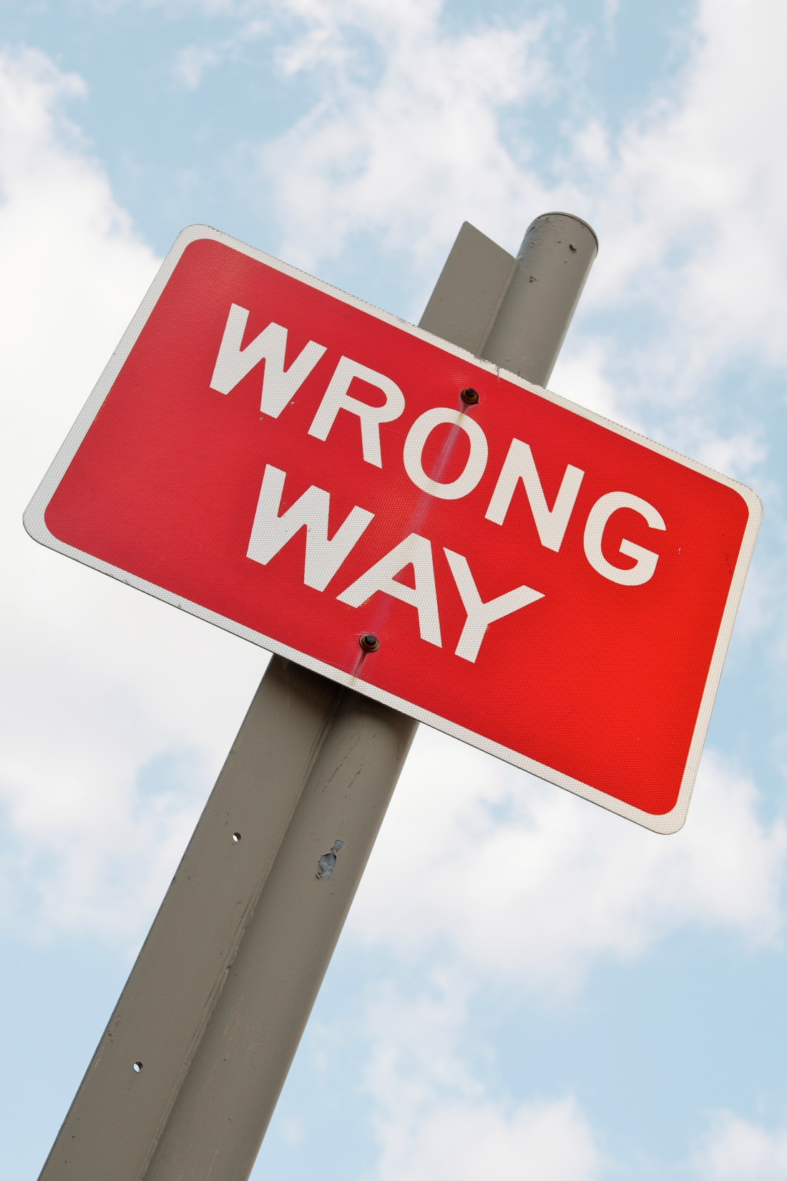
Top Mistakes To Avoid
Not testing a lead list
Using a lead list for too long without results
Calling a short lead list for a long period of time
Assuming that small changes in how you create a lead list won’t make a big difference
Forgetting to test your message
www.SmallBusinessSolver.com © 2016

Slide 12
Now What?
Don’t delay to start getting the word out about your business, as that only delays when the sales cycle starts.
The only way to truly know if it works, is to see if people pay you for it.
Don’t throw good money after bad. If it doesn’t work, don’t put money into it simply because you hope this will help to recoup losses. Put money in because you think you can get a return on the new money.
www.SmallBusinessSolver.com © 2016

Slide 13
Discussion: “How are you tweaking the message?”
Can questions be addressed upfront?
Can objections be avoided?
Are there times of the day that work better?
When it works, did you do something differently?
www.SmallBusinessSolver.com © 2016

Slide 14
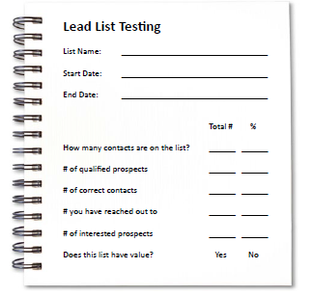
Worksheet
How does this work for your business?
www.SmallBusinessSolver.com © 2016

Slide 15
Key Points
Why lead lists go stale
What you need to test
Example
What not to do
Your next steps
Wrap up
www.SmallBusinessSolver.com © 2016

Slide 16
The Goal
Find out if your lead list is good or bad.
www.SmallBusinessSolver.com © 2016

Slide 17
After generating a list, the only true way to know if it works is to use it.
www.SmallBusinessSolver.com © 2016

