Slide 1
Building Good Customer Relationships
People buy from people they like.

Slide 2
Discussion: “How Important Are Customer Relationships For Your Business?”
Where are you a repeat customer? Why do you shop there? What are reasons why you’d stop going there?
Have you ever given someone a referral?
Why did you refer the business?
What was the tipping point (the point at which you went out of your way to give the referral)?
What would be the benefit of getting a referral?

Slide 3
The Goal
Have a rapport building strategy.

Slide 4
Key Points
First Impressions
Building The Relationship
Keeping It Strong
Example
What not to do
Your next steps
Wrap up

Slide 5
Worksheet
Grab your worksheet and follow along.

Slide 6
First Impressions

Slide 7
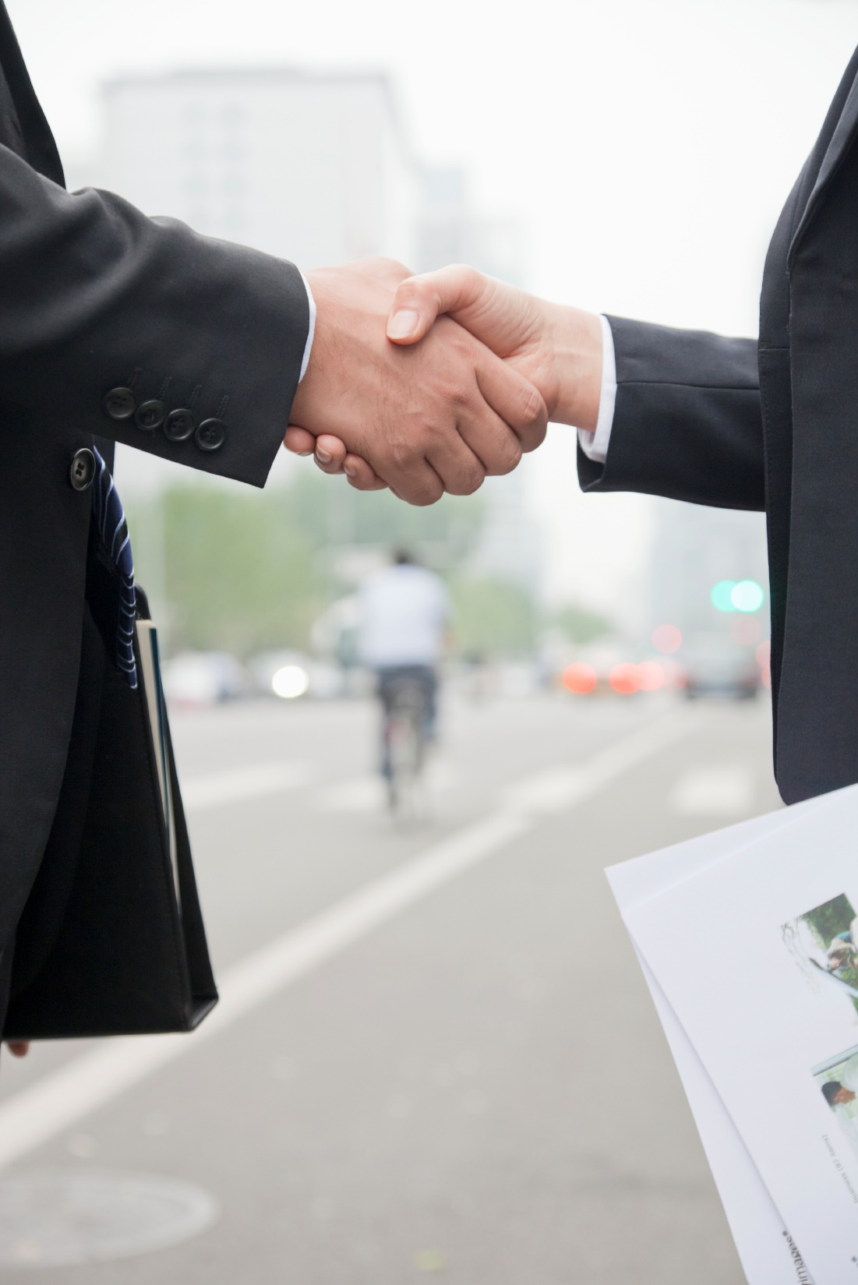
Building The Relationship

Slide 8
Keeping It Strong

Slide 9
Discussion: “How Do You Avoid Dissatisfied Customers?”
Have you ever walked out of a store without buying something 100% because of the bad service?
What did the employee do or not do that caused you to leave?
How could the situation have been avoided?
How can you apply that learning to your own business?
What are some ways that you can mitigate any negative interactions (billing, collection, service issues)?

Slide 10
How Does It Work?
First Impression
Match their talking speed, tone, vocabulary and volume
Mirror their body language and breathing patterns
Assume that they are your friend and treat them that way
Remember their name
Smile
Building the Relationship
Give without expectation
Relax
Laugh and have fun
Remember details about them
Ongoing
Show humility
Be sincere and have integrity
Remain consistent
Follow up

Slide 11
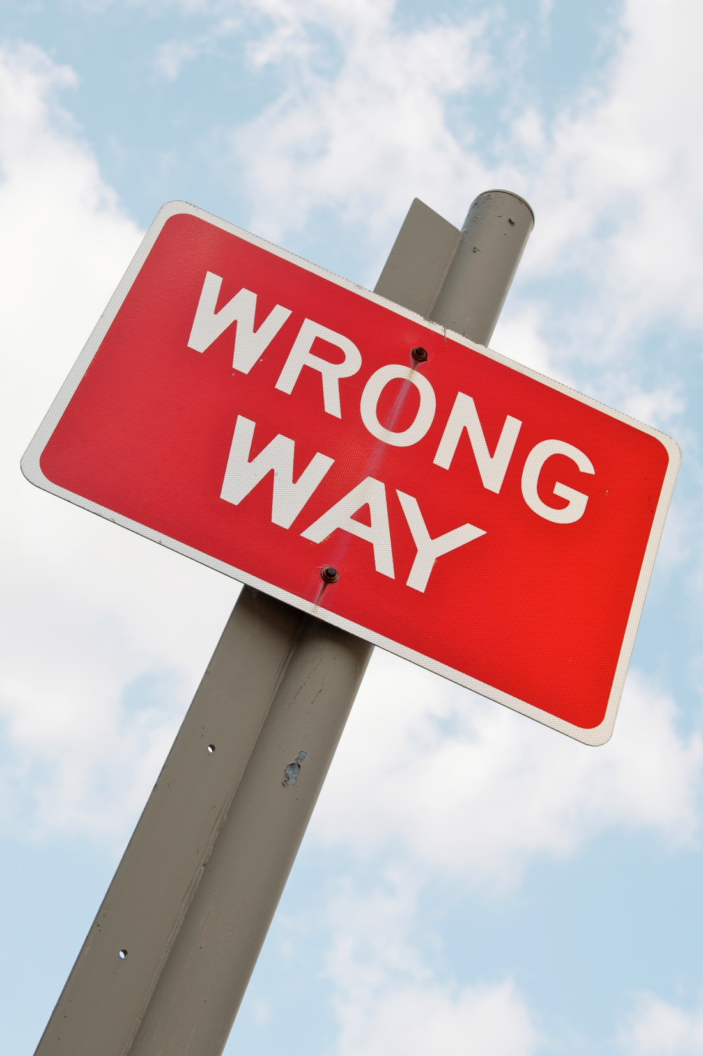
Top Mistakes To Avoid
Assuming that the buying process is logical.
Believing that rapport is a natural thing and doesn’t take any work.
Believing that rapport is a natural thing and not trying to build it.

Slide 12
Now What?
Be genuine.
Smile.
Follow up.
Learn to tell stories, stats, facts, or jokes well. You might even read a book about how to make any awkward situation dissolve.
Make note of the names of a client’s spouse, children, and pet(s) in addition to personal events (holidays, birthdays).
Bring up the fact that you listened and you care. For example, “Please say Happy 5th Birthday to your son Joe.” This type of activity further illustrates that you listen, you care and that we are all human.

Slide 13
Discussion: “How Do You Form Customer Relationships Today?”
Have you ever bought something you weren’t 100% sure that you needed, but you liked the sales person?
Why do you think people buy from people they like? Why do you buy from people you like?
Who is the most likeable person at your company/business? If you are a solopreneur, who is the most likeable person that you know? Why do you think that is?
How can you start building better relationships with your customers?
What do you think is the most likeable thing about yourself?
What are ways in the long run that you can further improve you likeability?
If you were going to start doing one thing to be more likeable, what would that be?

Slide 14
Worksheet
How does this work for your business?

Slide 15
Key Points
First Impressions
Building The Relationship
Keeping It Strong
Example
What not to do
Your next steps
Wrap up

Slide 16
The Goal
Have a rapport building strategy.

Slide 17
Listen.
Be Human.
Remember Names.

