Slide 1
Lead List Generation
No matter how you plan to reach out to customers, you need to start with a list.
www.SmallBusinessSolver.com © 2016

Slide 2
The better the list, the more sales you’ll get.
www.SmallBusinessSolver.com © 2016

Slide 3
Discussion: “How big does your list need to be?”
If you only close 1% of your list, would that be enough business?
Is 1% what your close rate is, can you adjust this?
Does your list include channel partners who each represent multiple customers? This would result in a shorter list.
www.SmallBusinessSolver.com © 2016

Slide 4
The Goal
Creating better lead lists to start your selling process off right.
www.SmallBusinessSolver.com © 2016

Slide 5
Key Points
What is searchable?
Find databases
Example
What not to do
Your next steps
Wrap up
www.SmallBusinessSolver.com © 2016

Slide 6
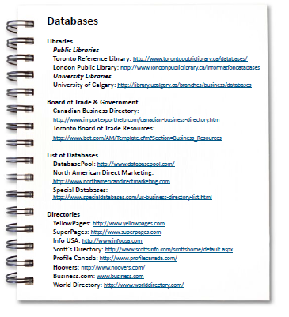
Worksheet
Grab your worksheet and follow along.
www.SmallBusinessSolver.com © 2016

Slide 7
What is searchable?
www.SmallBusinessSolver.com © 2016

Slide 8
Find databases!
www.SmallBusinessSolver.com © 2016

Slide 9
Discussion: “What if your list isn’t big enough?”
Are there other target markets that you could reach out to? Do you need to create a second list?
Are there channel partners to reach out to?
Do you need to reassess your sales target or your business concept? Is this a good idea?
Is your list too big? Do you have twice as many contacts as you need? Is there a way to focus on the ones that are more ideal than others?
www.SmallBusinessSolver.com © 2016

Slide 10
How Does It Work? Painter
What is the searchable criteria?
Size of home (square footage)
Number of rooms
Just moved into area
What are the databases?
Local mailing lists / post office
Real estate postings
www.SmallBusinessSolver.com © 2016

Slide 11
Top Mistakes To Avoid
Having too small a list
Not using any criterion
Spending money on calling or emailing a list, when you didn’t spend money on developing the list
Not worrying about how you are going to use a list
www.SmallBusinessSolver.com © 2016

Slide 12
Now What?
Create a lead list using at least 2 criterion.
Start with a lead list of 300 or more customers.
Understand what customers you don’t want to work with up-front.
Make sure that you have as much information as possible prior to reaching out to a prospect
www.SmallBusinessSolver.com © 2016

Slide 13
Discussion: “How do you manage your database as it grows and is updated?”
Are you doing one region at a time? This is less upfront cost and gives you time to test your approach.
Are you creating an exhaustive list upfront? This would result in less duplication and a lower cost per contact.
Are you storing this list within a CRM? Or using a cloud tool to help your sales representative update the information remotely?
www.SmallBusinessSolver.com © 2016

Slide 14
Worksheet
How does this work for your business?
www.SmallBusinessSolver.com © 2016

Slide 15
Key Points
What is searchable?
Find databases
Example
What not to do
Your next steps
Wrap up
www.SmallBusinessSolver.com © 2016

Slide 16
The Goal
Creating better lead lists to start your selling process off right.
www.SmallBusinessSolver.com © 2016

Slide 17
No matter how you plan to reach out to customers, you need to start with a list.
www.SmallBusinessSolver.com © 2016

