Slide 1
Qualifying
A qualified customer
falls within your target market, needs your product or service, has the money (or ability) to pay for it, and is a customer with whom it makes sense for your company to work.
www.SmallBusinessSolver.com © 2016

Slide 2
Discussion: “How much time do unqualified customers take?”
What percentage of your list is expected to be unqualified?
How long does each meeting or interaction take you?
How many prospects do you have on your list to contact?
What’s the total number that you get when you multiple these together?
www.SmallBusinessSolver.com © 2016

Slide 3
Too many companies spend marketing/sales time and money going after customers who are simply not qualified.
www.SmallBusinessSolver.com © 2016

Slide 4
The Goal
Having the ability to better qualify your customers upfront.
www.SmallBusinessSolver.com © 2016

Slide 5
Key Points
Is this customer within your target market?
Do they need your product or service?
Can they afford it?
Do you want to work with them?
Example
What not to do
Your next steps
Wrap up
www.SmallBusinessSolver.com © 2016

Slide 6
Worksheet
Grab your worksheet and follow along.
www.SmallBusinessSolver.com © 2016

Slide 7
Is this customer within your target market?
www.SmallBusinessSolver.com © 2016

Slide 8
Do They Need Your Product or Service?
www.SmallBusinessSolver.com © 2016

Slide 9
Can They Afford It?
www.SmallBusinessSolver.com © 2016

Slide 10
Do You Want To Work With Them?
www.SmallBusinessSolver.com © 2016

Slide 11
Discussion: “What are your qualifiers?”
Can the prospect afford it? Do they have the budget?
Is their strategy aligned making them willing to pay for your product or service?
Do they have the correct IT requirements? Or other infrastructure that is required?
Are they easy to work with? Do you have to convert to their processes or is there flexibility with any integration?
Will they love it? Will you retain them as customers or will this be simply a single transaction?
www.SmallBusinessSolver.com © 2016

Slide 12
How Does It Work? Bookkeeper
My ideal customer is:
Organized
On time
Making more than $80,000 annually
Target market | Do they need it? | Can they afford it? | Are they ideal?
Zuper Furniture store | Yes – lots of transactions | Yes. High revenues. | Yes
Hamburg-you Restaurants | Yes – lots of transactions | Some can. | No.
Beauty salon wholesalers | No – not a lot of transactions | Yes. | No
www.SmallBusinessSolver.com © 2016

Slide 13
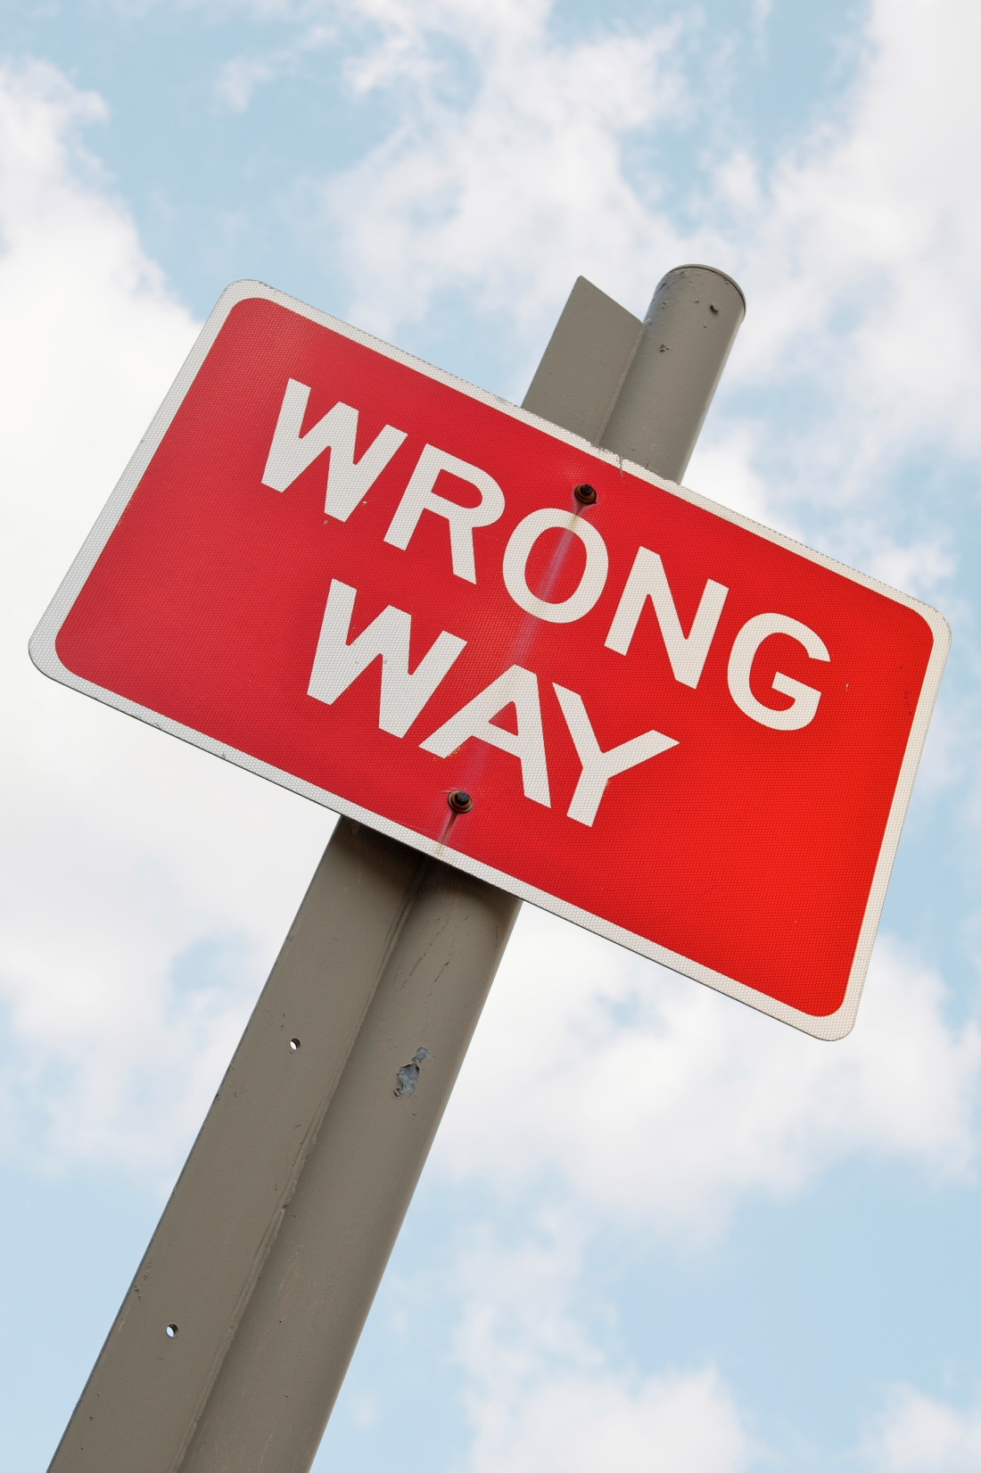
Top Mistakes To Avoid
Trying to sell to everyone
Not testing if someone can afford it
Not qualifying upfront
www.SmallBusinessSolver.com © 2016

Slide 14
Now What?
Selling to qualified customers is easier.
Selling to customers who already accept that they have a need is easier than selling the need itself.
Saying no to the wrong customers will save you time and make you money.
www.SmallBusinessSolver.com © 2016

Slide 15
Discussion: “How can you do this qualification upfront?”
Are there customer lists with this information? Even if it costs money, it might be worth it.
Are there upfront questions you can ask quickly to qualify customers?
www.SmallBusinessSolver.com © 2016

Slide 16
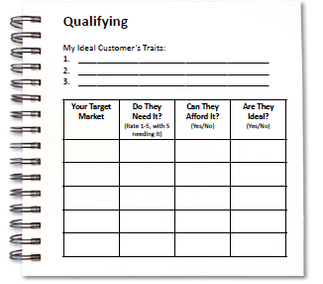
Worksheet
How does this work for your business?
www.SmallBusinessSolver.com © 2016

Slide 17
Key Points
Is this customer within your target market?
Do they need your product or service?
Can they afford it?
Do you want to work with them?
Example
What not to do
Your next steps
Wrap up
www.SmallBusinessSolver.com © 2016

Slide 18
The Goal
Having the ability to better qualify your customers upfront.
www.SmallBusinessSolver.com © 2016

Slide 19
A qualified customer
falls within your target market, needs your product or service, has the money (or ability) to pay for it, and is a customer with whom it makes sense for your company to work.
www.SmallBusinessSolver.com © 2016

