Slide 1
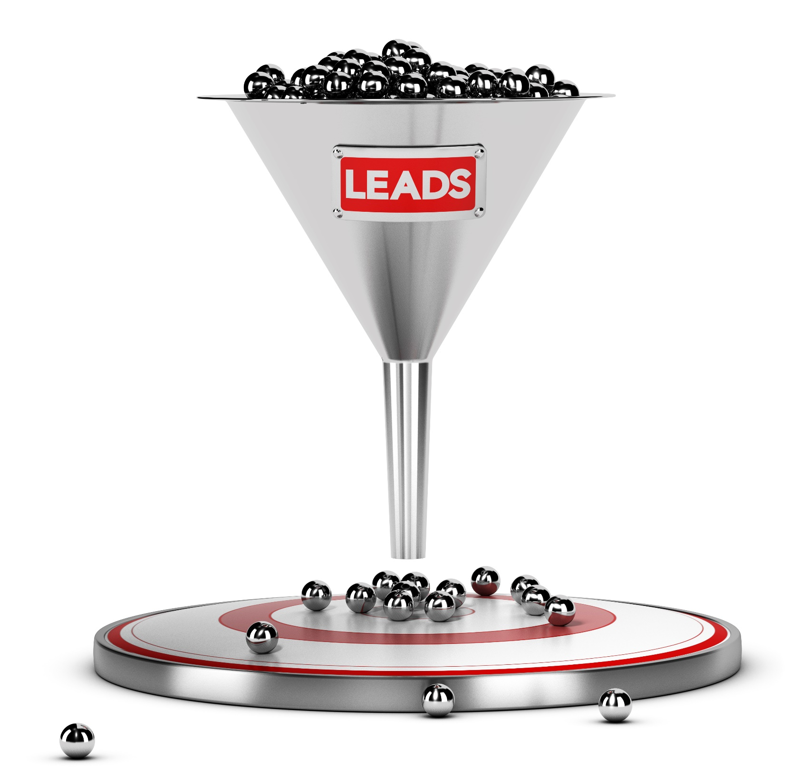
The Sales Funnel
The sales funnel drives your sales
and helps to refine your sales strategy.
www.SmallBusinessSolver.com © 2016

Slide 2
But it also assists finance and operations to plan—if they know what is coming down the pipeline, they can scale up or down to adjust.
www.SmallBusinessSolver.com © 2016

Slide 3
The Goal
Identify where and how to improve conversion rates.
www.SmallBusinessSolver.com © 2016

Slide 4
Discussion: “What does your sales funnel look like?”
What are the stages of your sales
funnel? Do you have a…
Qualified stage?
Awareness stage?
Interested stage?
Ready stage?
Closed stage?
Other?
How long does each stage of your sales funnel typically take? Could any of these be shortened?
How many prospects are you able to manage at each stage?
www.SmallBusinessSolver.com © 2016

Slide 5
Key Points
Qualify
Awareness
Interest
Close
Follow-up
Example
What not to do
Your next steps
Wrap up
www.SmallBusinessSolver.com © 2016

Slide 6
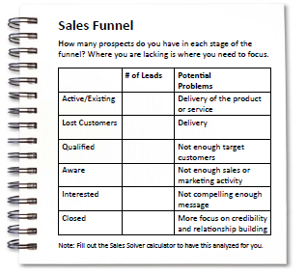
Worksheet
Grab your worksheet and follow along.
www.SmallBusinessSolver.com © 2016

Slide 7
Qualify
www.SmallBusinessSolver.com © 2016

Slide 8
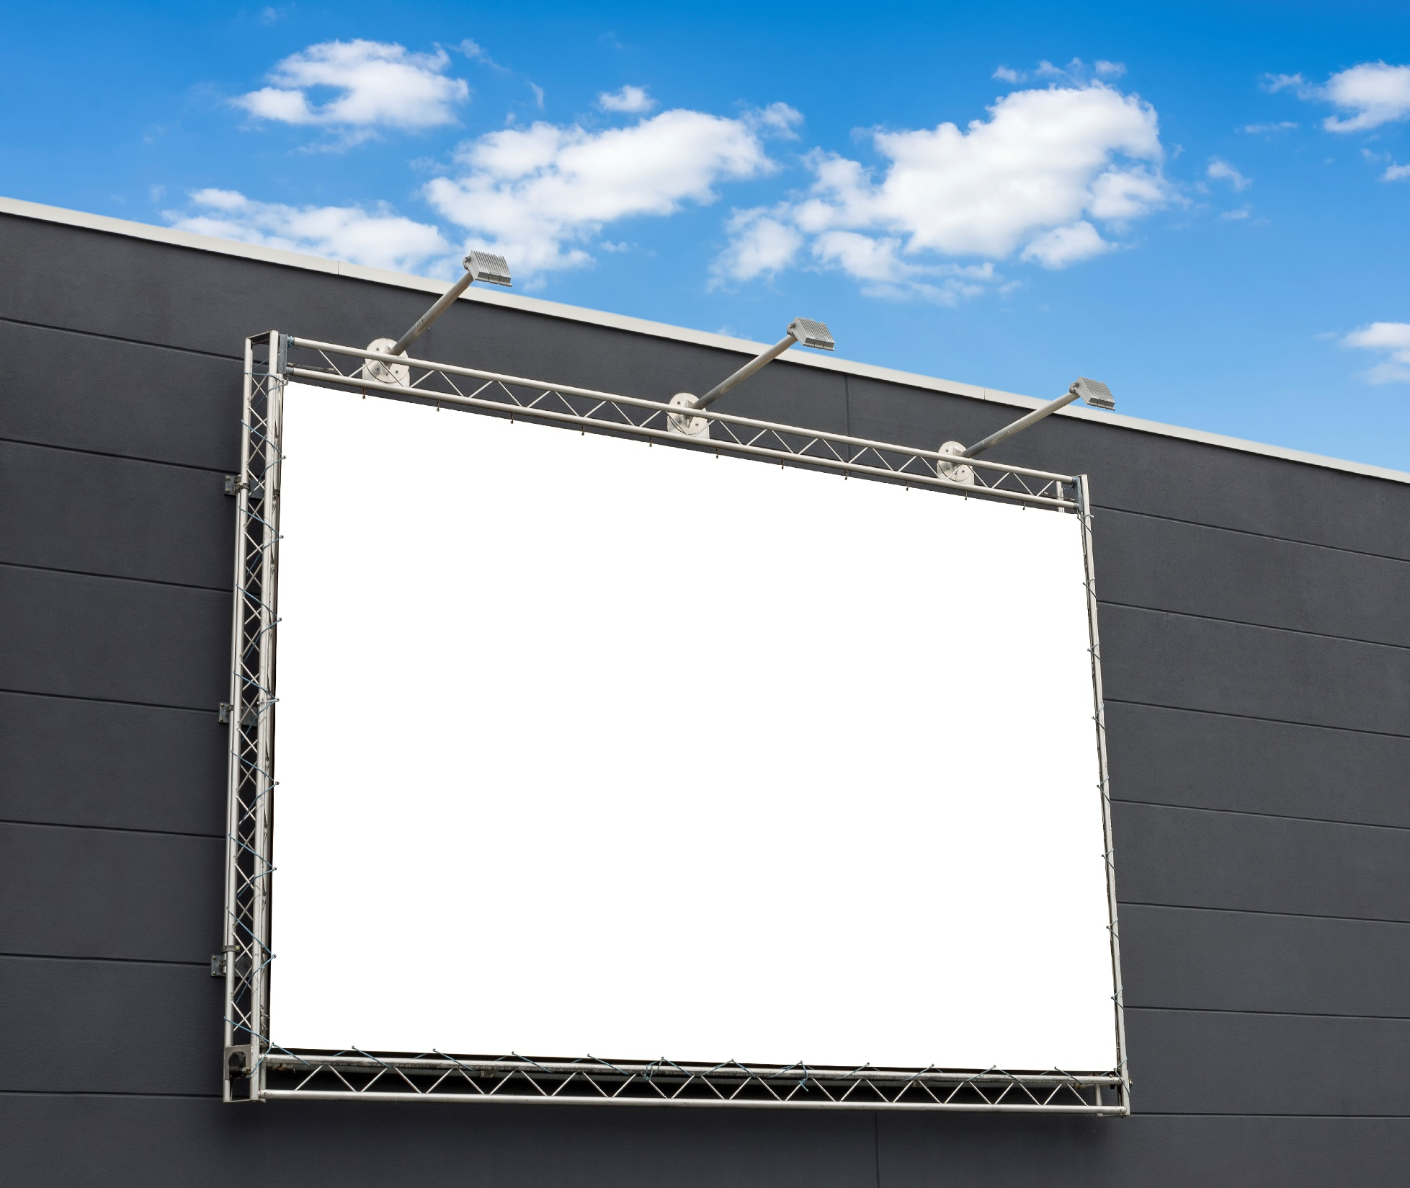
Awareness
www.SmallBusinessSolver.com © 2016

Slide 9
Discussion: “How do you keep your sales funnel healthy?”
How do you get new prospects into the funnel?
How do you spend time on moving prospects through the funnel?
How do you keep up momentum for your sales funnel?
How do you manage your time prioritization in new prospects versus hot leads?
www.SmallBusinessSolver.com © 2016

Slide 10
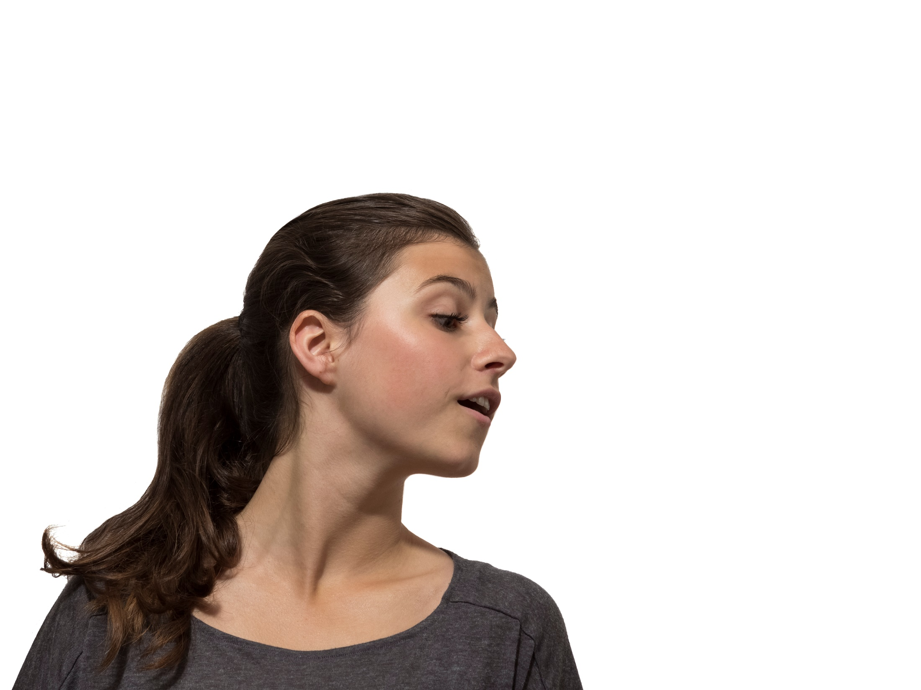
Interest
www.SmallBusinessSolver.com © 2016

Slide 11
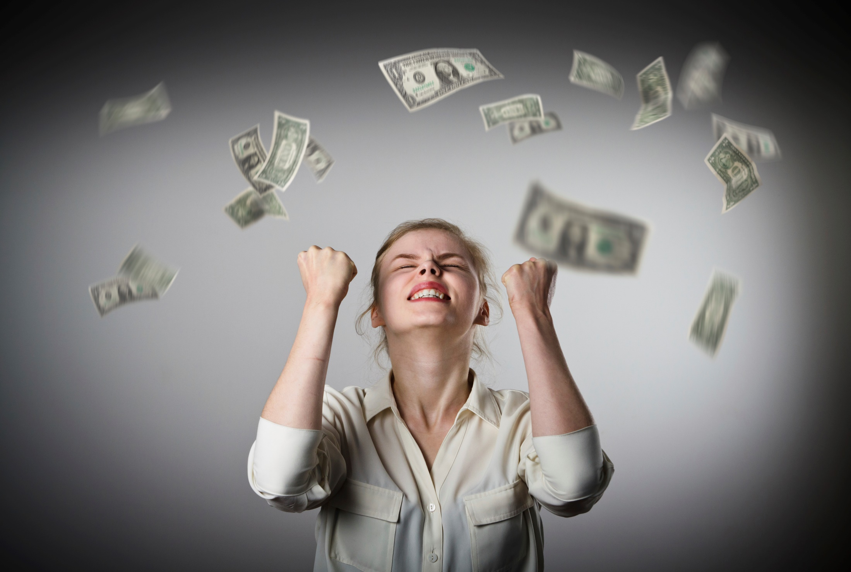
Close
www.SmallBusinessSolver.com © 2016

Slide 12
Discussion: “How do you focus on the higher priority sales prospects?”
Is there anything that you can automate in your sales funnel? Can you send out bulk email follow ups? Send out bulk thank you cards? Host a customer appreciation night for all of your customers at once?
Is there any part of your sales funnel that you could outsource? Can you hire an assistant? Can you hire a sales person? Can you outsource your drip marketing?
www.SmallBusinessSolver.com © 2016

Slide 13
Follow-Up
www.SmallBusinessSolver.com © 2016

Slide 14
How Does It Work? Marketing Firm
 | # of Leads | Potential Problems
Active/Existing | 4 | Delivery of the product or service
Lost Customers | 1 | Delivery
Qualified | 10,000 | Not enough target customers
Aware | 200 | Not enough sales or marketing activity
Interested | 50 | Not compelling enough message
Closed | 6 | More focus on credibility and relationship building
www.SmallBusinessSolver.com © 2016

Slide 15
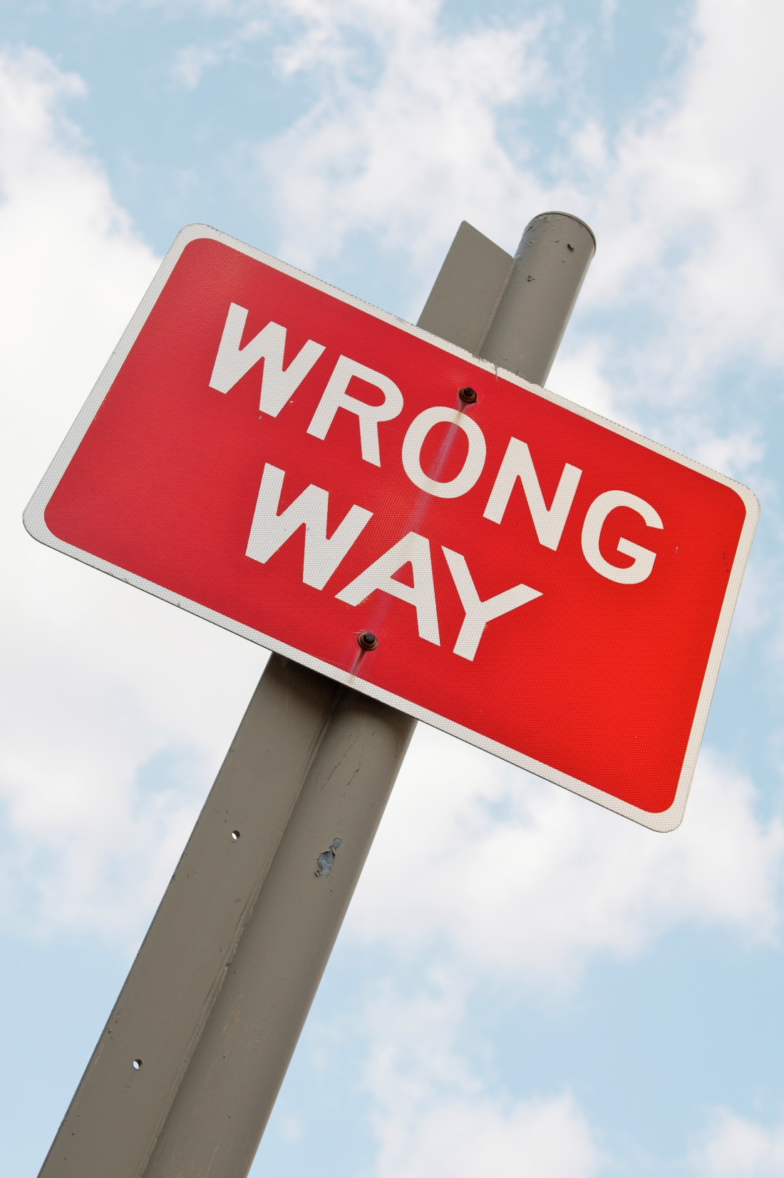
Top Mistakes To Avoid
Don’t use the sales funnel as a shield. It is an indicator, but the ultimate success is a close (a win).
Not measuring your sales funnel results.
Not communicating your sales funnel to others in your business.
www.SmallBusinessSolver.com © 2016

Slide 16
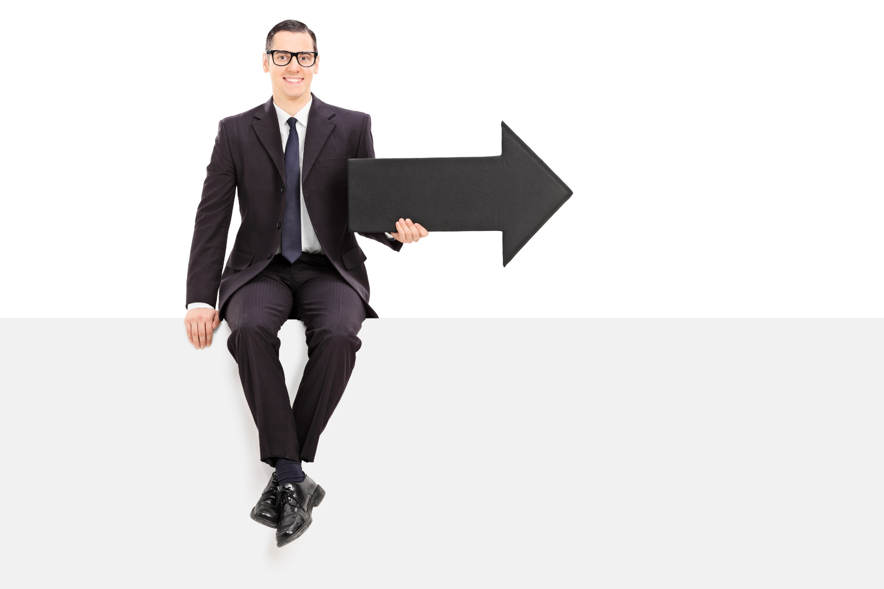
Now What?
Larger customers and bigger sales (called whales) take longer to reach the close phase.
Fill your funnel with plenty of smaller sales (minnows) to even out your results over the year.
The sales funnel helps to measure success and goals.
Things to measure for each stage are:
How many leads you have,
The probability of the sale, and
The amount of revenue or profitability in each stage.
www.SmallBusinessSolver.com © 2016

Slide 17
Worksheet
How does this work for your business?
www.SmallBusinessSolver.com © 2016

Slide 18
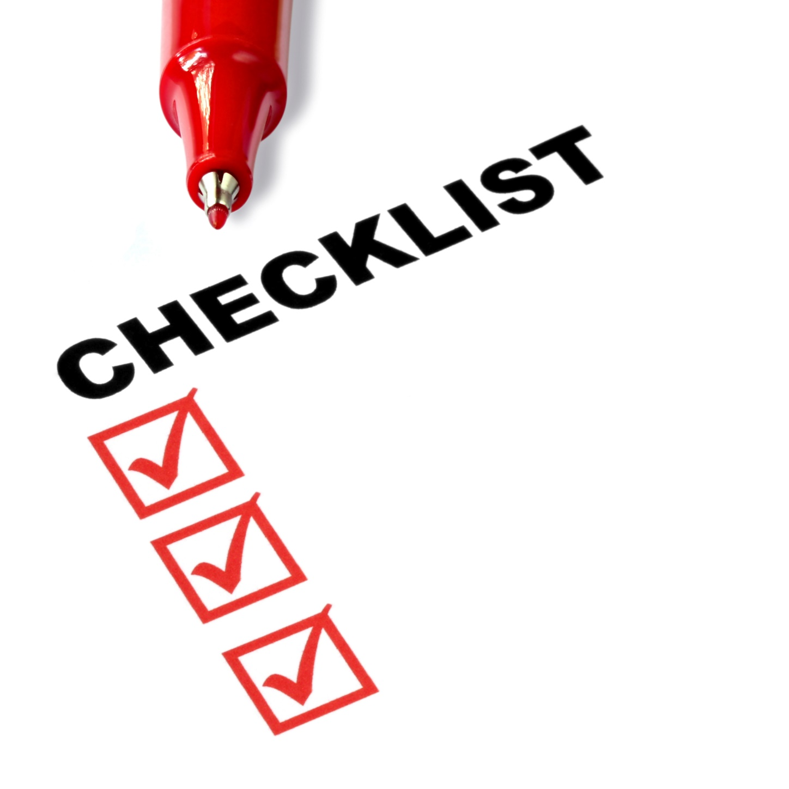
Key Points
Qualify
Awareness
Interest
Close
Follow-up
Example
What not to do
Your next steps
Wrap up
www.SmallBusinessSolver.com © 2016

Slide 19
The Goal
Identify where and how to improve conversion rates.
www.SmallBusinessSolver.com © 2016

Slide 20
The sales funnel drives your sales
and helps to refine your sales strategy.
www.SmallBusinessSolver.com © 2016

