Slide 1
The Buying Group
There is often more than just one person involved.
www.SmallBusinessSolver.com © 2016

Slide 2
When selling, you need to be aware of these different players, who you are already working with, who you don’t have access to, and who you should be speaking with.
www.SmallBusinessSolver.com © 2016

Slide 3
The Goal
Understand all of the players in a sale.
www.SmallBusinessSolver.com © 2016

Slide 4
Discussion: “Who are all your customers?”
Who are all the people that use your product or service?
Who influences the decision?
Who pays for it?
Who is accountable for the decision?
www.SmallBusinessSolver.com © 2014

Slide 5
Key Points
The initiator
The influencer
The decider
The buyer
The user
The gatekeeper
Example
What not to do
Your next steps
Wrap up
www.SmallBusinessSolver.com © 2016

Slide 6
Worksheet
Grab your worksheet and follow along.
www.SmallBusinessSolver.com © 2016

Slide 7
Initiator
www.SmallBusinessSolver.com © 2016

Slide 8
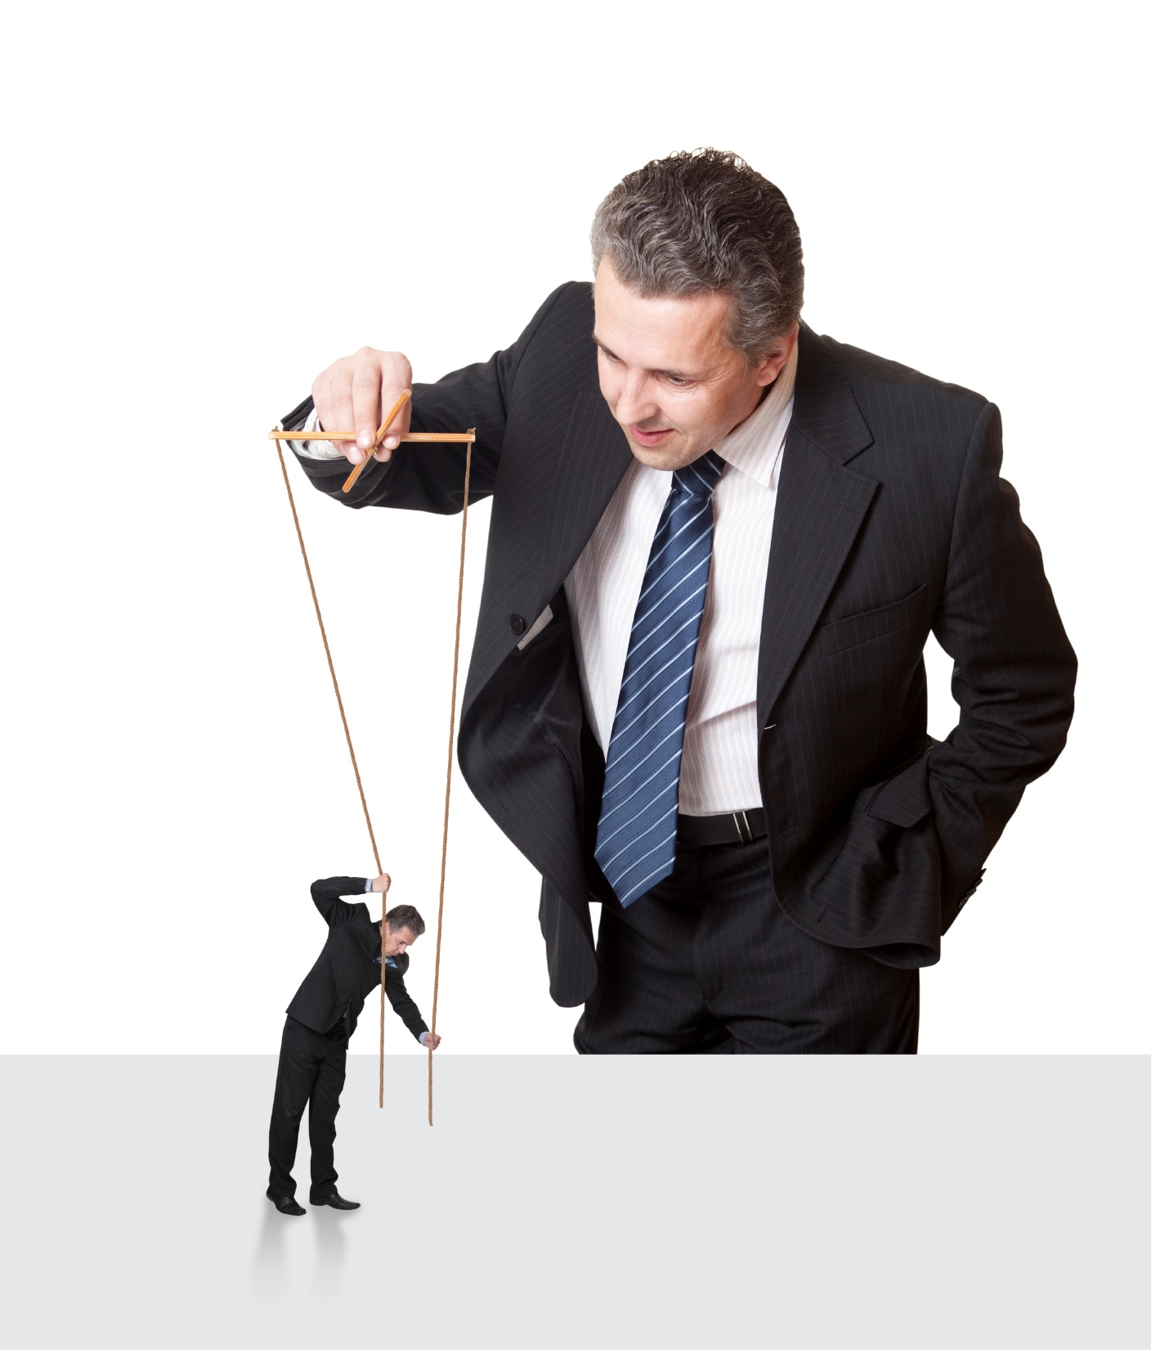
Influencer
www.SmallBusinessSolver.com © 2016

Slide 9
Decider
www.SmallBusinessSolver.com © 2016

Slide 10
Buyer
www.SmallBusinessSolver.com © 2016

Slide 11
User
www.SmallBusinessSolver.com © 2016

Slide 12
Gatekeeper
www.SmallBusinessSolver.com © 2016

Slide 13
Discussion: “What do your customers care about?”
What does the decision maker care about?
What does the payer care about?
What does the end user care about?
What does the gatekeeper care about?
www.SmallBusinessSolver.com © 2016

Slide 14
How Does It Work? Consultant
Buying Group Role | People’s Names | Concerns
Initiator | Sonya | Being rewarded Moving it forward Being allowed to recommend ideas in future
Influencer | Thomas | Best solution for money based on their criteria of: New ideas and future of business
Decider | Rakesh | Minimal risk Team is behind decision
Buyer | Susanne | - Following their process or following yours properly
User | Harold | Easy Effective
Gatekeeper | Pete | Helping external people navigate the system
www.SmallBusinessSolver.com © 2016

Slide 15
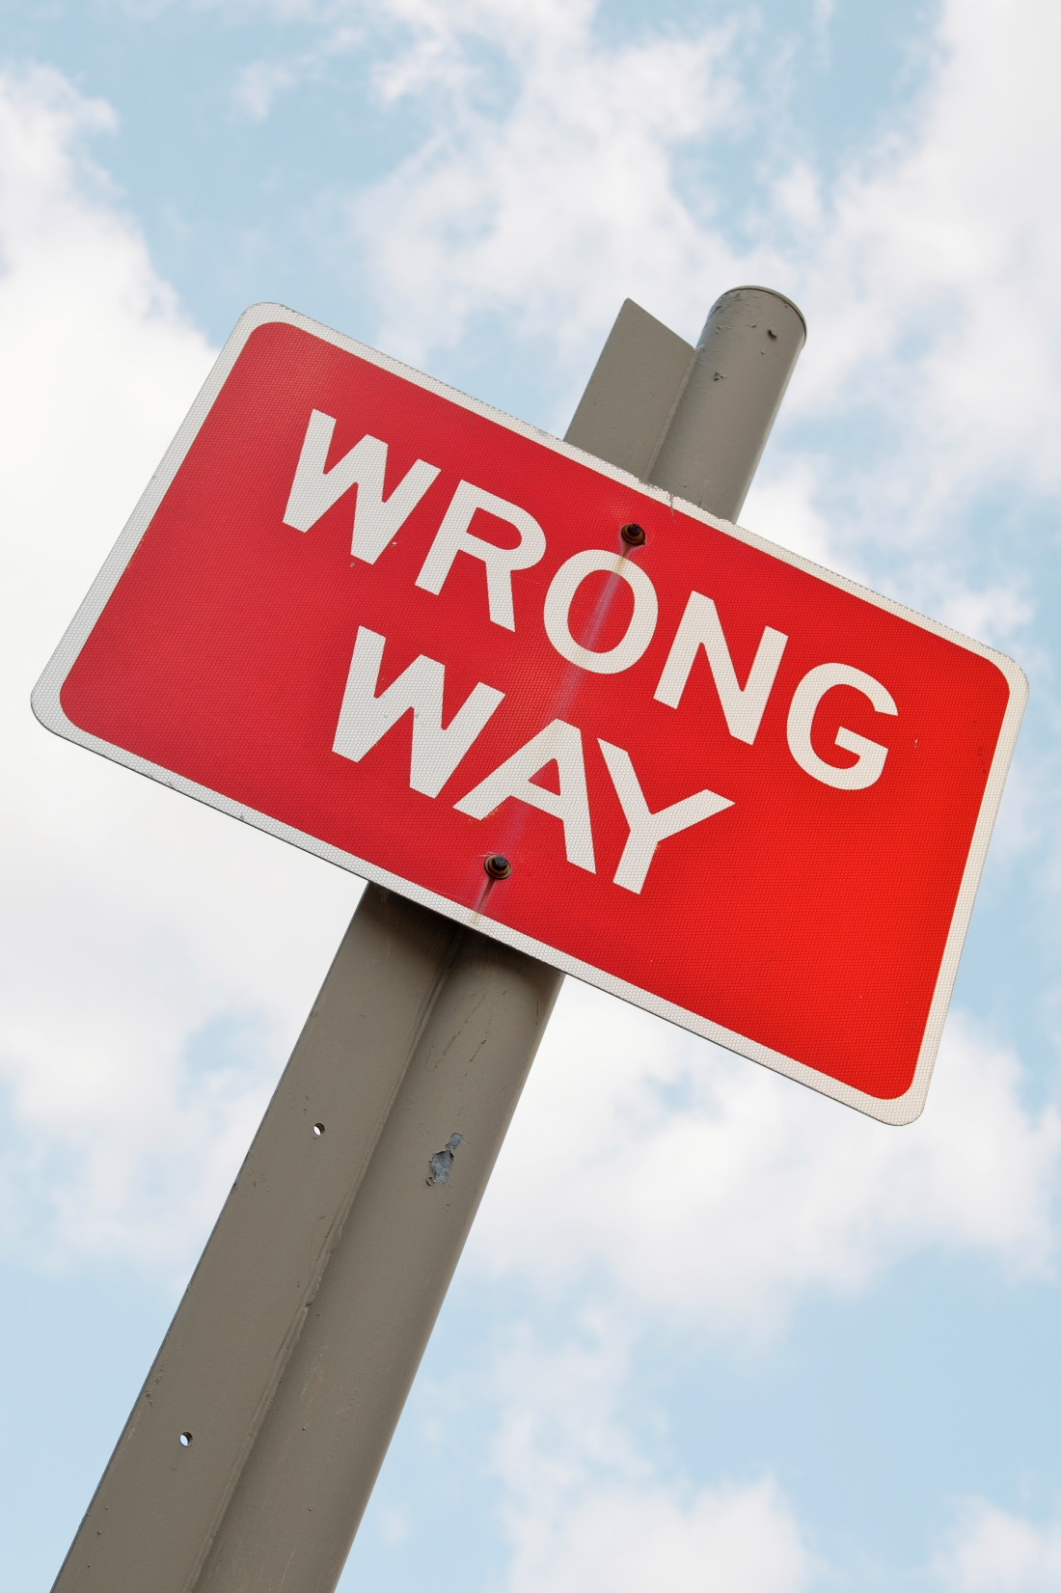
Top Mistakes To Avoid
Thinking that the first person that you are speaking to is all that matters
Thinking that only one person matters
Not taking into account everyone’s needs
www.SmallBusinessSolver.com © 2016

Slide 16
Now What?
The bigger the company, the more people involved in a buying group.
Each role is concerned about different things.
Two or more roles could be held by one person.
One role can be held by many people.
www.SmallBusinessSolver.com © 2016

Slide 17
Worksheet
How does this work for your business?
www.SmallBusinessSolver.com © 2016

Slide 18
Discussion: “How do you make sure you address everyone’s concern?”
Do you need to run reports or have some sort of tracking capability?
Do you need to reduce risk through a performance piece, a payment plan, or other mechanism?
Do you need to help with implementation, training or communication?
www.SmallBusinessSolver.com © 2016

Slide 19
Key Points
The initiator
The influencer
The decider
The buyer
The user
The gatekeeper
Example
What not to do
Your next steps
Wrap up
www.SmallBusinessSolver.com © 2016

Slide 20
The Goal
Understand all of the players in a sale.
www.SmallBusinessSolver.com © 2016

Slide 21
There is often more than just one person involved.
www.SmallBusinessSolver.com © 2016

