Slide 1
Selling Inside Your Skin
Whoever you are, be comfortable with that.
www.SmallBusinessSolver.com © 2016

Slide 2
It doesn’t matter who you are—take your strengths and minimize your weaknesses.
www.SmallBusinessSolver.com © 2016

Slide 3
The Goal
Leverage your natural strengths and minimize your weaknesses when selling.
www.SmallBusinessSolver.com © 2016

Slide 4
Key Points
Extroversion
Orderliness
Emotional stability
Accommodation
Inquisitiveness
Example
What not to do
Your next steps
Wrap up
www.SmallBusinessSolver.com © 2016

Slide 5
http://www.similarminds.com/bigfive.html

Slide 6
Extroversion: Outgoing vs. Shy
www.SmallBusinessSolver.com © 2016

Slide 7
Orderliness: Efficient vs. Easy-Going
www.SmallBusinessSolver.com © 2016

Slide 8
Emotional Stability: Sensitive vs. Secure
www.SmallBusinessSolver.com © 2016

Slide 9
Accommodation: Friendly vs. Cold
www.SmallBusinessSolver.com © 2016

Slide 10
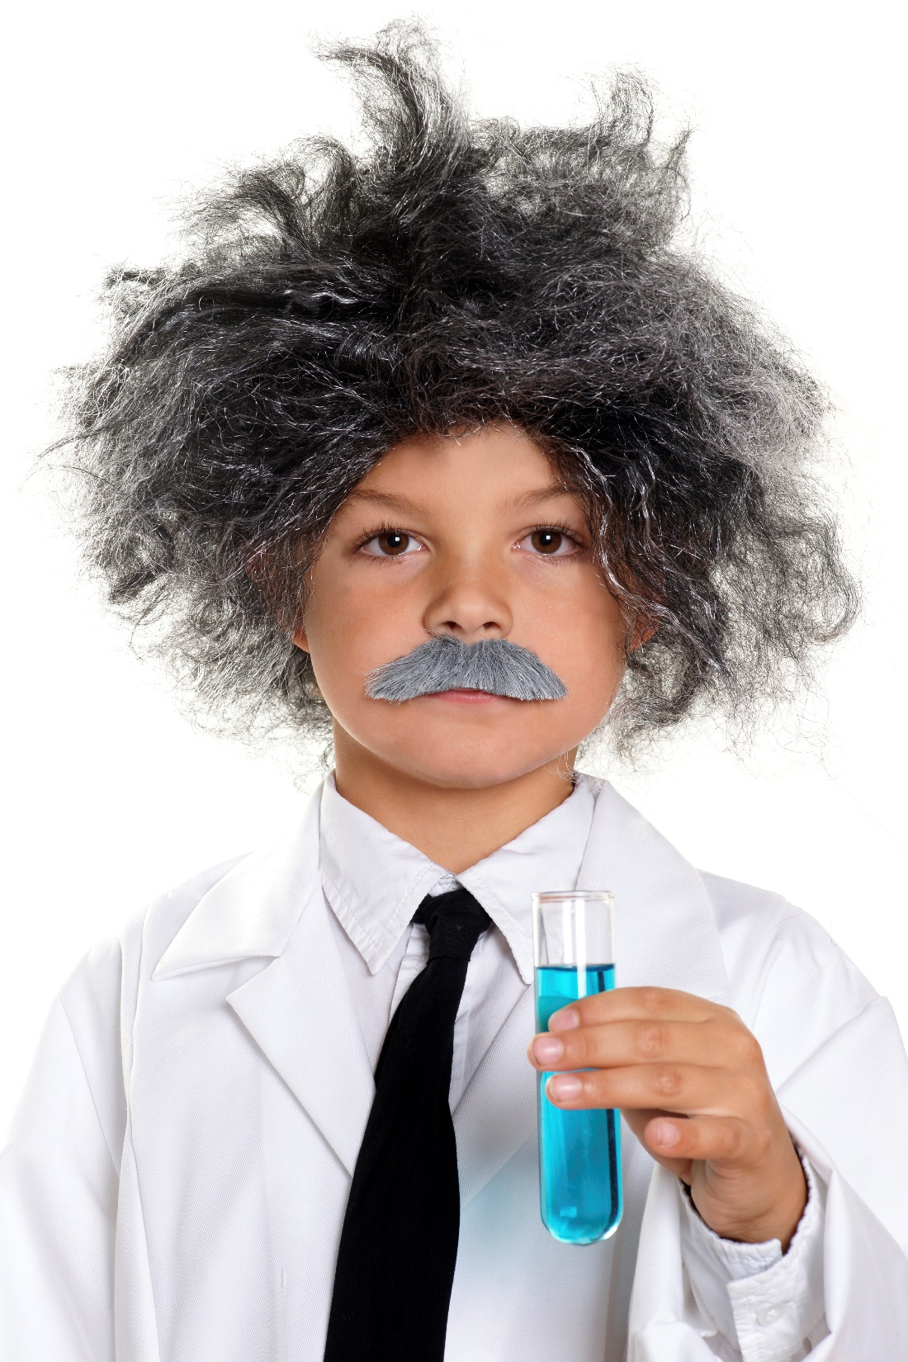
Inquisitiveness: Inventive vs. Consistent
www.SmallBusinessSolver.com © 2016

Slide 11
Discussion: “What are your own traits?”
What are your own personality traits? Are you an introvert or extrovert? Are you conscientious? Are you internal locus of control or external locus of control? Are you optimistic or pessimistic or a realist?
Which traits help make you a great sales person? Why?
What traits hinder you? Why?
www.SmallBusinessSolver.com © 2016

Slide 12
Discussion: “How can you improve?”
If there was one thing that you could stop doing to improve you sales, what would that be?
If there was one thing that you could do more to improve you sales, what would that be?
www.SmallBusinessSolver.com © 2016

Slide 13
How Does It Work? Electrician
Extroversion: Introvert so I listen.
Orderliness: Easy going so I’m easy to get along with and flexible with my customers.
Emotional stability: Secure so don’t take things too personally.
Accommodation: Friendly so welcome into people’s homes.
Inquisitiveness: Inventive so can recommend solutions and electronics that could make my customers’ lives easier.
www.SmallBusinessSolver.com © 2016

Slide 14
How Does It Work? Bookkeeper
Extroversion: Extrovert so I’m different than many other bookkeepers.
Orderliness: Organized so that I’m trusted and can perform my work well.
Emotional stability: Sensitive so I’m able to stay in tune to whether my customers are satisfied or not.
Accommodation: Cold so that it is business oriented conversations with customers and don’t waste time.
Inquisitiveness: Consistent so that we live by the rules and everyone understands their books.
www.SmallBusinessSolver.com © 2016

Slide 15
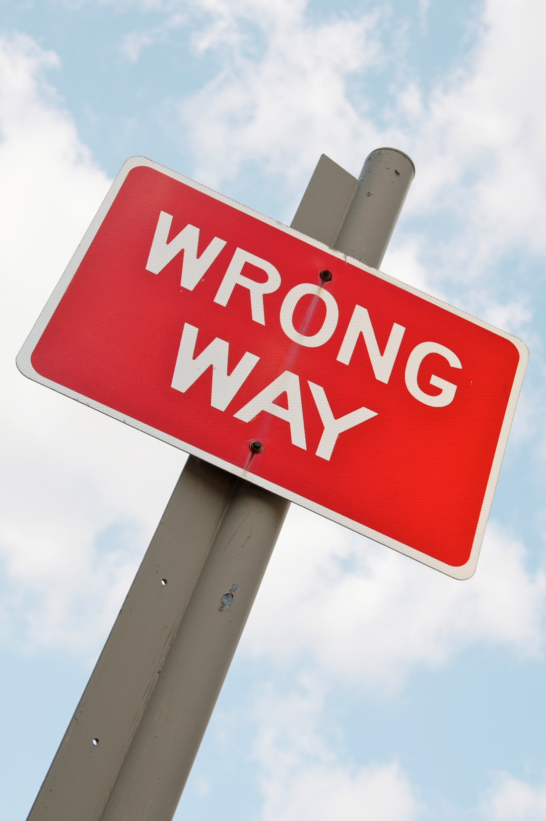
Top Mistakes To Avoid
Don’t just succumb to what you assume is your weakness
Not trying to improve
Not understanding yourself
Not being comfortable in your own skin
www.SmallBusinessSolver.com © 2016

Slide 16
Now What?
If you’re not comfortable, your customers will notice.
Know yourself to control yourself.
Practice, practice, practice. Comfort comes from doing.
www.SmallBusinessSolver.com © 2016

Slide 17
Discussion: “How do you become more confident in your selling technique?”
Have you gotten a sale before?
Have you tried selling to a friend? Or sales role playing with a business partner or colleague?
Have you brought someone along with you as a sale partner? For feedback? To help in areas where you feel less confident?
www.SmallBusinessSolver.com © 2016

Slide 18
http://www.similarminds.com/bigfive.html

Slide 19
Key Points
Extroversion
Orderliness
Emotional stability
Accommodation
Inquisitiveness
Example
What not to do
Your next steps
Wrap up
www.SmallBusinessSolver.com © 2016

Slide 20
The Goal
Leverage your natural strengths and minimize your weaknesses when selling.
www.SmallBusinessSolver.com © 2016

Slide 21
Whoever you are, be comfortable with that.
www.SmallBusinessSolver.com © 2016

