Slide 1
Customer Personalities
Amazing sales people adjust for their audience.

Slide 2
If people adjust to your preferences, they are easier to relate to.
Do you know what a teacher would wear?
Do you know what a lawyer’s convention would be like?
How could you adjust?

Slide 3
Discussion: “Can You Describe The Type of Person You Normally Sell To?”
1. What is the role or the job title within the organization that you sell normally sell to?
2. What is the person like that you normally sell to? Can you describe their personality? Their preferences?
3. Do you see commonalities between your customers? Do you see trends?

Slide 4
The Goal
Be able to quickly assess how best to communicate with customers.

Slide 5
Key Points
Drive
Influence
Steadiness
Compliance
Example
What not to do
Your next steps
Wrap up

Slide 6
http://www.quibblo.com/quiz/aw8npyx/DISC-Personality-Style

Slide 7
Drive
They are: direct, risk-takers, problem solvers, self-starters, have high ego
Best to be: direct, to the point, brief, results- focused, logical
Avoid: rambling, repetition, socializing, making generalizations

Slide 8
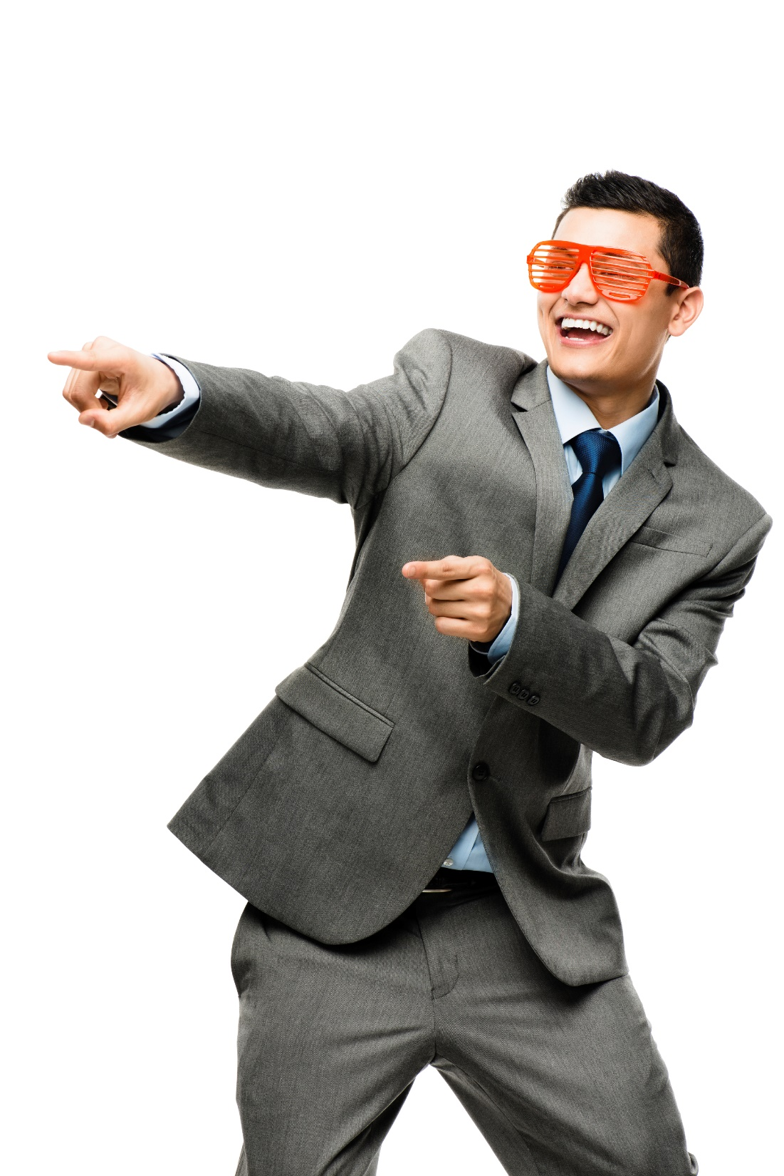
Influence
They are: optimistic, trusting, talkative, emotional, persuasive
Best to be: friendly and action-oriented, but let them speak
Avoid: focus on written, telling them what to do, ignoring their ideas, socializing

Slide 9
Steadiness
They are: listeners, team players, predictable, understanding, friendly
Best to be: genuine, interested, personable, patient, risk-reducing, supportive
Avoid: being pushy, aggressive, demanding

Slide 10
Conscientious
They are: analytical, careful, precise, systematic, have high standards
Best to be: Prepared, detailed, specific, patient, persistent, diplomatic, have data
Avoid: refusing to give details, being vague or casual

Slide 11
How Does It Work?
You cold call a prospect and start by introducing yourself. They say “I’m a very busy person.”
What should you do?
They could be driver. Make sure that get right to the point, show them how you can deliver results, and don’t repeat yourself.

Slide 12
How Does It Work?
You walk into a room to do a presentation. You greet everyone there, and your ready to get started. Everyone is quiet and waiting for you to start.
What should you do?
They could be steadiness. Make sure that you listen to them, remove risk, be patient in waiting for question, and DON’T be pushy.

Slide 13
How Does It Work?
You meet someone at a networking event who seems to be the life of the party. They have a lot of jokes, might be wearing something fashionable, and seem to be having fun.
What should you do?
They could be an influencer. Make sure you focus on the personal and friendly side. Don’t go over and start pushing your business. Let them know you’ll contact them over the next week.

Slide 14
How Does It Work?
You are sending an email to a prospect who has come back to you with a few questions about some marketing material that you had sent to them.
What should you do?
They could be conscientious. Make sure that you give them a lot of details and links to information on your website with even more details if they wish to explore it further. Anticipate what they could also want to know.

Slide 15
Discussion: “How Can you Improve Your Communication With These People?”
1. What type of communication does your customer like? Do they prefer the phone? Face to face? Emails? Detailed attachments?
2. What duration of communication do they prefer? Short and to the point, personal, or detailed?
3. How can you change how you interact with them in order to improve your relationship and communication?

Slide 16
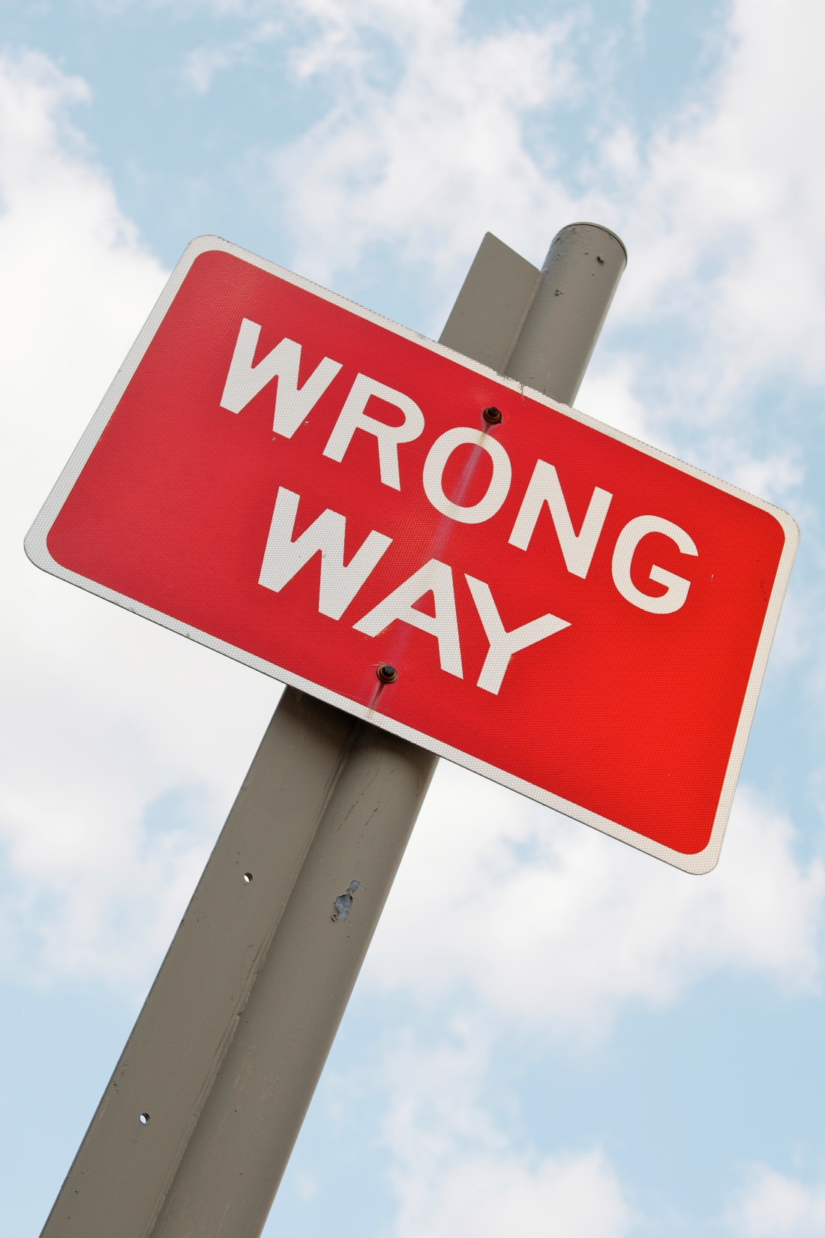
Top Mistakes To Avoid
Being the same with everyone.
Thinking that others should adapt to you and your preferences.
Not knowing your own DISC assessment.
Not understanding your own preferences and how this impacts your relationships and communication with others.

Slide 17
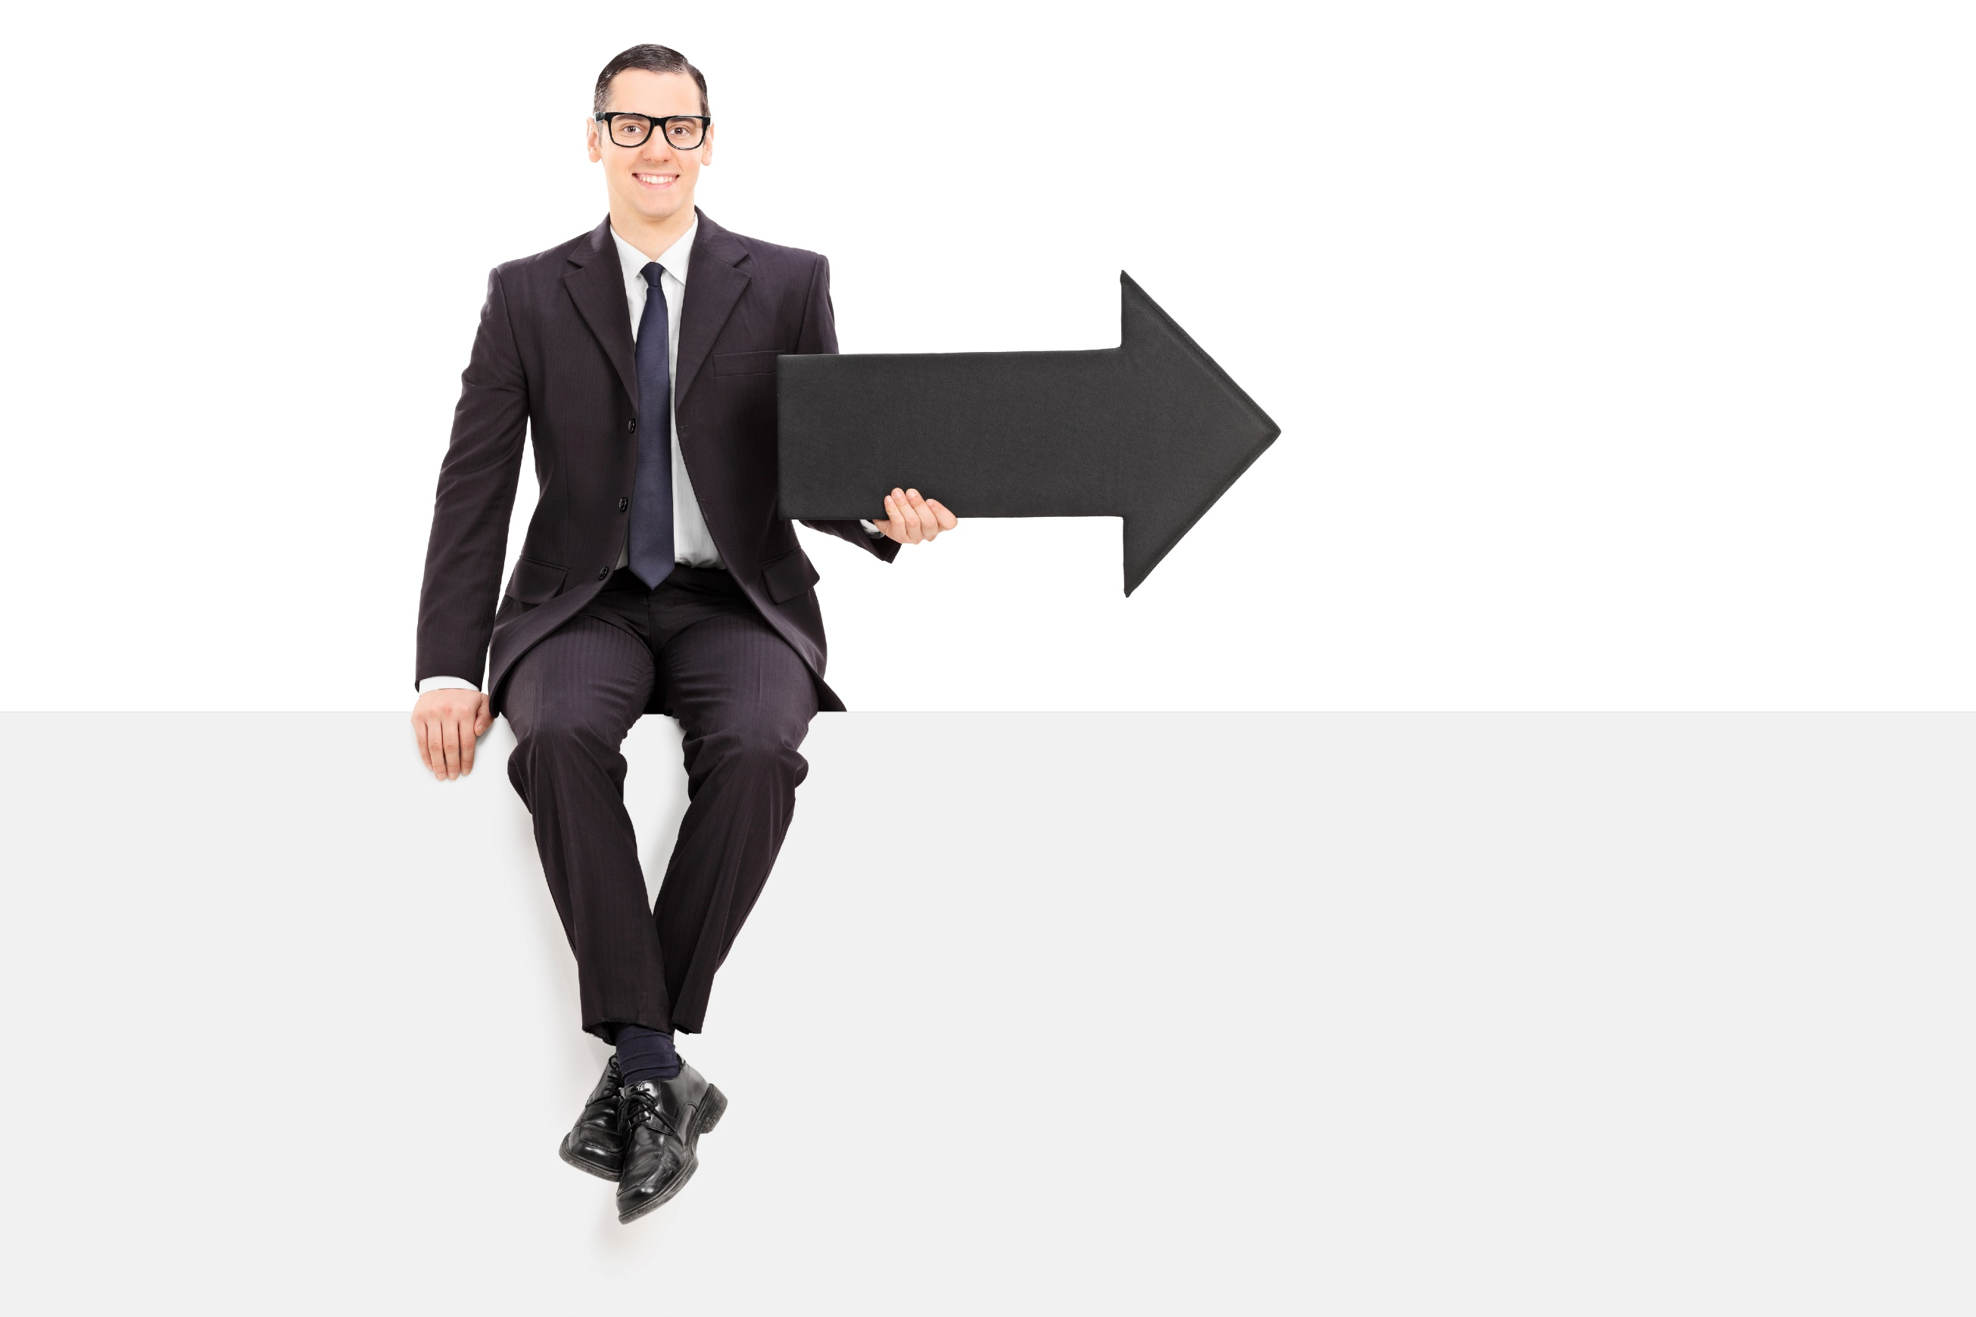
Now What?
Actively think about who your customer is.
Adapt yourself.
Use this in all of your interactions with others.

Slide 18
Discussion: “Beyond Disc, What other influences Affect your Customers?”
1. Are there other personality traits that you think that you might have to adapt for? Are there other models that make more sense for you?
2. Are there other parts of their role that may impact them? Does the corporate culture influence them?
3. Are there other decision makers that you also need to account for?

Slide 19
http://www.quibblo.com/quiz/aw8npyx/DISC-Personality-Style

Slide 20
Key Points
Drive
Influence
Steadiness
Compliance
Example
What not to do
Your next steps

Slide 21
The Goal
Be able to quickly assess how best to communicate with customers.

Slide 22
Amazing sales people adjust for their audience.
www.SmallBusinessSolver.com © 2016

