Slide 1
30-Second Pitch
Talk about your business to that people remember you.

Slide 2
Different names for the same thing!
Elevator pitch
30-second commercial
Entrepreneur’s pitch
Sticky story
Pushy pitch
Martini monologue
Positioning statement

Slide 3
Discussion: “When Shouldn’t You Be using Your Pitch?”
Does your pitch sound forced? Do you sound like a human or a robot?
Do you have an amazing relationship with the person? Should you be pitching or telling a story?
Do you have more time that a pitch isn’t necessary? Do you have time for an anecdote or to build a relationship?
Do you know enough about the person that you are speaking to? Are you jumping into the pitch when you should be asking questions?

Slide 4
The Goal
Say more things that matter to your customer.

Slide 5
Key Points
Name of the business
Industry
Target market
The benefit
Why you?
Example
What not to do
Your next steps
Wrap up

Slide 6
Worksheet
Grab your worksheet and follow along.

Slide 7
Your Business Name

Slide 8
Industry

Slide 9
Target Market

Slide 10
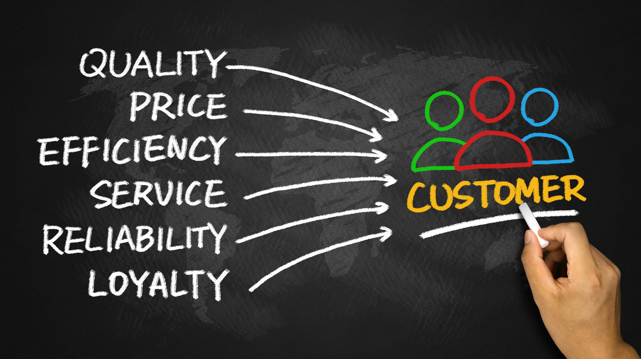
Benefits

Slide 11
Why You??

Slide 12
Who Does It Work?
Harry’s Dental Office, is a company that provides teeth cleaning and maintenance to fun families who need their families’ teeth kept healthy. Unlike the competition, we make the entire trip to the dentist fun with TVs in every cleaning room, toys, and a smiling staff.

Slide 13
Non Example
I’m a dentist accepting new patients. I take people in the New York area. I do pretty much everything that a dentist can do.

Slide 14
Top Mistakes To Avoid
Remove the words “I”, “we”, “our”, “us”.
Using words that your customer doesn’t understand!!
Being vague.
Spending too much time on explaining what you do.

Slide 15
Discussion: “How Many Pitches Do You Need To have?”
How many different targets to you have? Each one needs a pitch as each of them care about different things.
How many stakeholders do you have to communicate with? Each stakeholder cares about different things and therefore needs a slightly different pitch to be compelling.
How many different compelling reasons would someone want to hear about? Or care about?

Slide 16
Now What?
Practice!
Be comfortable with your own pitch.
Have different pitches for each audience.

Slide 17
Discussion: “how Do You Tweak On The Fly?”
Do you know all of the reasons why a customer might switch to you?
Do you know all of the ways that you are different (and better) than the competition?

Slide 18
Worksheet
How does this work for your business?

Slide 19
Key Points
Name of the business
Industry
Target market
The benefit
Why you?
Example
What not to do
Your next steps

Slide 20
The Goal
Say more things that matter to your customer.

Slide 21
People only listen when it matters to them.
www.SmallBusinessSolver.com © 2016

