Slide 1

How to
Structure
Your
Business
So you’ve started a business….
now what?!

Slide 2

You Have Options!

Slide 3

The Goal
Select a business model to start your business.

Slide 4

Key Points
Subcontractor or Contract
Sole Proprietorship
General Partnership
Limited Liability Partnership
Corporation
Non Profit
Example
What not to do
Your next steps
Wrap up

Slide 5

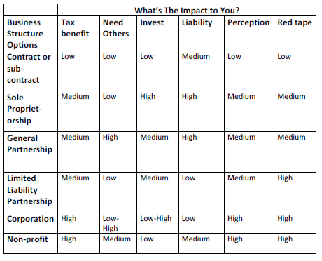
Worksheet
Grab your worksheet and follow along.

Slide 6

Importance of Your Structure

Slide 7

Contractor

Slide 8

Sole Proprietor

Slide 9

General Partnership

Slide 10

Limited Liability Partnership

Slide 11

Corporation

Slide 12

Non-Profit

Slide 13
How Does It Work?
 | What’s The Impact to You?
Business Structure Options | Tax benefit | Need Others | Invest | Liability | Perception | Red tape
Contract or sub-contract | Low | Low | Low | Medium | Low | Low
Sole Proprietorship | Medium | Low | High | High | Medium | Medium
General Partnership | Medium | High | Medium | High | Medium | Medium
Limited Liability Partnership | Medium | Low | Medium | Low | Medium | High
Corporation | High | Low-High | Low-High | Low | High | High
Non-profit | High | Medium | Low | Medium | High | High

Slide 14

Top Mistakes To Avoid
Not thinking about all of the different ways.
Not having an open mind.
Quitting your job without considering work as a contractor.
Incorporating your business from the very beginning.
Thinking that these are the only options.

Slide 15

Now What?
Decide which structure will work for you.
Do the appropriate work to set it up in the next month.
Make sure that you have all of the additional paperwork.
Double check that the structure you have is continuing to work for you.
Review your legal structure once a year.

Slide 16

Key Points
Subcontractor or Contract
Sole Proprietorship
General Partnership
Limited Liability Partnership
Corporation
Non Profit
Example
What not to do
Your next steps
Wrap up

Slide 17

The Goal
Select a business model to start your business.

Slide 18

Have a reason for selecting a business structure.

