Slide 1
Create Your Vision
Reach for the sky!

Slide 2
Dare To Dream

Slide 3
The Goal
A goal that stretches you & your business.

Slide 4
Key Points
Constraints
Strengths
Opportunities
Overlap of Opportunities & Strengths
My Vision
Example
What not to do
Your next steps
Wrap up

Slide 5
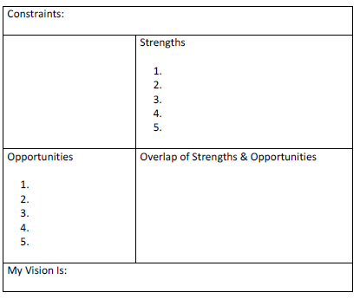
Worksheet
Grab your worksheet and follow along.

Slide 7
Constraints
Is there something that will hold you back?
Resources, values?
Something you can’t do?
Government regulations?

Slide 8
Strengths
Yours
Personality
Uniqueness
Your Business’
Intellectual Property
Infrastructure
Experience
Employees / Customers
Position in Market

Slide 9
Trends
Customers
Habits
Environment Changes
Opportunities

Slide 10
Overlap
Strengths
Opportunities

Slide 11
Your Vision

Slide 12
How Does It Work?
Constraints: Cash investment limited to founding partners Lack of prior business start-up experience
 | Strengths Knowledge of solar panels and industry trends Engineering experience Construction experience Friendly and approachable staff First company to serve local market
Opportunities Consumers becoming more aware of environmental protection and wanting renewable energy Renewable energy is less costly once installed Government legislation which provides cash incentives for converting to renewable energy Business want to showcase their social responsibility through green initiatives Technological advancements making alternative energies more feasible | Overlap of Strengths & Opportunities Opportunity to incorporate technological advancements into company due to engineering experience Opportunity to serve both consumers and businesses Opportunity to partner with government agencies to become the preferred installer of solar panels
My Vision Is: To become the preferred installer of solar panels for both consumers and businesses in my local community and get 25% of all homeowners and businesses in my city not only off the grid but also generating excess energy they can sell to the city within the next five years.

Slide 13
Top Mistakes To Avoid
Not having a vision.
Not ensuring that everything you do is aligned with the vision.
Not aiming for your full potential.
Not communicating your vision.
Not believing in yourself and committing to your business goals.
Not maintaining awareness of the changes in your strengths and opportunities.

Slide 14
Now What?
Write down your goal(s) and tell everyone what you are trying to do.
Get their feedback as you may not be able to look at it objectively yourself.
Monitor anything and everything you do; it should always be in line with your vision.

Slide 15
Key Points
Constraints
Strengths
Opportunities
Overlap of Opportunities & Strengths
My Vision
Example
What not to do
Your next steps
Wrap up

Slide 16
The Goal
A goal that stretches you & your business.

Slide 17
Your vision is not only where you want your business to go but your everyday inspiration and drive.

