Slide 1
QUESTIONS FOR CORE BUSINESS CLARITY 2015
Notes:
If participants in session have had a debrief…”Before we start, almost everyone has had a debrief, without giving away your primary style, let’s share one thing that really stuck out” (write on flip chart).
If participants in session have had NO debrief, ask for one thing that stuck out when they read their report.
The Sales Breakthrough program is going to show you how to use this information to break through the barriers and achieve maximum sales results!!

Slide 2
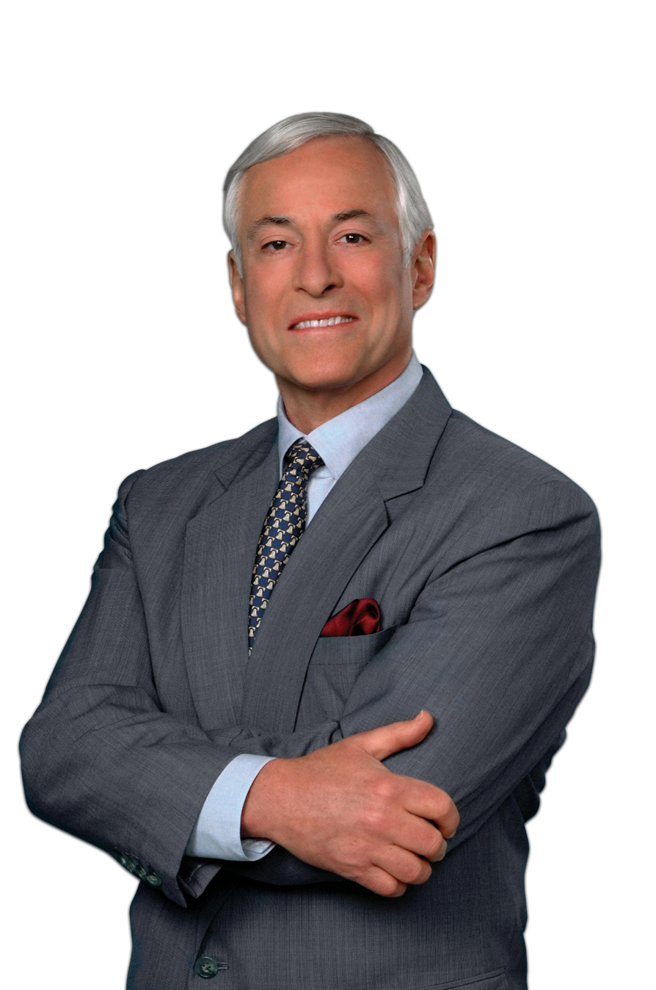
INTRODUCTION
40YEARS
OF BUSINESS & SALES EXPERIENCE
1000s of TRAINED
SALES PEOPLE
FocalPoint?
WHO IS
70 BOOKS
MOTIVATIONAL SPEAKER
TO HUNDREDS OF THOUSANDS
OF PEOPLE A YEAR
GLOBALLY
Brian Tracy/Founder
Notes:
FocalPoint is the premier coaching and sales training organization out there. We are here to bring you the absolute best and most effective strategies and tactics that will set you apart from everyone else.
Content and approaches are based on the work of Brian Tracy who has been in the business of sales for over 40 years. He’s written over 70 books, trained 1000’s of sales people globally, travels and speaks to 100’s of thousands of people per year, he is to business and sales improvement what The Beatles/ Elvis / etc are to music
You probably quote him 100 times a day in business sayings, but don’t know it.
What that means to you is….what we discuss here is proven!
120+ coaches worldwide sharing these approaches which result in millions of $ of profit

Slide 3
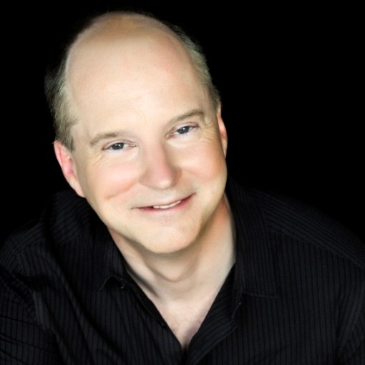
INTRODUCTION
AWARD-WINNING
DIRECTOR OF OVER 60 PROFESSIONAL THEATRE PRODUCTIONS/ TEAMS
PERFORMING ARTS EXECUTIVE
SALES, STRATEGY, BRANDING, OPERATIONS
ARTS PRODUCER
Charles McFarland
WHO IS
RAISED $6 M IN ARTS CENTRE CAPITAL CAMPAIGN
3 BUILT IN OTTAWA 2004-2011
FOUNDER, OTTAWA SHAKESPEARE CO
Certified FocalPoint Business Performance Coach
Lead, North America, The Corporate Theatre

Slide 4
INTRODUCTION
THE “CURTAIN HAS COME DOWN” ON 2014 ….
How was the ‘show’ for you?
What worked? What did you learn?
What would you have done differently?
Notes:
Flip chart: What business am I really in? spend 2 mins
Flip Chart: What business is my client really in? spend 2 mins
Starbucks …coffee or the experience?? or similar example

Slide 5
INTRODUCTION
AND ON TO 2015 ….
HAVE YOU CREATED YOUR NEW SHOW’S SCRIPT?
IS IT READY TO PUT INTO PRODUCTION?
Notes:
Flip chart: What business am I really in? spend 2 mins
Flip Chart: What business is my client really in? spend 2 mins
Starbucks …coffee or the experience?? or similar example

Slide 6
INTRODUCTION
AND ON TO 2015 ….
IT STARTS WITH ‘CORE CLARITY’:
PRECISELY KNOWING YOUR BUSINESS
Notes:
Flip chart: What business am I really in? spend 2 mins
Flip Chart: What business is my client really in? spend 2 mins
Starbucks …coffee or the experience?? or similar example

Slide 7
CORE CLARITY QUESTIONS
1. WHERE ARE YOU AND YOUR COMPANY?
BUSINESS LIFE CYCLE
LEARNING PHASE
GROWTH PHASE
DECLINE PHASE
X
X
X
X
X
Notes:
Flip chart: What business am I really in? spend 2 mins
Flip Chart: What business is my client really in? spend 2 mins
Starbucks …coffee or the experience?? or similar example

Slide 8
CORE CLARITY QUESTIONS
2. WHAT BUSINESS ARE YOU REALLY IN?
Notes:
Flip chart: What business am I really in? spend 2 mins
Flip Chart: What business is my client really in? spend 2 mins
Starbucks …coffee or the experience?? or similar example

Slide 9
CORE CLARITY QUESTIONS
3. WHAT ARE YOUR CORE COMPETENCIES?
Your Company’s? Yours? Your Key Staff?
Notes:
Write down your role in your notebook (2 mins)
EX: I am here to find clients
I am here to sell
I am here to keep clients
I am here to support my family, etc.
But what is your role with clients?? (flip chart) 2 mins to share

Slide 10
CORE CLARITY QUESTIONS
Our Products
& Services
4. WHAT ARE YOUR CORE ACTIVITIES?
Notes:
Write down your role in your notebook (2 mins)
EX: I am here to find clients
I am here to sell
I am here to keep clients
I am here to support my family, etc.
But what is your role with clients?? (flip chart) 2 mins to share

Slide 11
CORE CLARITY QUESTIONS
5. WHO IS YOUR IDEAL/ CORE CUSTOMER?
Notes:
Write down your role in your notebook (2 mins)
EX: I am here to find clients
I am here to sell
I am here to keep clients
I am here to support my family, etc.
But what is your role with clients?? (flip chart) 2 mins to share

Slide 12
CORE CLARITY QUESTIONS
6. YOUR CORE MARKETING/ SALES METHODS?
Why does your ideal customer buy your product?
Notes:
Write down your role in your notebook (2 mins)
EX: I am here to find clients
I am here to sell
I am here to keep clients
I am here to support my family, etc.
But what is your role with clients?? (flip chart) 2 mins to share

Slide 13
CORE CLARITY QUESTIONS
So What?
W.I.I. – F.M.?
7. YOUR UNIQUE SELLING PROPOSITION?
What Level of Customer Satisfaction Do I Currently Deliver to my Core Customer – and What Would I Like to?
Notes:
Write down your role in your notebook (2 mins)
EX: I am here to find clients
I am here to sell
I am here to keep clients
I am here to support my family, etc.
But what is your role with clients?? (flip chart) 2 mins to share

Slide 14
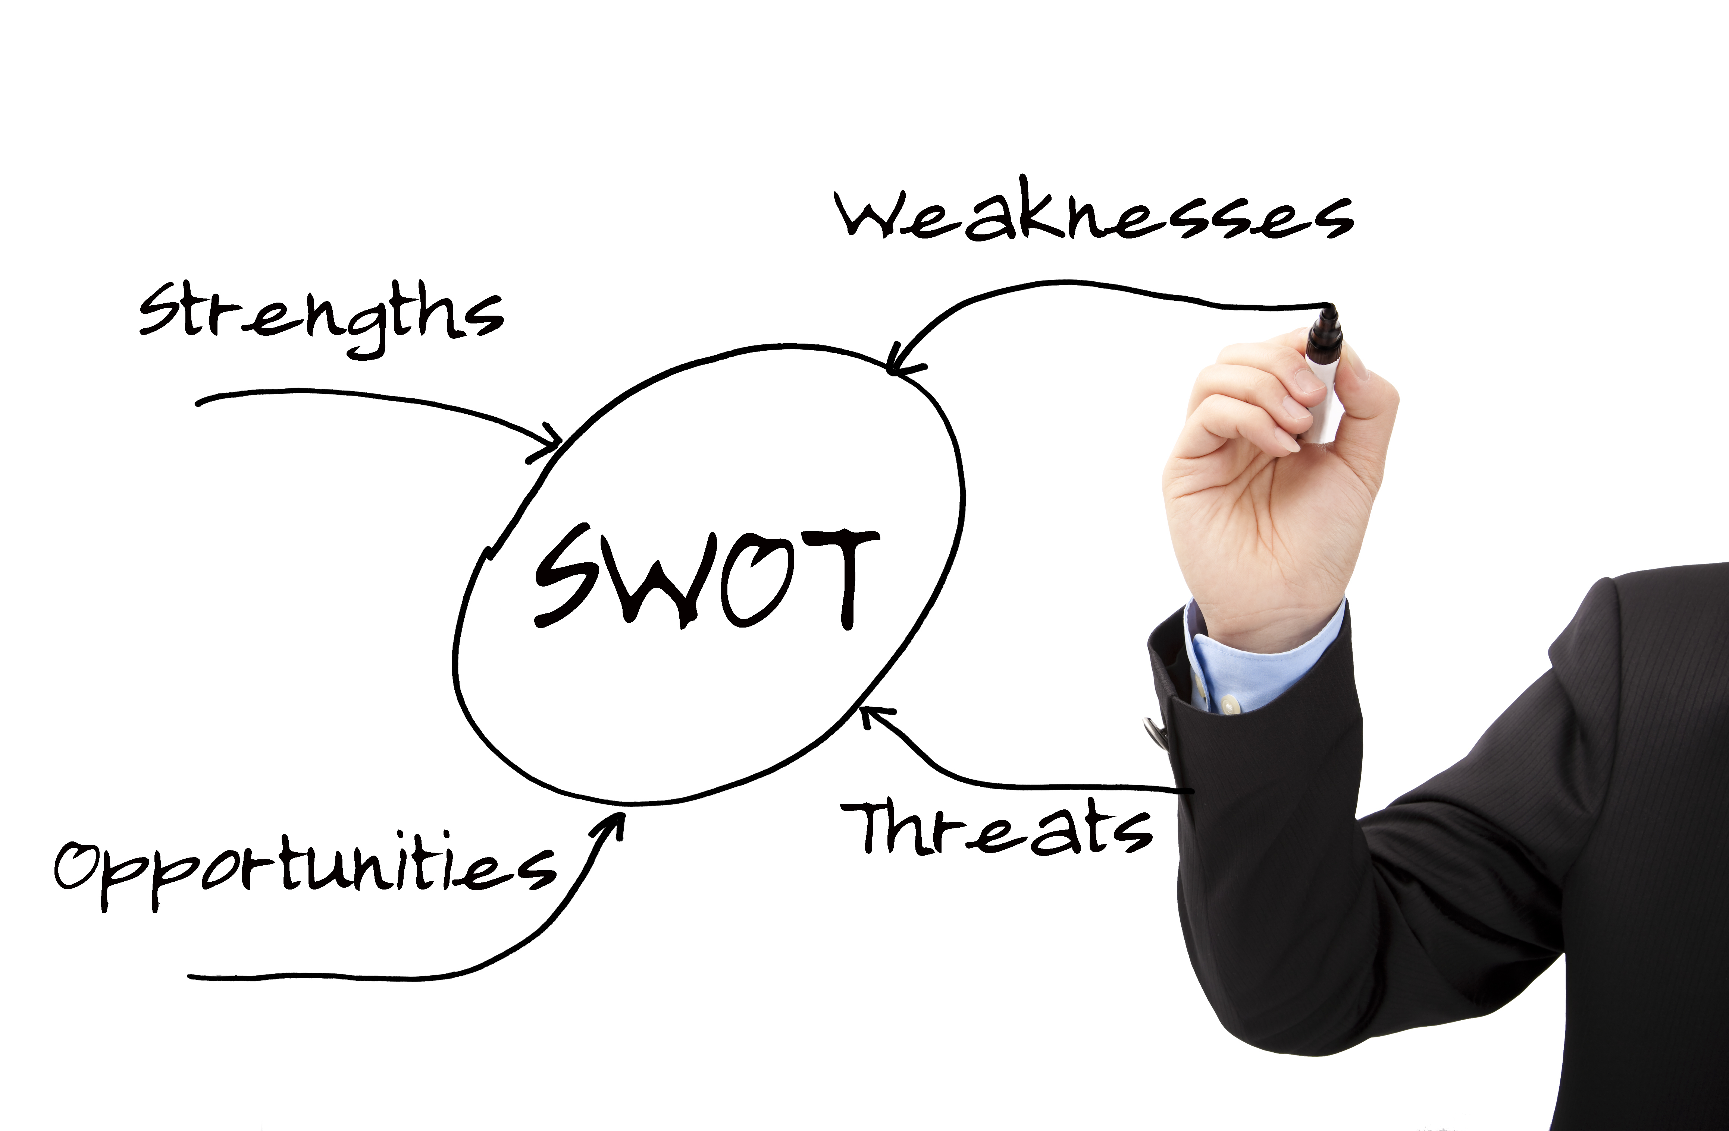
CORE CLARITY QUESTIONS
IN SUMMARY
Notes:
Write down your role in your notebook (2 mins)
EX: I am here to find clients
I am here to sell
I am here to keep clients
I am here to support my family, etc.
But what is your role with clients?? (flip chart) 2 mins to share

Slide 15
CLARITY: SETTING GOALS FOR 2015
Notes:
Write down your role in your notebook (2 mins)
EX: I am here to find clients
I am here to sell
I am here to keep clients
I am here to support my family, etc.
But what is your role with clients?? (flip chart) 2 mins to share

Slide 16
COACHING MODULES: “THE STACK”
Clarity
Leadership
Sales
Growth
Effectiveness

Slide 17
IN CONCLUSION
YOUR BUSINESS’ “SCRIPT” FOR 2015 ….
PURPOSE VALUES
MISSION VISION
Strategy
Notes:
Flip chart: What business am I really in? spend 2 mins
Flip Chart: What business is my client really in? spend 2 mins
Starbucks …coffee or the experience?? or similar example

Slide 18
Thank you for your valuable time and for investing in yourself today
www.charlesmcfarland.ca
647.405.0642
cmcfarland@focalpointcoaching.com

