Slide 1
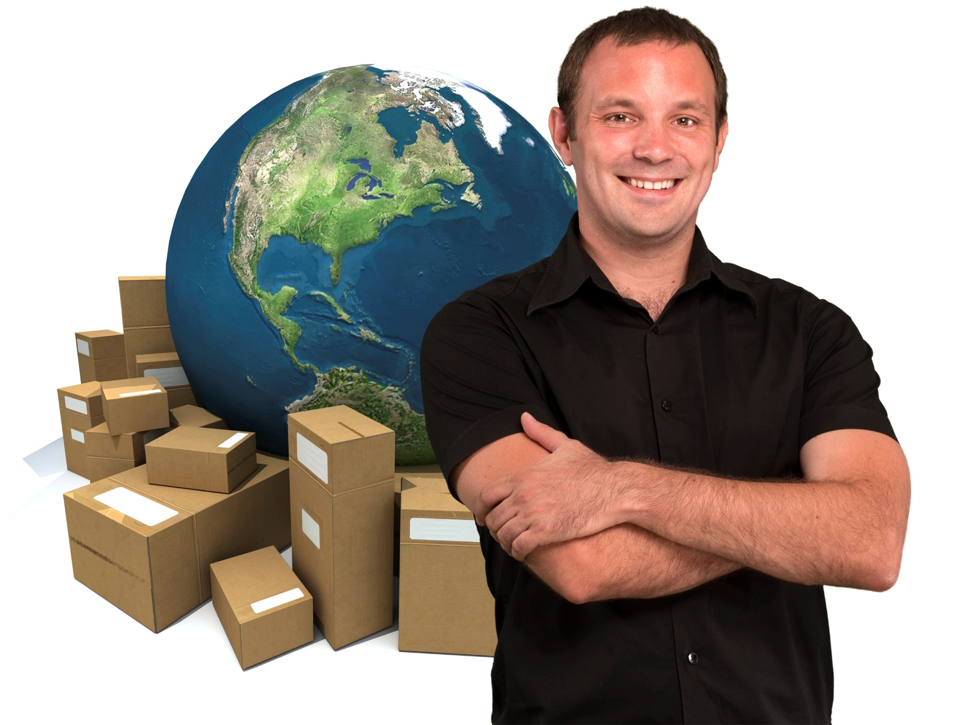
What’s The Right Business Model?
Don’t get stuck in a rut.

Slide 2
Reality Check

Slide 3
The Goal
Select a business model to start your business.

Slide 4
Key Points
1 Part Delivery
2 Parts Delivery
3 Parts Delivery
Example
What not to do
Your next steps
Wrap up

Slide 5
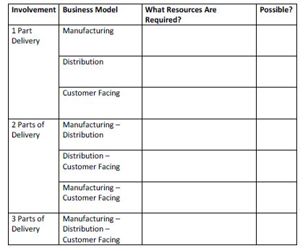
Worksheet
Grab your worksheet and follow along.

Slide 6
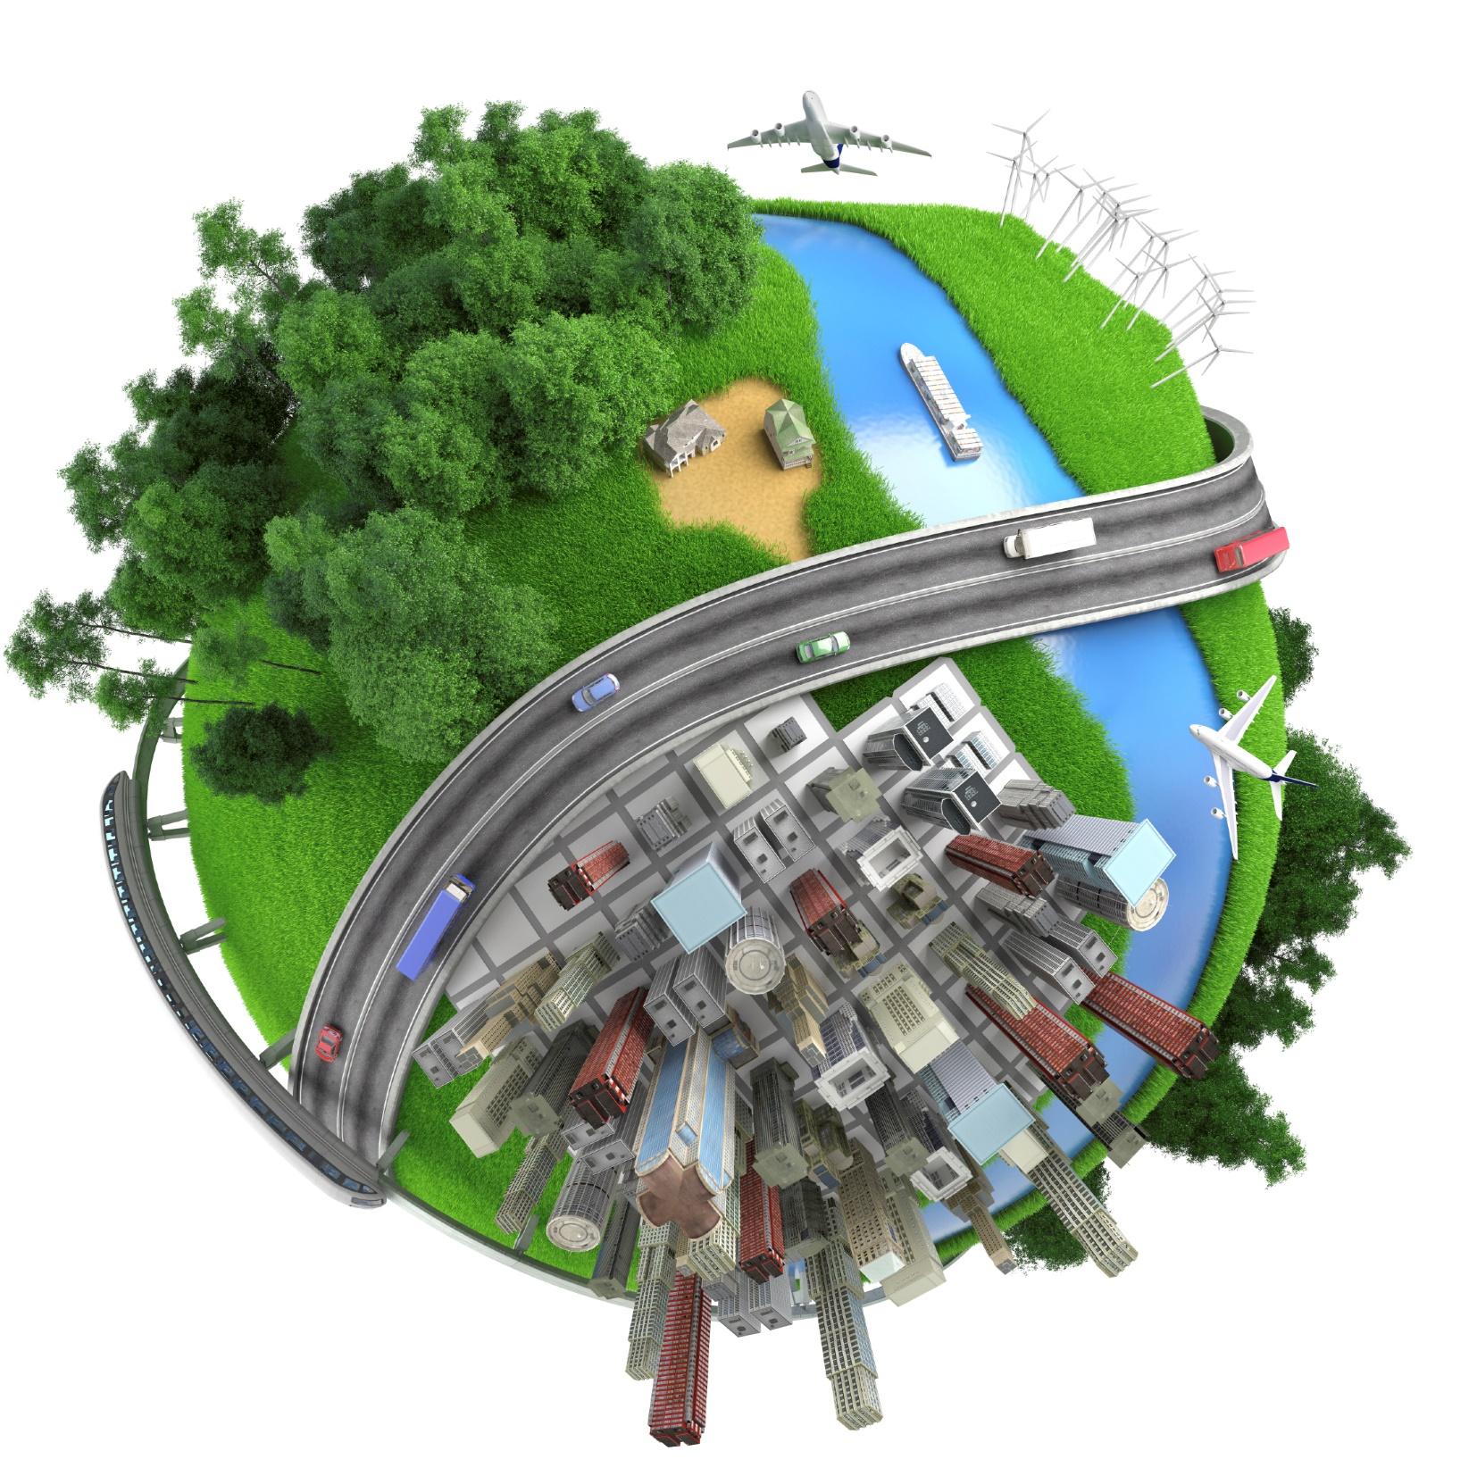
What’s a Business Model?

Slide 7
Involvement

Slide 8
Milk Supply Chain
Manufacturing
Distribution
Customer Facing

Slide 9
1-Part Delivery

Slide 10
2-Part Delivery

Slide 11
3-Part Delivery

Slide 12
What Resources are Required?

Slide 13
What’s Possible?

Slide 14
How Does It Work?
Involvement | Business Model | What Resources Are Required? | Possible?
1 Part Delivery | Manufacturing | -Materials/Equipment -Time/Labour | Yes
 | Distribution | -Transportation -Inventory -Logistics -Relationships with other businesses | Yes
 | Customer Facing | -Storefront -Marketing -Staff | No

Slide 15
How Does It Work?
Involvement | Business Model | What Resources Are Required? | Possible?
2 Parts of Delivery | Manufacturing – Distribution | -Materials/Equipment -Time/Labour -Transportation -Inventory -Logistics -Relationships with other businesses | Yes
 | Distribution – Customer Facing | -Transportation -Inventory -Logistics -Relationships with other businesses -Storefront -Marketing -Staff | No
 | Manufacturing – Customer Facing | -Materials/Equipment -Time/Labour -Storefront -Marketing -Staff | No

Slide 16
How Does It Work?
Involvement | Business Model | What Resources Are Required? | Possible?
3 Parts of Delivery | Manufacturing – Distribution – Customer Facing | -Materials/Equipment -Time/Labour -Transportation -Inventory -Logistics -Relationships with other businesses -Storefront -Marketing -Staff | No

Slide 17
Top Mistakes To Avoid
Being stubborn.
Ignoring what this model is telling you.
Not being creative with how this is done.
Not worrying about how the other parts are going to be done.
Not being flexible.

Slide 18
Now What?
Think about your old decision of a business model versus the new options for at least one day
Once you decide on a business model, move forward
Be creative as you move forward
Never lose track that everything that you are doing is actually for the end customer
Continue to re-evaluate the options and see whether it is possible or makes sense
If you find that your partners aren’t very helpful, expand your resources

Slide 19
Key Points
1 Part Delivery
2 Parts Delivery
3 Parts Delivery
Example
What not to do
Your next steps
Wrap up

Slide 20
The Goal
Select a business model to start your business.

Slide 21
Your first plan of how your business should be implemented is not necessarily the only way of doing business.

