Slide 1
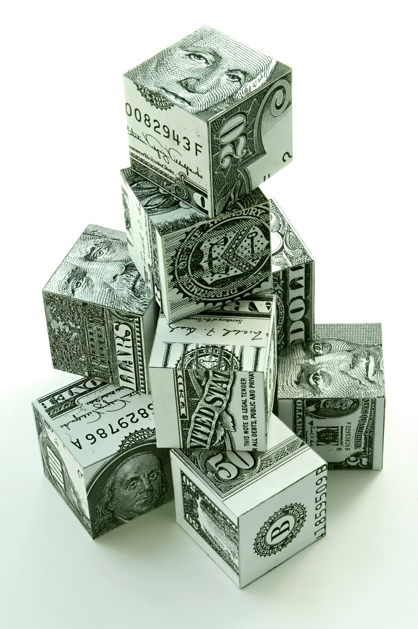
What You Should Spend Money On
Start with what you shouldn’t...

Slide 2
Top Things Not To Spend Money On In The First 90 Days
Incorporating
Useless marketing
Accounting
Trademarks
Rent
Driving
Expensive associations or networking
Your lifestyle

Slide 3
The Goal
Save your money for the most important things in your business.

Slide 4
Key Points
The Basics
Your Difference
The Wow Factor
Example
What not to do
Your next steps
Wrap up

Slide 5
Worksheet
Grab your worksheet and follow along.

Slide 6
The Basics
What do you need to be in business?

Slide 7
Your Difference
What helps you win business and makes you better than the competition?
Spend money here.

Slide 8
The ‘Wow’ Factor
What would it take to blow the competition out of the water?
Can you afford this?

Slide 9
How Does It Work?
Scott has just begun operations of his new small business enterprise specializing in the sale of laptop and desktop computers. To ensure that he is making the most of his business expenditures, Scott wants to review what he is spending money on. Scott has to compete with big box retailers in his target market which also sell computers as part of a larger product line-up. Scott’s business has a competitive edge by offering a broader selection of computers than those of his competitors.

Slide 10
How Does It Work?
The Basics | Your Difference | The “Wow”Factor
Offering the same computers that are sold by the competition Offering the same level of customer service as the competition Offering the same number of payment options/terms as the competition | Providing a broader selection of computers than offered by any competitor Offering the newest and fastest computers as soon as they are available | Paying all employees to test and review all of the computers sold by his business. With this additional time, all of Scott’s employees are empowered to provide first-hand reviews of equipment to clients and recommend the best solutions for the clients’ needs.

Slide 11
Practice: Postcards
Imagine you are the owner of a postcard printing company. You need to figure out where to spend money and where to save.
What do you do?

Slide 12
Practice: Postcards
The Basics | Your Difference | The “Wow”Factor
20 Pictures Sturdy Paper with 1 side glossy Racks | Memorabilia on more than postcards as there is more than one way to remember including calendars, placemats, books, photo albums means that you would spend money on inventory and setting up new partnerships | Customize memorabilia with your own pictures means investment in online portal Select from a wide variety of other products to put the pictures on which means more inventory

Slide 13
Top Mistakes To Avoid
Overshooting the basics
If no one can tell the difference, don’t spend
Spending where customers see no value
Falling behind on the basics
Only delivering to the basics

Slide 14
Now What?
Make sure you are at industry standards, otherwise you can’t compete
Give your customers a reason to switch
Focus on “wowing” your existing customers
Don’t fall behind

Slide 15
Key Points
The Basics
Your Difference
The Wow Factor
Example
What not to do
Your next steps
Wrap up

Slide 16
The Goal
Save your money for the most important things in your business.

Slide 17
Only spend money on things that your customers notice and care about.

