Slide 1

Time
Management
Work smart and hard.

Slide 2

The president & the janitor.

Slide 3

The Goal
Time management that helps achieve strategic tasks.

Slide 4

Key Points
Weekly Goal
Day
Things To Do
Strategic Activity
Example
What not to do
Your next steps
Wrap up

Slide 5

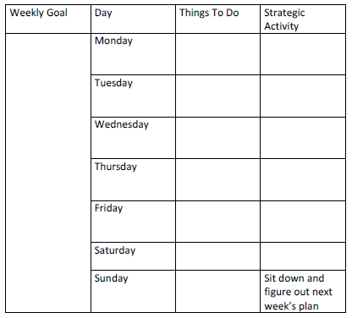
Worksheet
Grab your worksheet and follow along.

Slide 6

Weekly Goal

Slide 7

Day

Slide 8

Things To Do

Slide 9

Strategic Activity

Slide 10

Reward Yourself!

Slide 11
How Does It Work?
Weekly Goal | Day | Things To Do | Strategic Activity
Create and post a position for an apprentice Create a weekly family outing Close two new clients | Tuesday | -photo editing -fix equipment | - create listing for apprentice position
 | Wednesday | -photo editing | -post listing for apprentice -plan family activity next Wed
 | Thursday | -update website -create list of all event planners to contact | -follow-up with the new contacts made from last week
 | Friday | -photo editing -pick up equipment Photo Shoot 6pm-11pm
 | Saturday |  | -Network at Wedding Show event 10am-8pm
 | Sunday | Shoot 8am-10pm
 | Monday | -photo editing | -Sit down and figure out next week’s plan -Go through Apprentice applications received -Follow-up with contacts made on Saturday

Slide 12

Top Mistakes To Avoid
Not taking time out to plan your next week
Postponing all of the objectives for later on in the week
Not having a goal for the week
Not having a reward once you hit your goal
Not having strategic things to do at least once a week
Forgetting about personal time
Doing too many things at once and not finishing anything

Slide 13

Now What?
Go back and look at your week.
Improve the next set of tasks.
Have someone who you are accountable to.

Slide 14

Key Points
Weekly Goal
Day
Things To Do
Strategic Activity
Example
What not to do
Your next steps
Wrap up

Slide 15

The Goal
Time management that helps achieve strategic tasks.

Slide 16

Time is money.

