Slide 1

Social media Strategy
Social media can help no matter your size.

Slide 2

Want to…
Have an edge against a larger business?
Build a strong relationship with customers?
To survive in the new economy?

Slide 3

The Goal
Use your social media time wisely.

Slide 4

Key Points
Your Target Market
Type of Social Media Your Target Market Uses
Purpose of using that Social Media
Your Plan
Example
What not to do
Your next steps
Wrap up

Slide 5

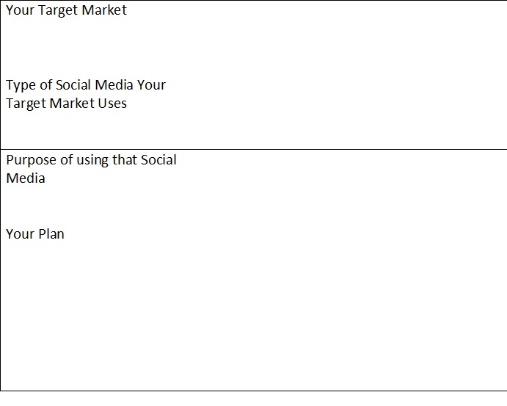
Worksheet
Grab your worksheet and follow along.

Slide 6

Your Target Market

Slide 7

Type Of Social media They Use

Slide 8

Purpose of using that Social Media

Slide 9

Your Plan

Slide 10
How Does It Work?
Candice is a financial planner and thinks it’s important to start using social media tools. She is confused by the number of sites, their purposes, and about which tools she should invest her time in. She uses the Social Media model to help get herself organized.

Slide 11
How Does It Work?
Your Target Market | Business professionals
Type of Social Media Your Target Market Uses | LinkedIn
Purpose of using that Social Media | Get 5 referrals a month
Plan | Create a LinkedIn Account In the first month, get 50 contacts (25 existing customers and 25 friends and family) Get recommendations from 3 existing customers Add 10 contacts a month through networking events and new clients Create a Twitter Account Link Twitter to LinkedIn Follow all conversations regarding financial planning Comment on 2 conversations a week Tweet one finance related article a week that is relevant to my target market

Slide 12

Top Mistakes To Avoid
Using social media just to say you are using it
Not having any social media tools
Having too many social media tools, so none are well utilized or regularly updated
Not strategically planning your online presence and having to revamp your social media tools down the road
Having to switch social media tools—you could lose some followers in the process
Not considering all the options from the start
Not having a goal
Not linking your social media, so that it takes a long time to update each individually
Being satisfied with your current list of social media—the tools constantly change and evolve and need to be reviewed regularly.
Not adding value to your customers through social media
Not actively recruiting new followers.

Slide 13

Now What?
Create a database of potential followers for your social media sites (or ramp up your existing database).
Get started with the social media tools that are relevant to your business (start with 2 to 3 to keep the work manageable).
Link the tools together to help reduce upkeep time.
Spend 15 minutes a day or 30 minutes every other day on updating/monitoring your tools to keep content fresh and relevant.
Grow your following.
Learn about new applications and tools on the social media sites you are already using to improving your online presence.
Keep an eye out for any new developments in social media. Stay trendy!

Slide 14

Key Points
Your Target Market
Type of Social Media Your Target Market Uses
Purpose of using that Social Media
Your Plan
Example
What not to do
Your next steps
Wrap up

Slide 15

The Goal
Use your social media time wisely.

Slide 16

Social media is a powerful tool, but it’s best utilized with a plan.

