Slide 1

Short Term Goals
Long term goals are not achieved without short term goals.

Slide 2

How do you eat an elephant?

Slide 3

The Goal
Way to track goals over a short period of time.

Slide 4

Key Points
Goal
Goal timeframe
Checkpoint timeframe
Tasks
Reward
Example
What not to do
Your next steps
Wrap up

Slide 5

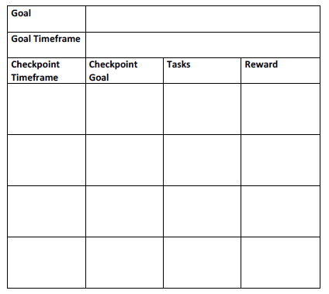
Worksheet
Grab your worksheet and follow along.

Slide 6

Goal

Slide 7
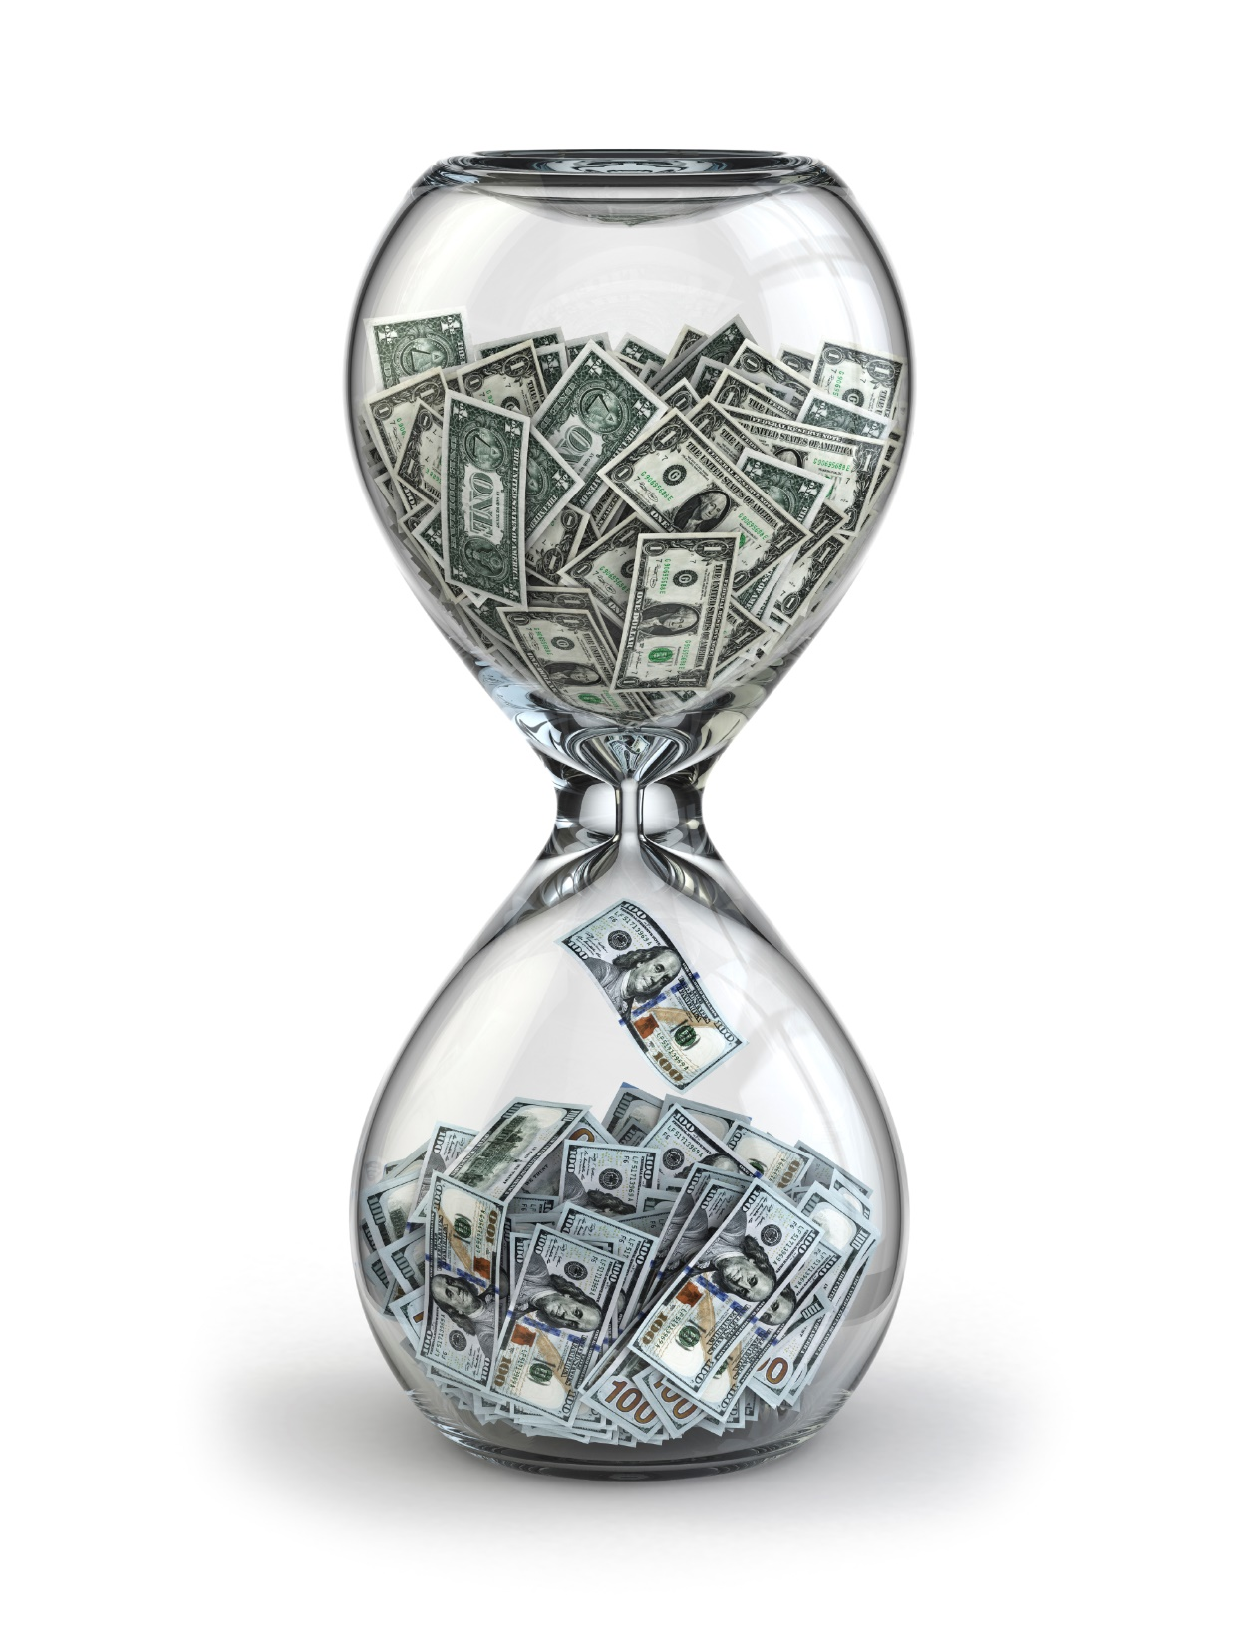
Goal Timeframe

Slide 8

Checkpoint Timeframe

Slide 9

Checkpoint Goal

Slide 10

Tasks

Slide 11

Reward

Slide 12
How Does It Work?
Goal | Create website and online store
Goal Timeframe | 6 months
Checkpoint Timeframe | Checkpoint Goal | Tasks | Reward
2 months | Create web content and secure payment processing method | Identify products to sell online Purchase domain name and web hosting services Create content to describe company Create content to describe products Select web programmer | Team building scavenger hunt
4 months | Launch website | Create individual web pages Photograph models with clothing for sale for website Test website Launch prototype website without online sales | 1-day off-site retreat for staff
6 months | Have online store operational | Analyze website traffic/flow and refine site accordingly Secure distribution channels (shipping options) for online sales Test online sales | Launch party for company and clients at head office

Slide 13

Top Mistakes To Avoid
Making your goals too big
Making your goals subjective
Not breaking a goal down
Forgetting what you were aiming for
Not giving yourself a reward
Thinking that a reward is not important
Not taking time to organize and deliver on the strategy

Slide 14

Now What?
Come up with time
Spend the time once during every checkpoint timeframe
Keep the momentum going
This may be a long haul
Take some time in between to relax

Slide 15

Key Points
Goal
Goal timeframe
Checkpoint timeframe
Tasks
Reward
Example
What not to do
Your next steps
Wrap up

Slide 16

The Goal
Way to track goals over a short period of time.

Slide 17

Short term goals are the best mechanism to push yourself and your business forward.

