Slide 1

Selecting a Target Market
Going after the right target market makes selling easier.

Slide 2

Is your target market everyone?
NO!!
If you believe your product or service is good for everyone, you business is more than likely to fail.

Slide 3

The Goal
Choose a target market that matches you and your business.

Slide 4

Key Points
Target markets
Your strengths
Degree of competition
Reachable
Personal preference
Total
Example
What not to do
Your next steps
Wrap up

Slide 5

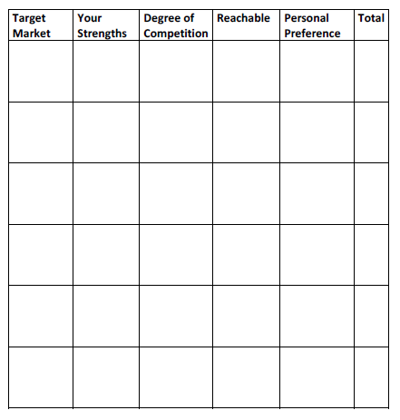
Worksheet
Grab your worksheet and follow along.

Slide 6

Target Markets

Slide 7

Your strengths

Slide 8

Degree of Competition

Slide 9

Reachable

Slide 10

Personal Preference

Slide 11

Total

Slide 12
How Does It Work?
Target Market | Your Strengths | Degree of Competition | Reach | Prefer- ence | Total
Wedding Planners | 3 | 2 | 3 | 3 | 11
Event Halls | 1 | 3 | 2 | 1 | 7
Individuals for their own events | 2 | 1 | 1 | 2 | 6

Slide 13

Top Mistakes To Avoid
Always pursuing every target market.
Thinking that each target market will have the same demands.
Considering no other factor than profitability.
Chasing a target market that can’t purchase your product or service.
Not adjusting your product or service to meet the needs of a target market.

Slide 14

Now What?
Choose a primary target market
Adjust your product or service
Create a message specifically designed for your target market.
Create a plan to reach the target market
Choose a secondary target market, if desired
Evaluate your target market strategies after a few months

Slide 15

Key Points
Target markets
Your strengths
Degree of competition
Reachable
Personal preference
Total
Example
What not to do
Your next steps
Wrap up

Slide 16

The Goal
Choose a target market that matches you and your business.

Slide 17

Choose the target market that offers you the best opportunity, but make sure it fits with what you enjoy most about your business.

