Slide 1

Projecting
Sales
No sales?
No business.

Slide 2

If you aren’t making money, it is called a hobby.

Slide 3

The Goal
Have a realistic sales forecast as a benchmark to guide you in your first year.

Slide 4

Key Points
Top Down
Bottom Up
Example
What not to do
Your next steps
Wrap up

Slide 5

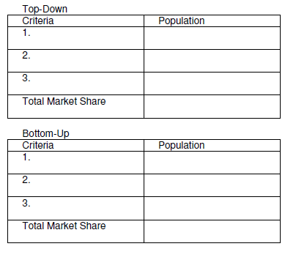
Worksheet
Grab your worksheet and follow along.

Slide 6

Supply Vs. Demand

Slide 7

Top Down
How many other businesses just like yours are out there?
How many products do they offer?
How many products do they sell annually?
How many of these businesses are in the same region or targeting the same audience?
What is your projected market share?

Slide 8

Bottom Up
How big is your target audience?
What is the adoption rate within this target audience?
Is there a niche that you are focused on to secure additional market share rather than just the standard population?

Slide 9

Do They Overlap?

Slide 10
How Does It Work? Top Down
Criteria | Population
1. Other Pizzerias in town and their pizza sales per week | 3 pizzerias x 100 pizzas = 300 pizzas sold
2. Grocery store pizza sales per week | 2 grocery stores x 125 pizzas = 250 pizzas sold
Total Market | 450 pizzas sold per week

Slide 11
How Does It Work? Bottom Up
Criteria | Population
1. No. of pizzas consumed per family of 4 per week | 2 pizzas per week
2. No. of families in town | 225 families
Total Market | 2 x 225 = 450 pizzas consumed per week

Slide 12

Top Mistakes To Avoid
Being a dreamer.
Arguing with the numbers.
Arguing with your investors.
Forgetting to check how many sales your organization is actually capable of delivering to.
Making outrageous assumptions.
Not double checking critical numbers.
Intention to buy is not buying.
Assuming that other people will work as fast.
Only hanging around people who agree with you.

Slide 13

Now What?
Re-evaluated annually.
Use these numbers to create a vision.
Assess the cash flow.
Monitor these results.

Slide 14

Key Points
Top Down
Bottom Up
Example
What not to do
Your next steps
Wrap up

Slide 15

The Goal
Have a realistic sales forecast as a benchmark to guide you in your first year.

Slide 16

Accept that your realistic projected sales are going to be significantly less than your planned sales.

