Slide 1
Networking for a Difference
It isn’t the quantity of events…

Slide 2
It’s The Quality!

Slide 3
The Goal
Get business and amazing contacts from your networking.

Slide 4
Key Points
Type of Contact
Networking Event
Number of Contacts
Cost & Cost Per Contact
Time & Time Per Contact
General Comments
Example
What not to do
Your next steps
Wrap up

Slide 5
Worksheet
Grab your worksheet and follow along.

Slide 6
Type of Contacts

Slide 7
Networking Event

Slide 8
Number of Contacts

Slide 9
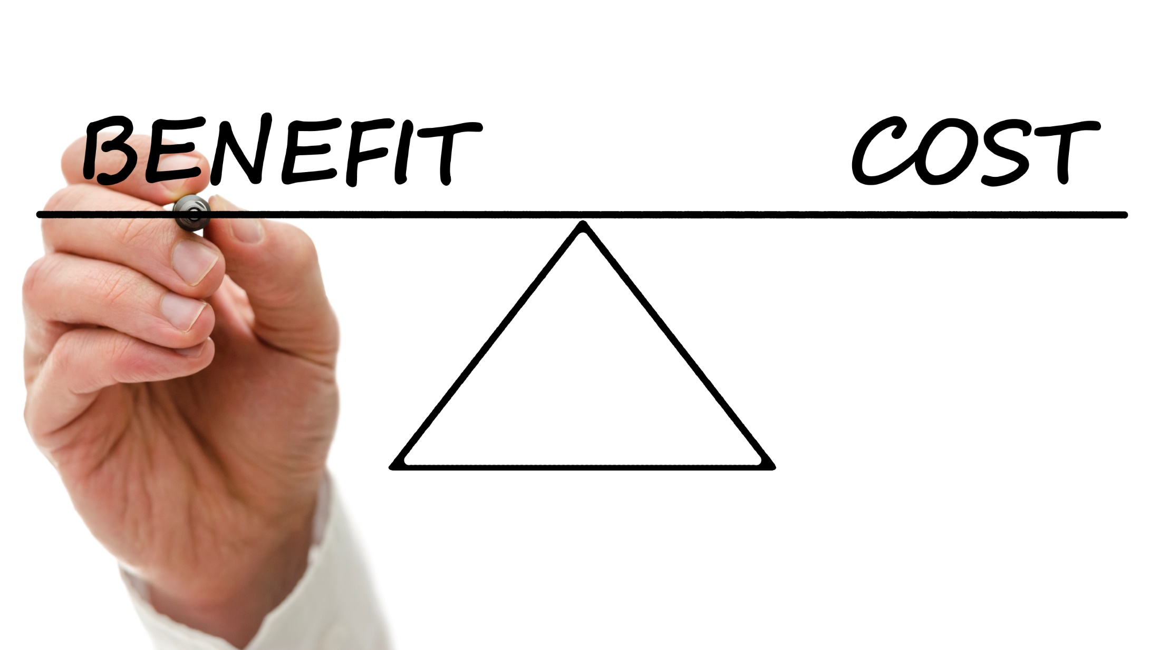
Cost Per Contact

Slide 10
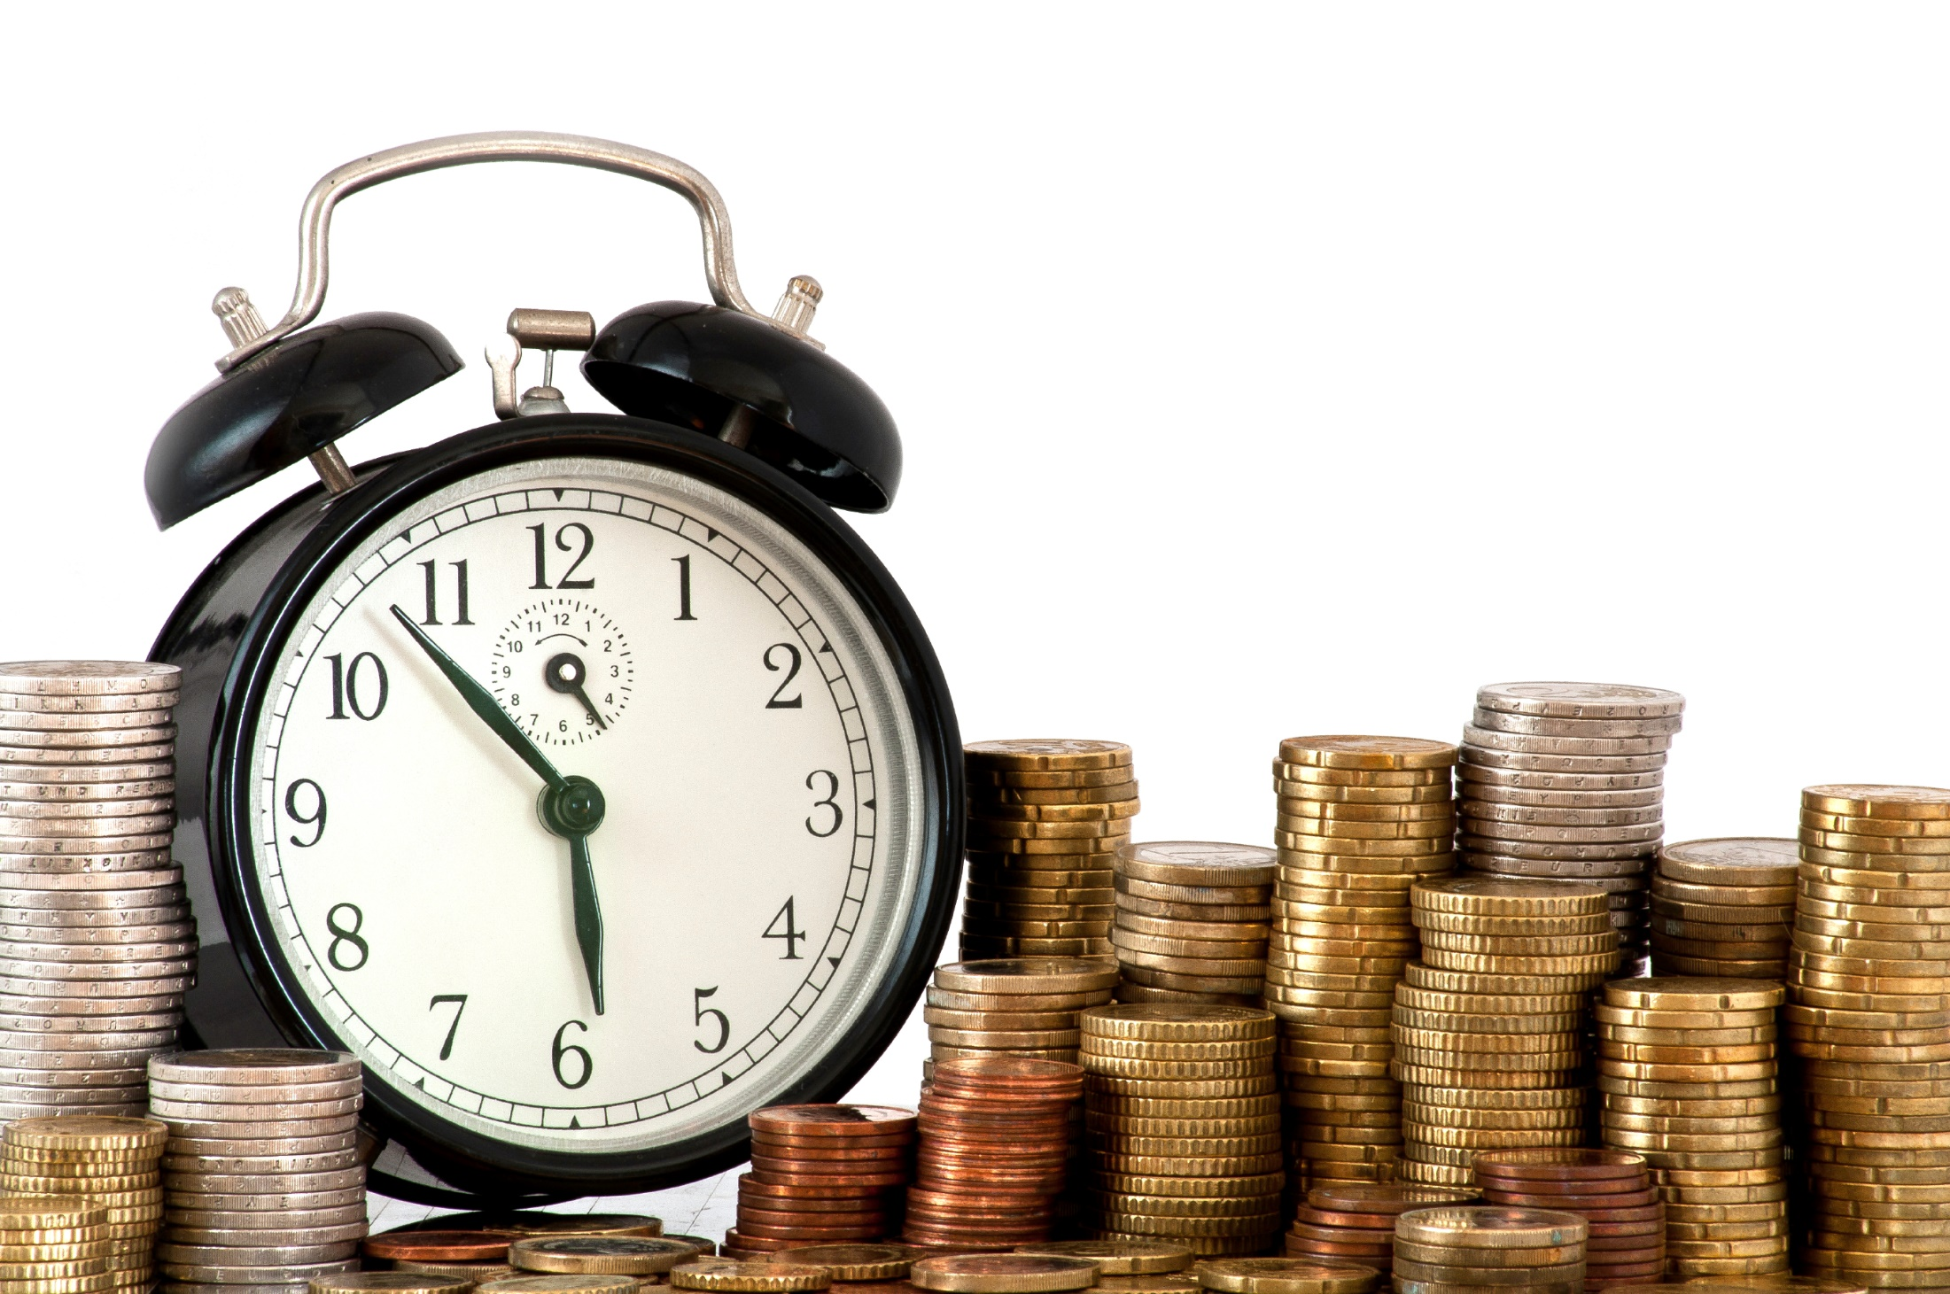
Time Per Contact

Slide 11
General Comments

Slide 12
How Does It Work?
Sam is the owner of a software developing company that makes games and applications for cell phones. Sam has been networking to expand his business relationships and to increase the visibility of his company in the business community. Last year Sam attended 3 networking events. As he plans the budget for the upcoming year, he is interested in determining strategic benefits of the events he attended last year.

Slide 13
How Does It work?
Type of Contact | Networking Event | Number of Contacts | Cost ($) | Cost per Contact | Time | Time per Contact | General Comments
Customers | National Electronics Association, Annual Conference | 10 | $250 | $25 | 10 hours | 1 hour | High quality contacts
Customers | Tech Professionals Group meeting | 5 | $250 | $50 | 5 hours | 1 hour | Enjoyable event but limited exposure to new contacts
Customers | Local electronics exposition | 15 | $1,125 | $75 | 7.5 hours | 30 minutes | Moderately enjoyable

Slide 14
Top Mistakes To Avoid
Continuing to attend a networking event that has proven to be a waste of time and/or money.
Falling in love with a networking event.
Thinking you no longer need to evaluate your networking cost and benefit over time.
Being overly pushy at a networking event.
Thinking about what you can get from others. Give first.
Being overly professional.
Being overly conservative.
Waiting too long to follow up.
Talking about yourself.

Slide 15
Now What?
How many new contacts are you hoping to find ?
How many networking events do you have to attend ?
Attend the highest benefit producing events.
Keep an ongoing record.
Continue to probe for networking events.
Evaluate your networking events regularly.

Slide 16
Key Points
Type of Contact
Networking Event
Number of Contacts
Cost & Cost Per Contact
Time & Time Per Contact
General Comments
Example
What not to do
Your next steps
Wrap up

Slide 17
The Goal
Get business and amazing contacts from your networking.

Slide 18
You should strategically select the networking events you are attending to optimize the time and money that you are spending on them.

