Slide 1
The Mighty Marketing Plan
Less Is More!

Slide 2
Marketing & Success Go Hand In Hand

Slide 3
The Goal
A 3 month marketing plan to launch a business.

Slide 4
Key Points
When? Timeframe
What? Sales Goals
Who? Target Audience
How? Message
Where? Tools
Example
What not to do
Your next steps
Wrap up

Slide 5
Worksheet
Grab your worksheet and follow along.

Slide 6
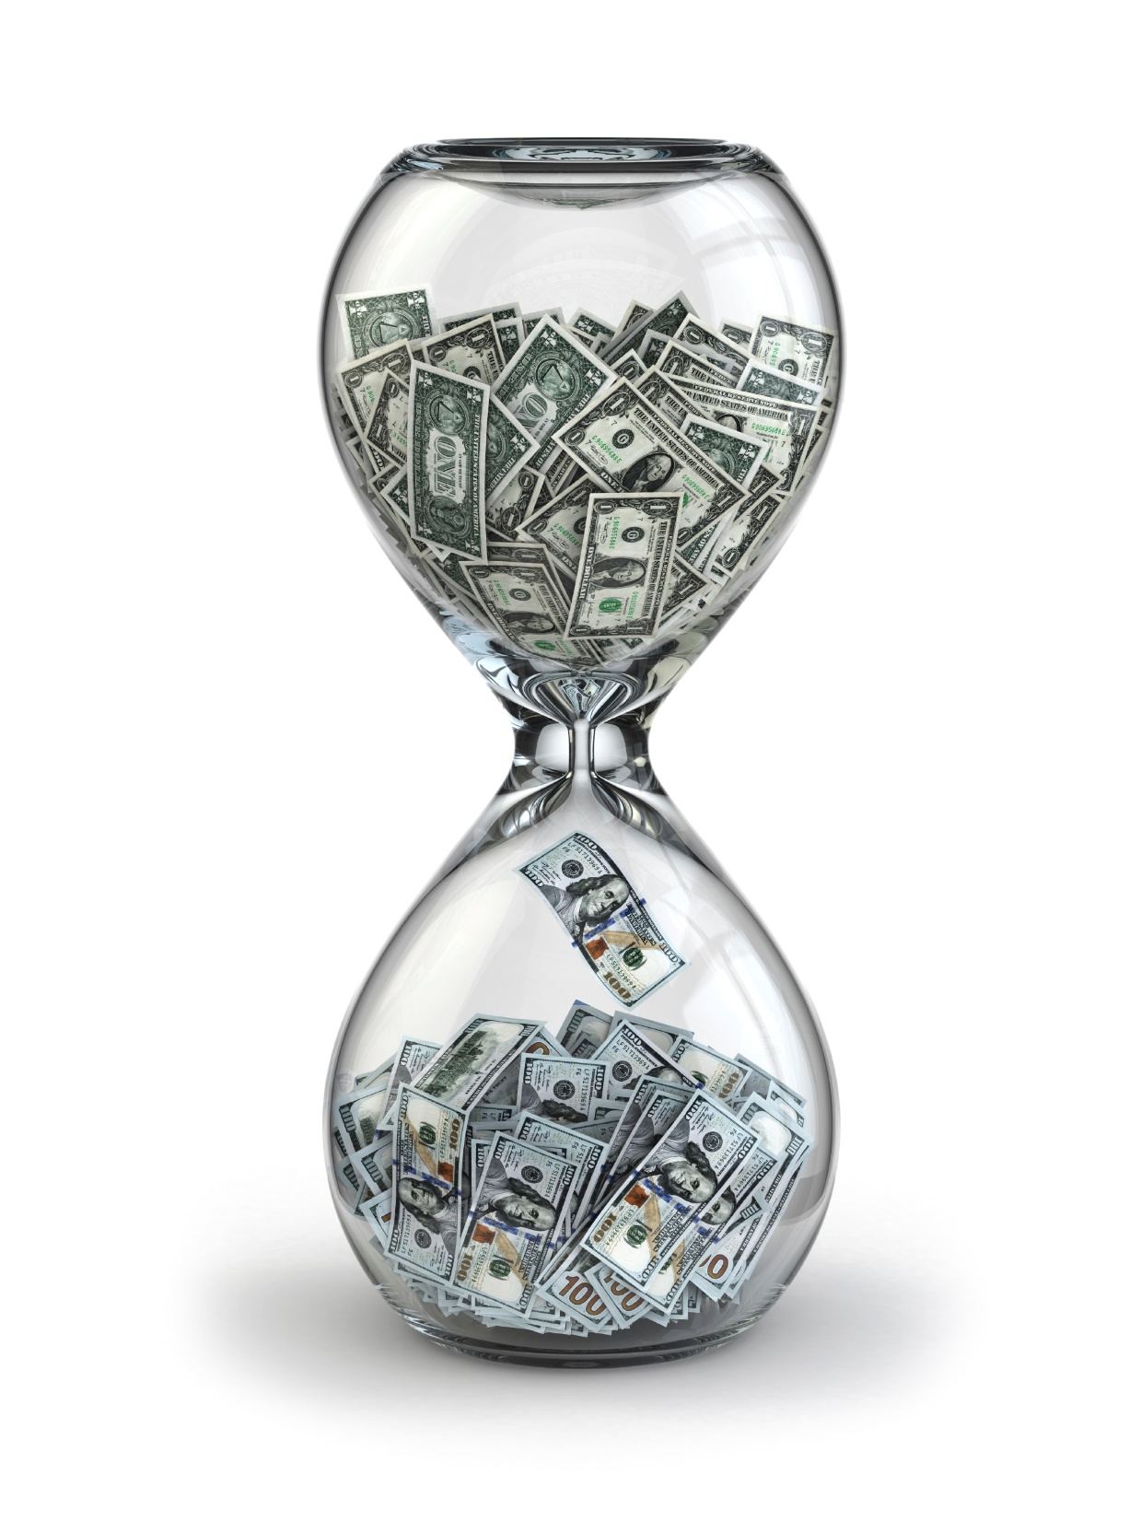
When? Timeframe

Slide 7
What? Sales Goals

Slide 8
Who? Target Audience

Slide 9
How? Message

Slide 10
Where? Tools

Slide 11
How Does It Work?
When? Timeframe | 6 months
What? Sales goals | Increase of 20% (40 units/month) in lipsticks, and an increase of 10% (10 units/month) in foundation and eye shadows and (5 units/month) in blushes and bronzers.
Who? Target audience | Ethnic women aged 25-45 who value environmentally friendly and 100% natural make-up products

Slide 12
How Does It Work?
How? Message: Benefits Of The Product/Service Why you? 3. Personality | 1.) Make-up specifically formulated for women of colour who want only 100% natural ingredients and want the full range of colour and choices as offered by all the other non-natural brands 2.) I love make-up but refuse to use any make-up that is made of chemicals and derivatives of petroleum. But there is such little choice with natural cosmetics lines, and even less for ethnic skin tones. 3.) If you can’t find what you want, create it. Empowering women to be as beautiful outside as they are inside. Re-create yourself.

Slide 13
How Does It Work?
Where? Tools: | 1.)Blogs and search engine advertising 2.)Print (ethnic beauty magazines) 3.)Attend ethnic conventions and offer free make- overs, i.e ethnic wedding shows, cultural conferences

Slide 14
Top Mistakes To Avoid
Stopping.
Overcomplicating.
Going with the creative idea that does not make sense
Thinking that branding is too difficult
Thinking that you can’t start your business until everything in your marketing campaign is up and running.
Doing marketing initiatives that your target audience doesn’t see.
Having too many things that you are working on
Inconsistency.
Doing too much.
Forgetting to brand your own image.

Slide 15
Now What?
Break the marketing tools up into manageable pieces
Then do it, step by step
Don’t lose momentum
Know that customers take anywhere from three to 20 communication points
Reflect at the end of the marketing timeframe

Slide 16
Key Points
When? Timeframe
What? Sales Goals
Who? Target Audience
How? Message
Where? Tools
Example
What not to do
Your next steps
Wrap up

Slide 17
The Goal
A 3 month marketing plan to launch a business.

Slide 18
Only spend time & money on marketing ideas that reach your target audience.

