Slide 1

Is There A Need?
If a customer doesn’t need it, they aren’t going to buy it.

Slide 2

What Is The Difference Between An Inventor & An Entrepreneur?

Slide 3

Market Focus!

Slide 4

The Goal
Go from just thinking you have a great idea to knowing you have one that will work.

Slide 5

Key Points
Needs assessment
Customer caring factor
Need meeting factor
Is it compelling?
Example
What not to do
Your next steps
Wrap up

Slide 6

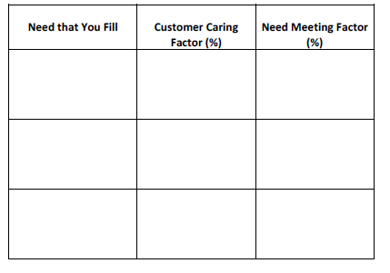
Worksheet
Grab your worksheet and follow along.

Slide 7

Needs Assessment

Slide 8
Customer Caring Factor
If your customer doesn’t care, it is lower ranked.
Pain points are more important to customers

Slide 9

Need Meeting Factor
You should be meeting your customer requirements 100%

Slide 10

Is It Compelling?

Slide 11
How Does It Work?
Need that You Fill | Customer Caring Factor (%) | Need Meeting Factor (%)
Thirst (Negative Motivator) | 50% | 100%
Need for Vitamins (Positive Motivator) | 100% | 100%
Need to be Healthy (Negative Motivator) | 80% | 80%
Taste (Positive Motivator) | 70% | 50%

Slide 12

Top Mistakes To Avoid
Starting with the feature of a product and making up needs.
Thinking that a feature of a product is a need.
Not boiling a need down to a positive or negative motivation factor.
Going after needs that aren’t important to customers.
Only fixing part of the customer’s need.

Slide 13

Now What?
If you have a need move forward with the product.
If you don’t have a need reconsider your business.
If you have a need that people don’t care for you should re-evaluate your strategy.
If your product or service doesn’t fully meet a need you should adapt it.

Slide 14

Key Points
Needs assessment
Customer caring factor
Need meeting factor
Is it compelling?
Example
What not to do
Your next steps
Wrap up

Slide 15

The Goal
Go from just thinking you have a great idea to knowing you have one that will work.

Slide 16

When thinking about a new business idea, start with the need first so you don’t pursue an idea that may not succeed.

