Slide 1

Getting the most out of a Mentor
If you have found a willing mentor, you have won half the battle.

Slide 2
The other half is learning how to make the most out of your relationship.

Slide 3

The Goal
Increase the success of your business by 80% by working well with your mentor.

Slide 4

Key Points
Learning
Ongoing Advice
Contacts
Motivation
Other
Example
What not to do
Your next steps
Wrap up

Slide 5

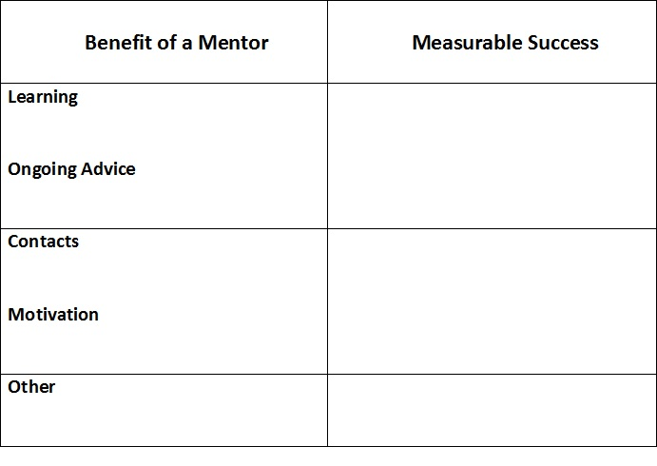
Worksheet
Grab your worksheet and follow along.

Slide 6

Learning

Slide 7

Ongoing Advice

Slide 8

Contacts

Slide 9

Motivation

Slide 10

Other

Slide 11
How Does It Work?
Julia has been operating her bakery business for 1 year and has found Dale Roberts as a mentor to help with marketing. Julia has been meeting with Mr. Roberts for the past 4 months and wants to evaluate her progress to date.

Slide 12
How Does It work?
Benefit of a Mentor | Measurable Success
Learning | Julia has learned how marketing is done in her industry, and the best channels to use to get her message to customers.
Ongoing Advice | Julia meets for Dale for a working lunch every other month and emails him on a weekly basis to keep him up to date on her business.
Contacts | Dale has introduced Julia to 2 new suppliers during the past 4 months.
Motivation | Dale uses mainly positive motivation to encourage Julia by helping her to envision her success if she follows his advice.

Slide 13

Top Mistakes To Avoid
Staying with a mentor longer than needed.
Not having a plan when starting with a mentor.
Refusing to have more than one mentor at a time. You will miss out on some of the benefits another mentor may offer.
Being scared to ask for help and advice.
Having no positive return for your mentor. It could be as simple as saying “thank you” or buying them a coffee.
Not being honest with your mentor about what you are looking for.

Slide 14

Now What?
Sit down face to face with your mentor and come up with an understanding of what your relationship goals are.
Agree upon the framework and how you will reach those goals.
Agree upon a time in which to reassess the relationship.
Start the relationship with an understanding of when and how this may no longer be beneficial to both of your.
Be grateful and show your appreciation. Your mentor is basically volunteering their time to help you.
Give back to someone else in the future.

Slide 15

Key Points
Learning
Ongoing Advice
Contacts
Motivation
Other
Example
What not to do
Your next steps
Wrap up

Slide 16

The Goal
Increase the success of your business by 80% by working well with your mentor.

Slide 17

Every mentor should be helping you meet an objective.

